Slide 1
SRF Cavity and Cryomodule Conceptual Design for eRHIC
Douglas Holmes
February 7, 2019

Slide 2
Outline
eRHIC general layout and Electron Storage Ring (eSR) cryomodule location
Pre-Conceptual cavity mechanical design/analysis
Pre-Conceptual Cryomodule Configuration
Power Couplers R&D
Beamline HOM Absorbers R&D

Slide 3
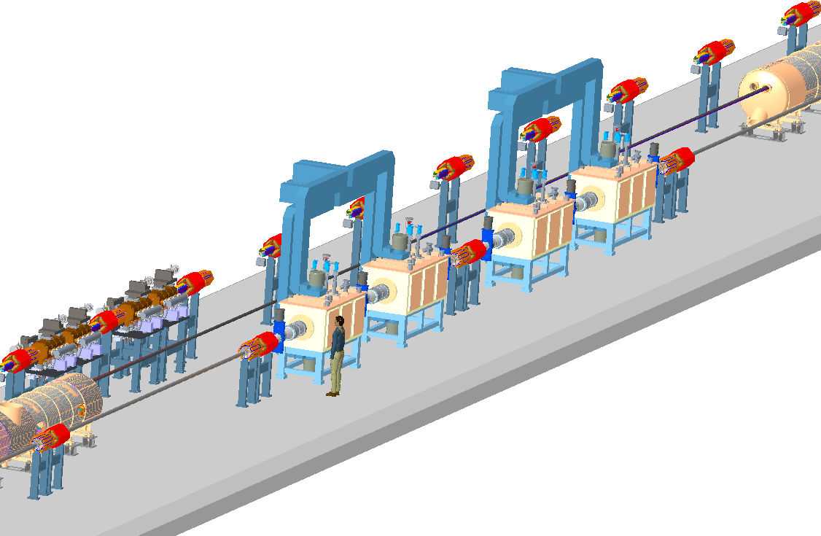
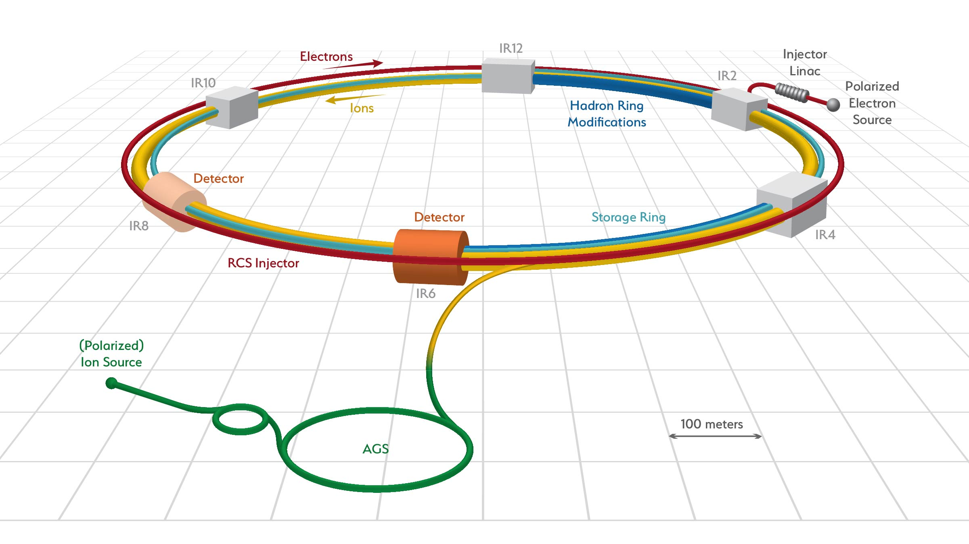
eRHIC Layout
eRHIC is BNL’s proposed Electron-Ion Collider
Utilizes the existing ion accelerator systems of RHIC
Add Electron Rapid Cycling Synchrotron (RCS) Injector and Electron Storage Ring (eSR)
eSR SRF Systems are located at IR10

Slide 4
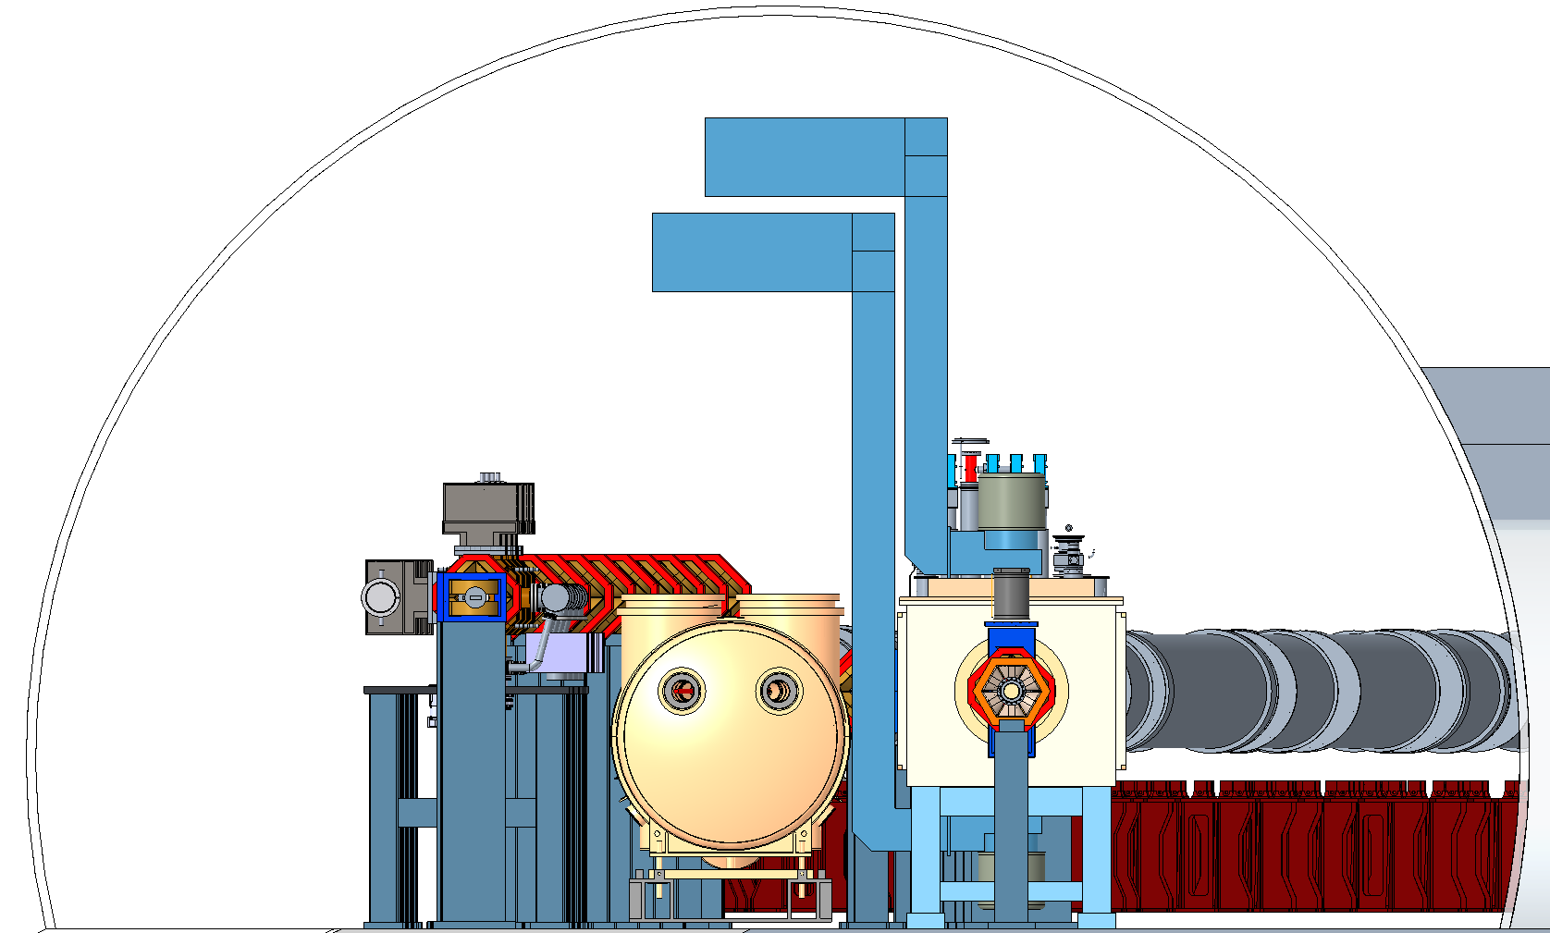
eRHIC IR10
1.4 m
1.5 m
RCS Ring
Existing
Hadron Ring
eSR Cryomodules
0.5 m
1.27 m

Slide 5
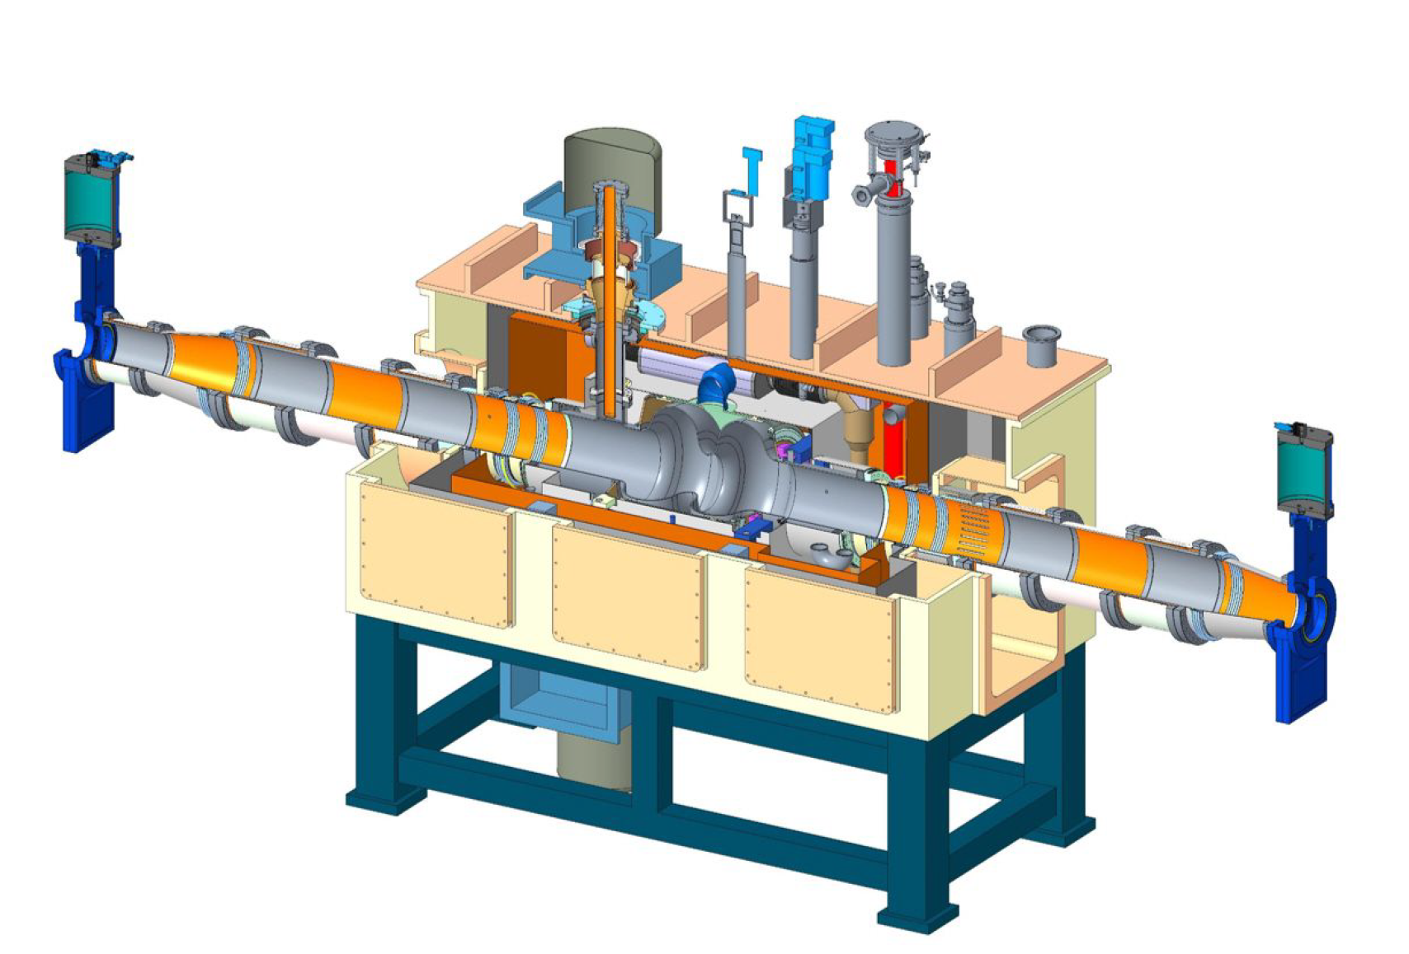
eSR Cryomodule
Single 2-cell 563 MHz SRF cavity per cryomodule
V = 8 MV/cavity
2x 500 kW adjustable Fundamental Power Couplers (FPCs).
4x SiC Beamline HOM Absorbers (BLAs)
4 cryomodules in total (upgradeable to 12 for full luminosity and energy reach)
2K operating temperature
Top loading design
563 MHz Cavity Cryomodule

Slide 6
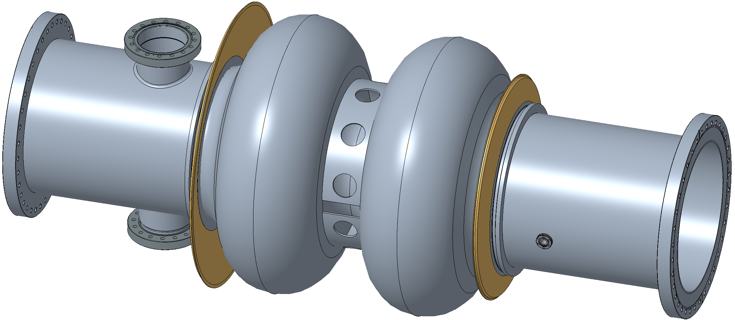
Cavity Concept Design
Cavity wall thickness: 4mm
Helium Vessel Interface
Stainless Steel Flanges
w/ Knife Edge Seals
Tuner Interface Ring
FPC Ports
Iris Stiffener
270 mm ID
RF Pickup Port
1.24 m

Slide 7
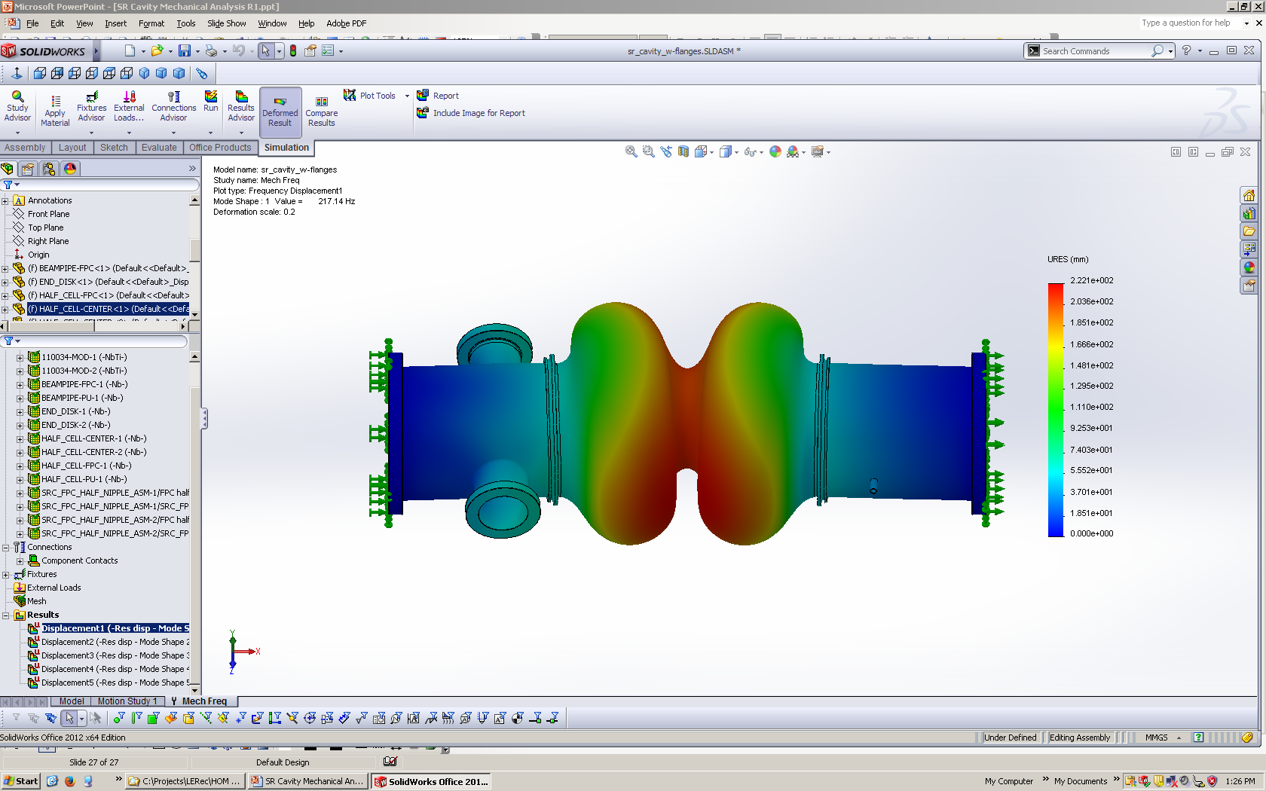
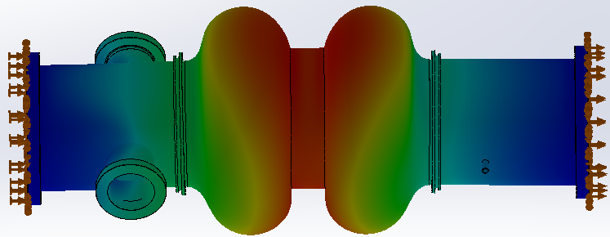
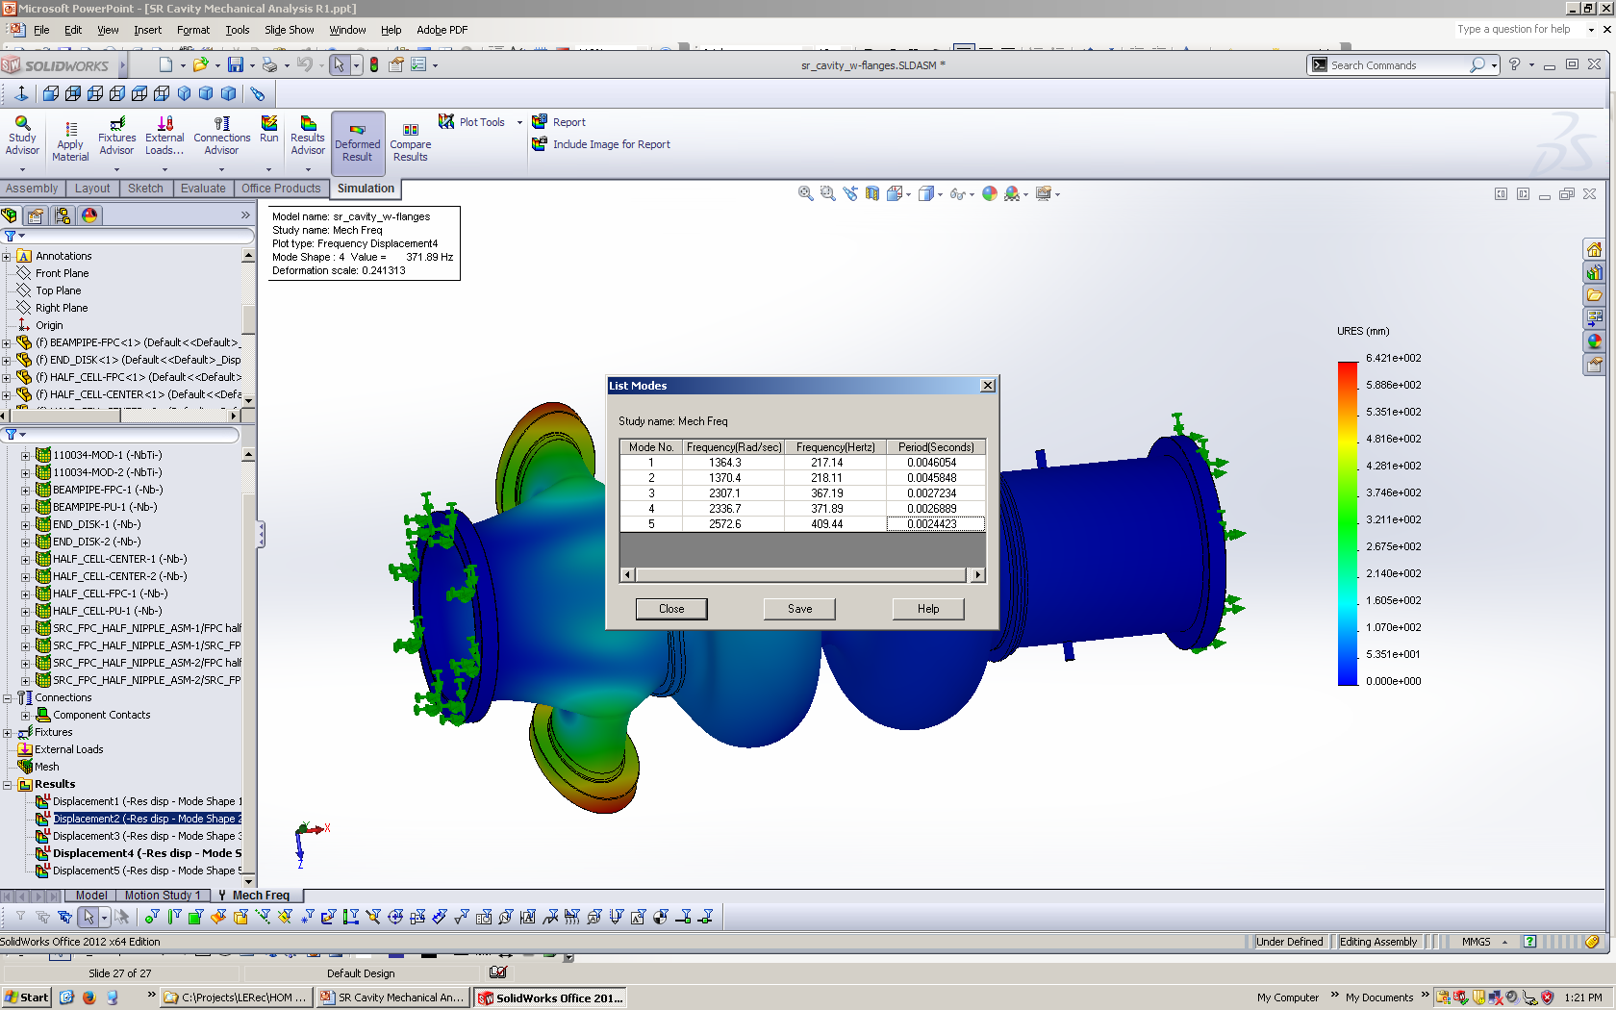
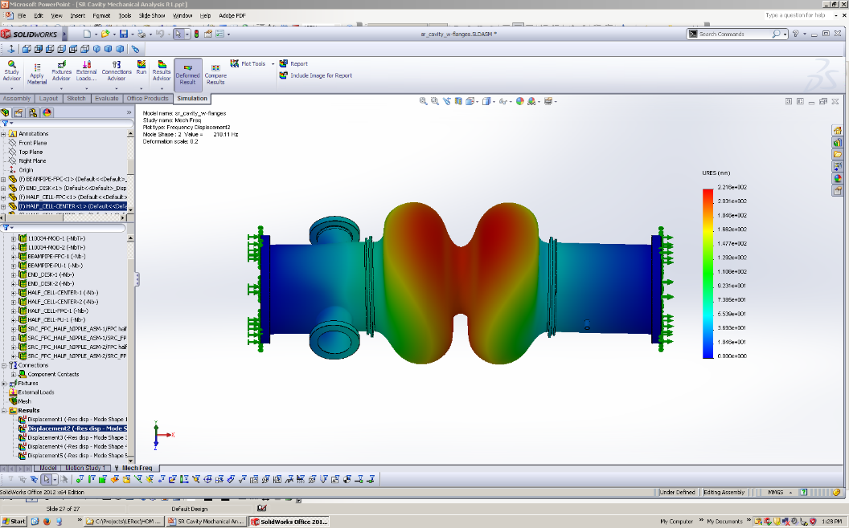
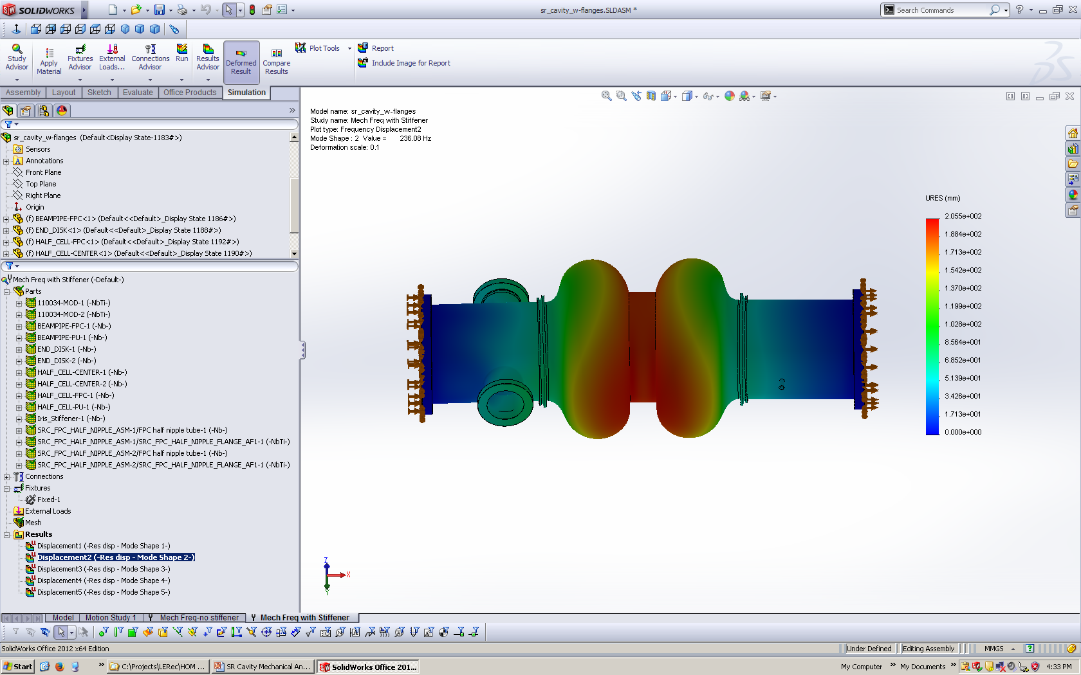
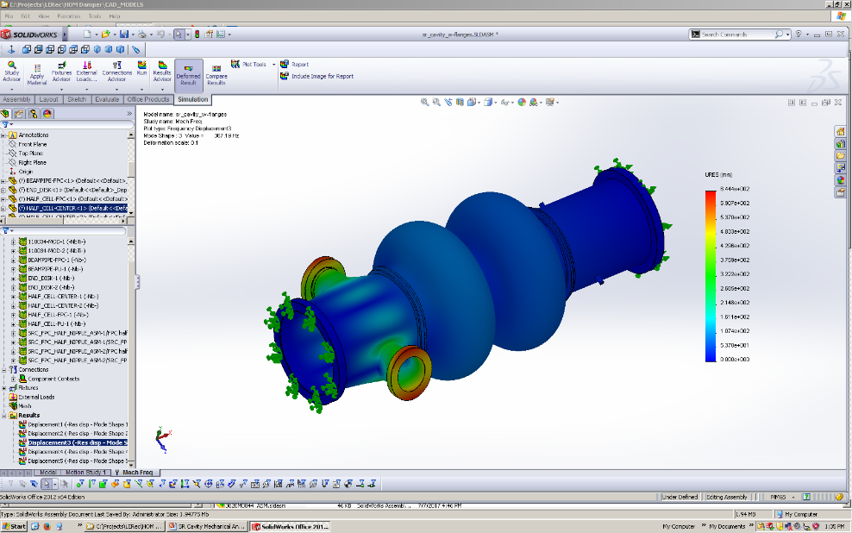
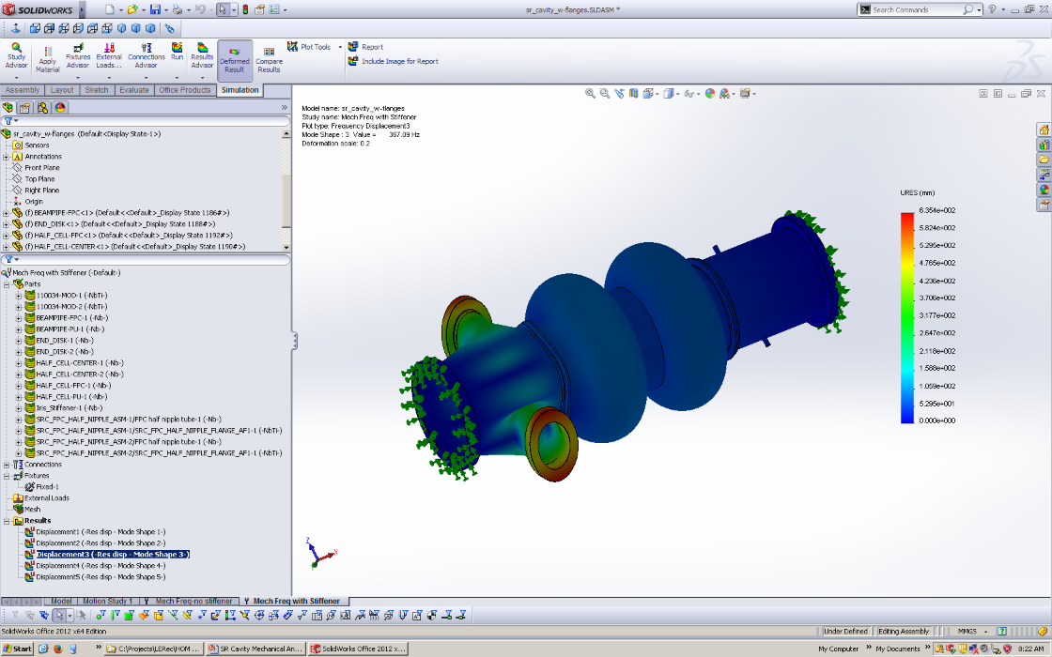
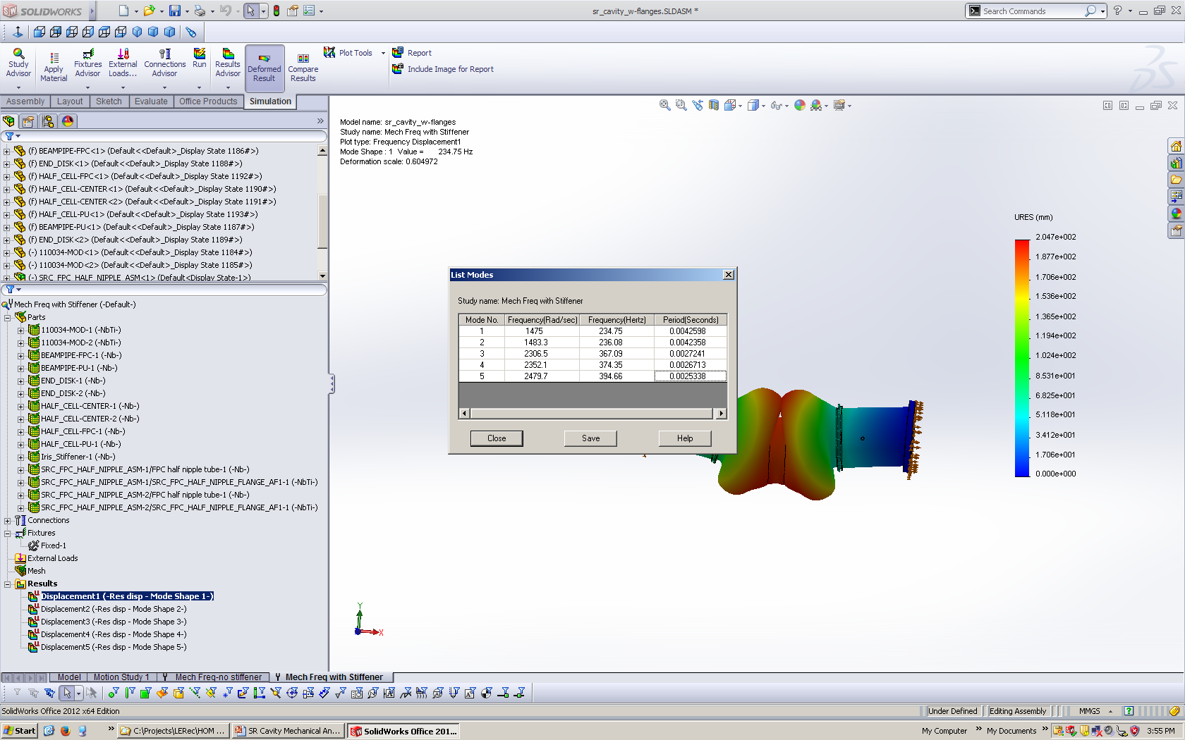
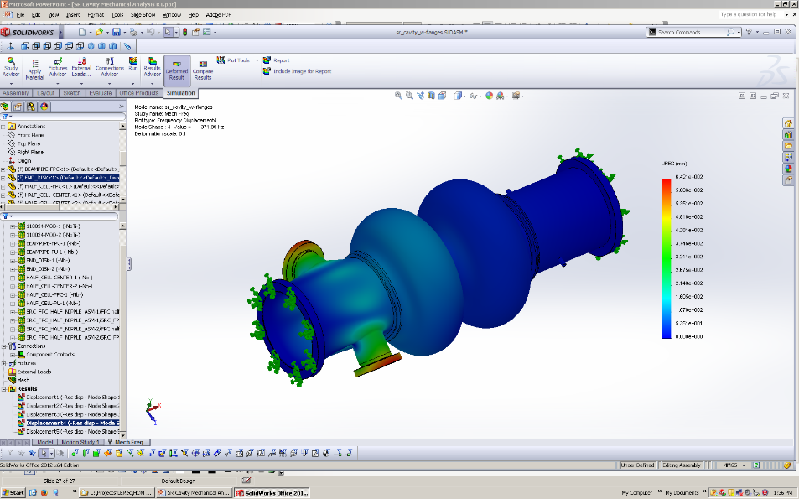
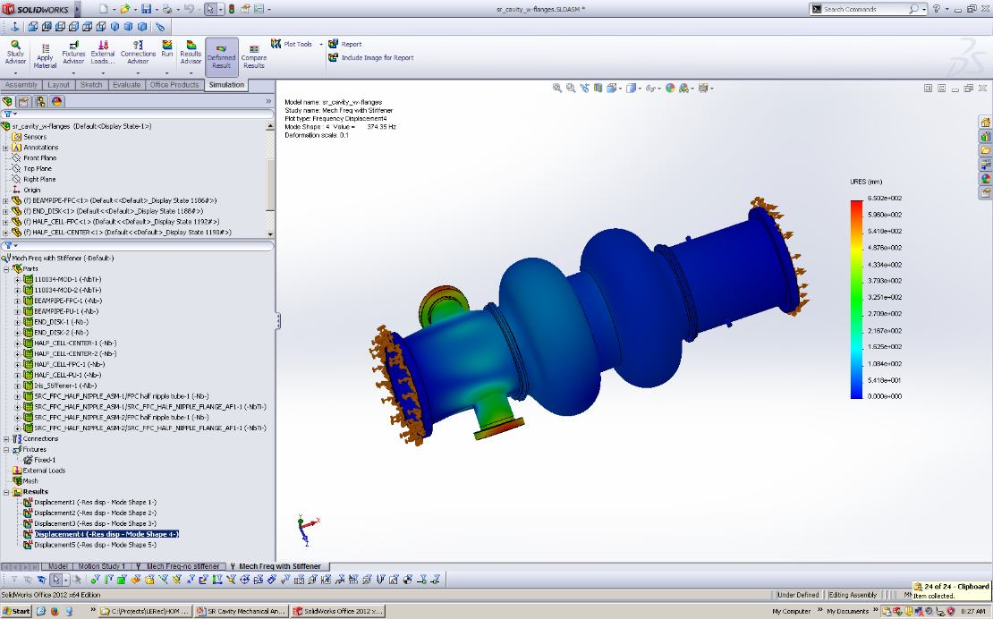
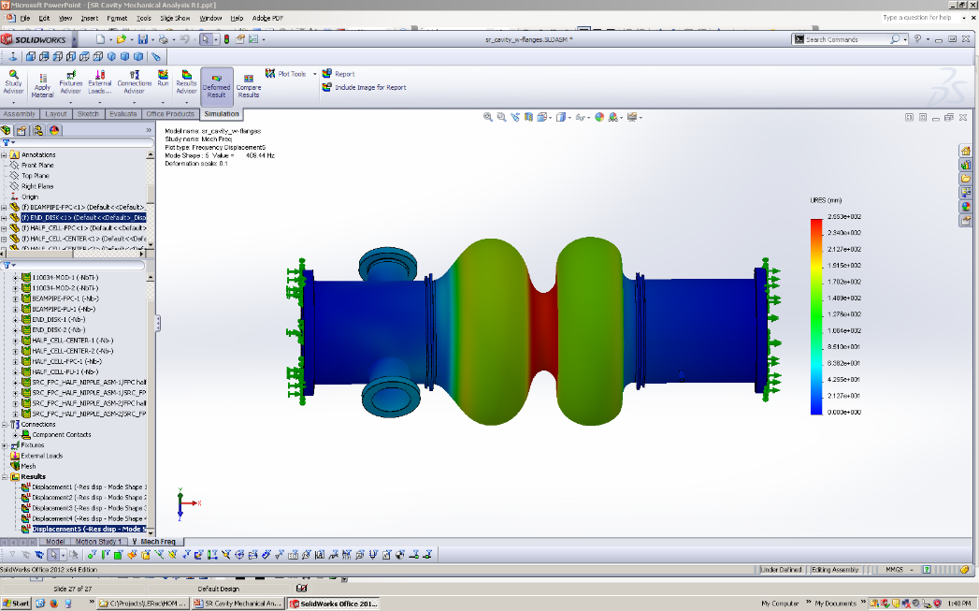
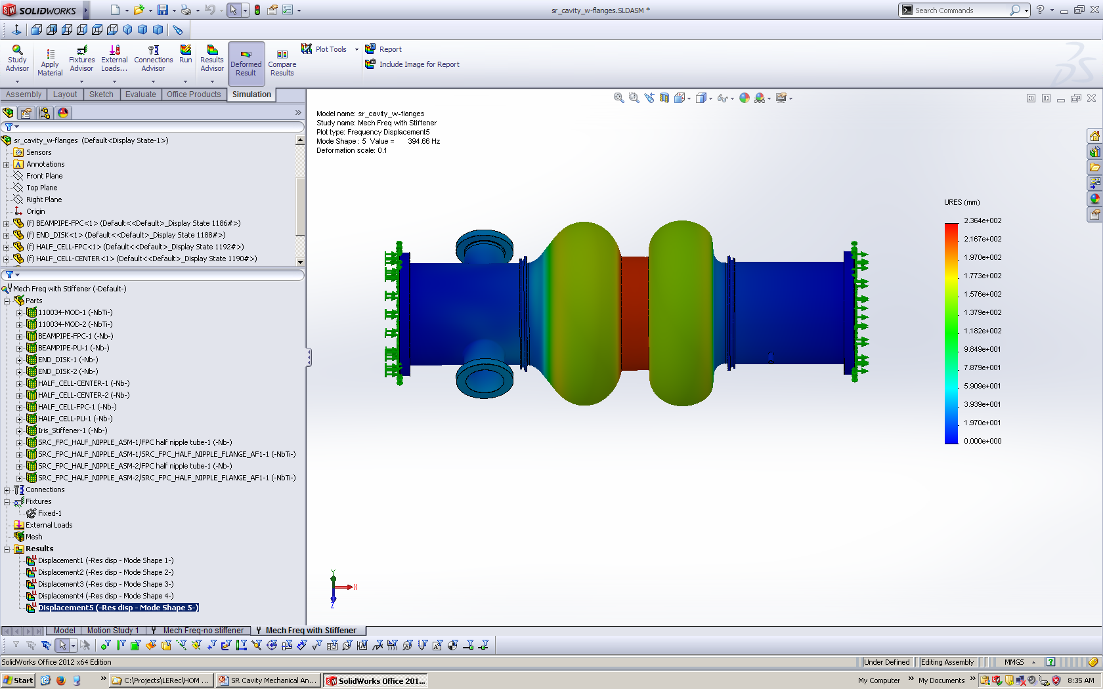
Mechanical Resonance Modes
No Iris Stiffener
With Iris Stiffener
No Iris Stiffener
Mode 1
Mode 2
With Iris Stiffener
Mode 3
Mode 4
Mode 5

Slide 8
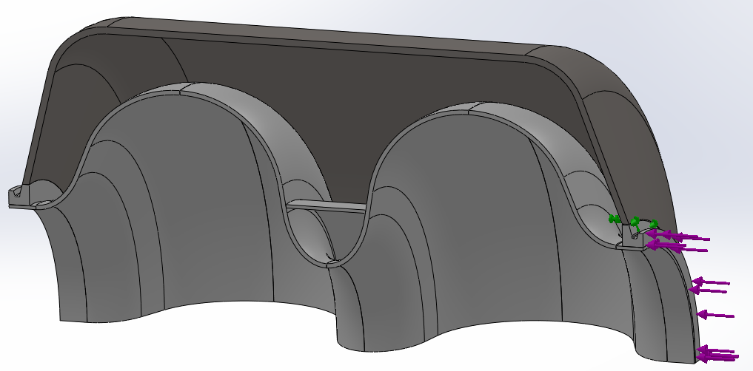
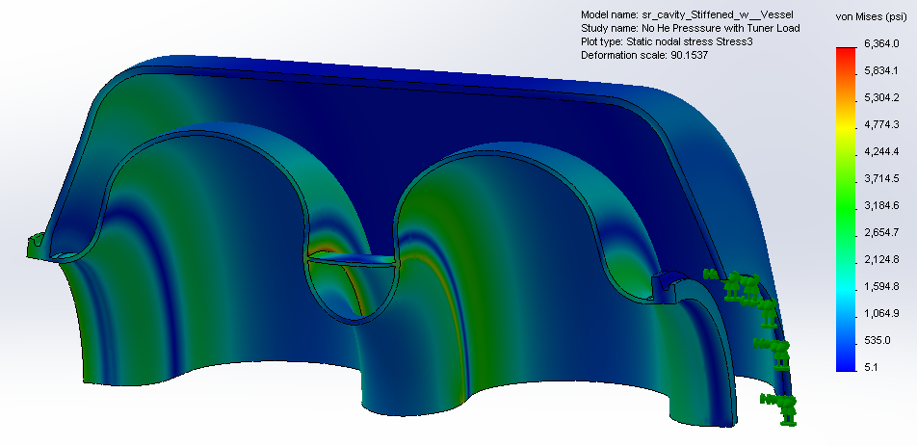
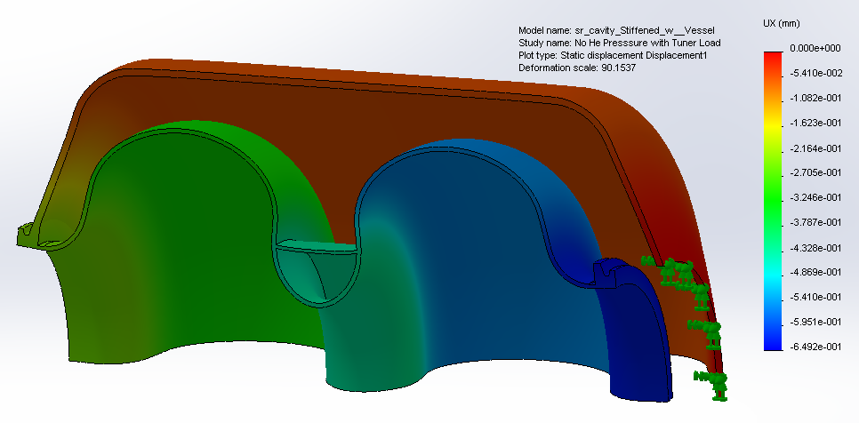
Cavity Tuning
Load Conditions:
He Vessel Edge Fixed
Max Cavity Stress 43.9 MPa (6,360 psi)
910 kg Tuner load
Max Cavity Deflection 0.41mm
Spring rate:
  2,270 kg/mm iris stiffened
  1,500 kg/mm unstiffened
Tuning Coef. est.:
  300 kHz/mm iris stiffened
  190 kHz/mm unstiffened
For 100 kHz Tuning (stiffened cavity):
  Stroke= 0.33mm
  Force=730 kg
  Induced Stress= 35 MPa (5,100 psi )
Total Cavity Compression = -0.41 mm
Total He Vessel Extension = +0.24 mm

Slide 9
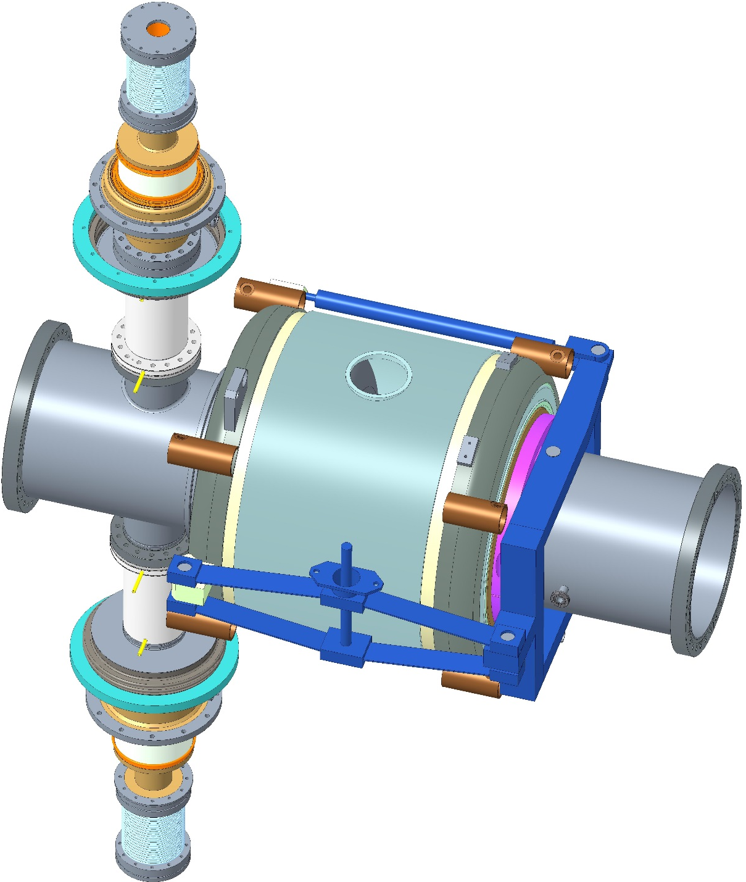
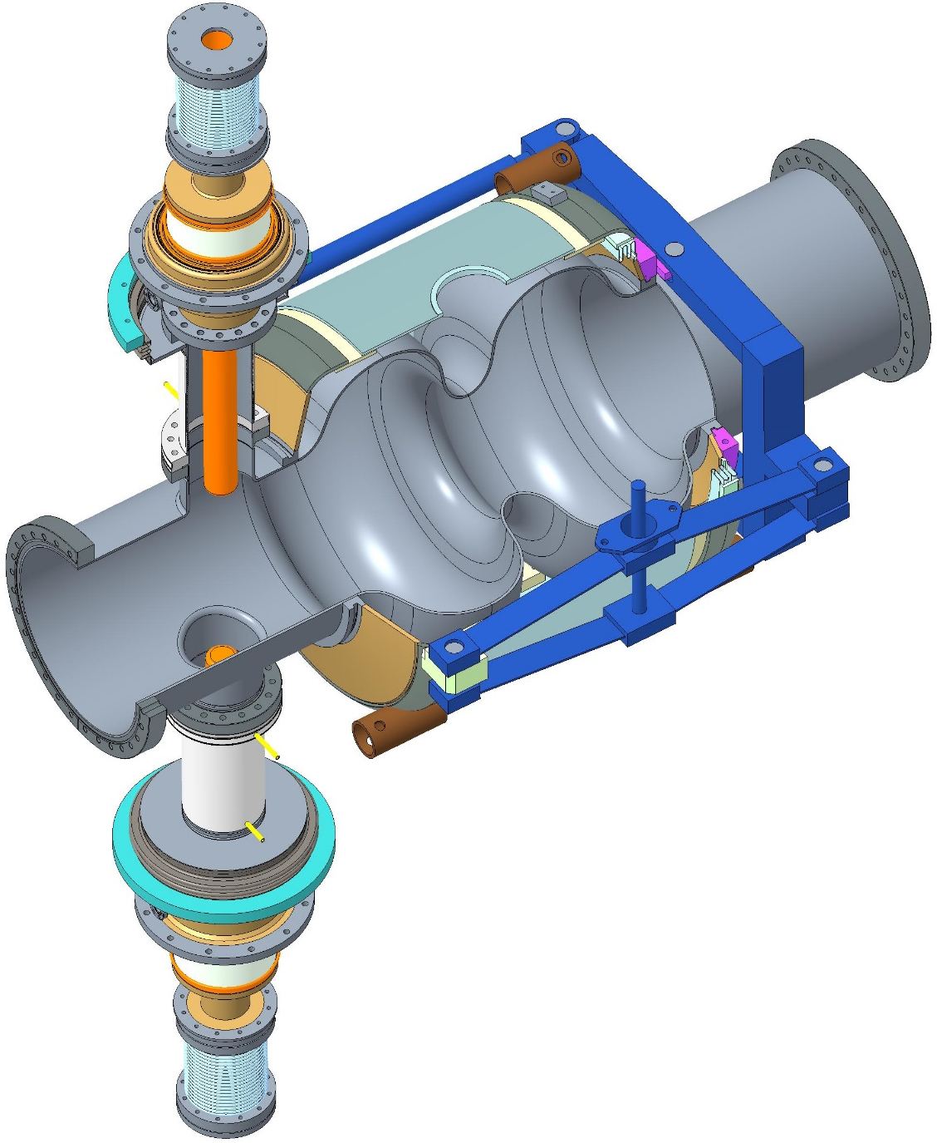
Helium Vessel, Tuner, FPC Concept
Tuner Bellows
Tuner Struts
Cavity
FPCs
Tuner
Actuation
Helium Vessel
Helium Vessel Hangers
Cutaway view
Tuner Frame
Tuner Flexure

Slide 10
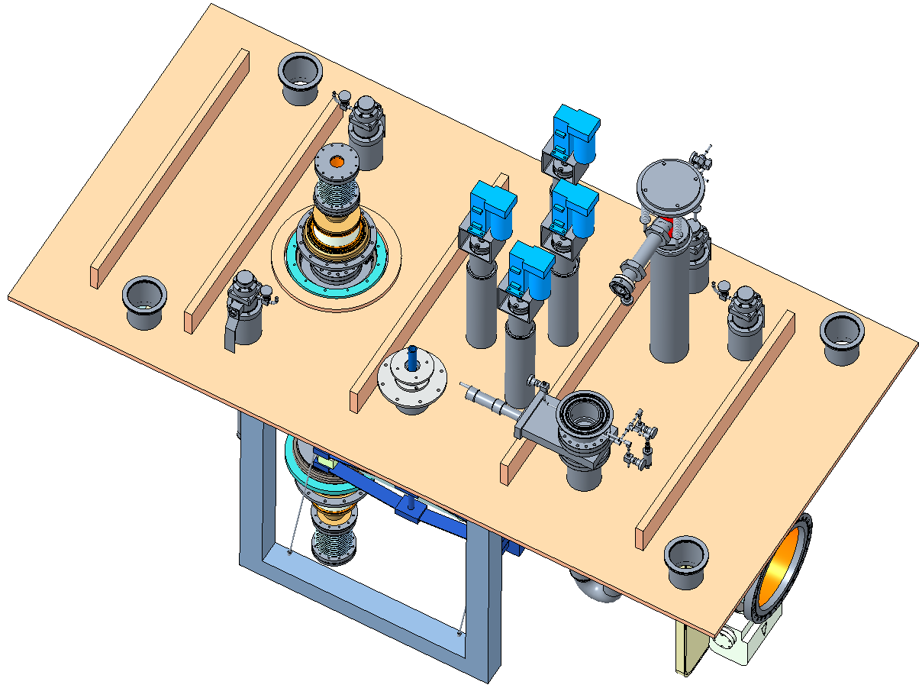
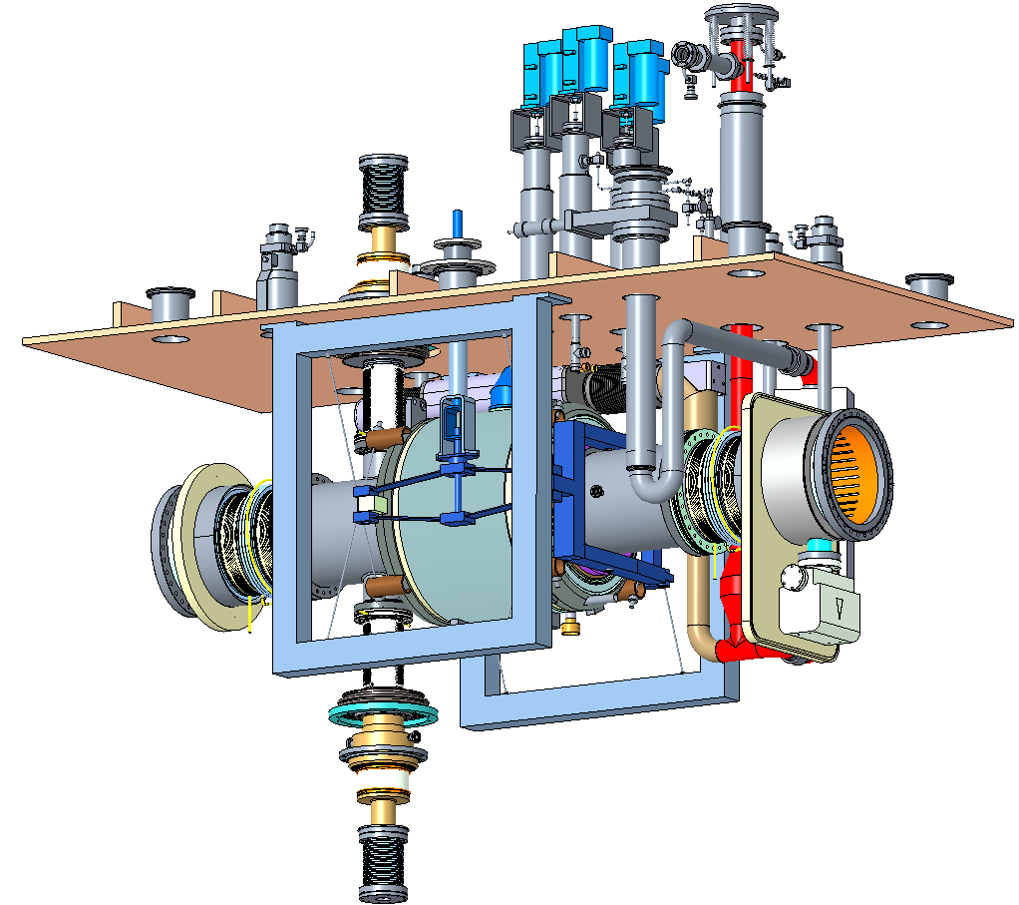
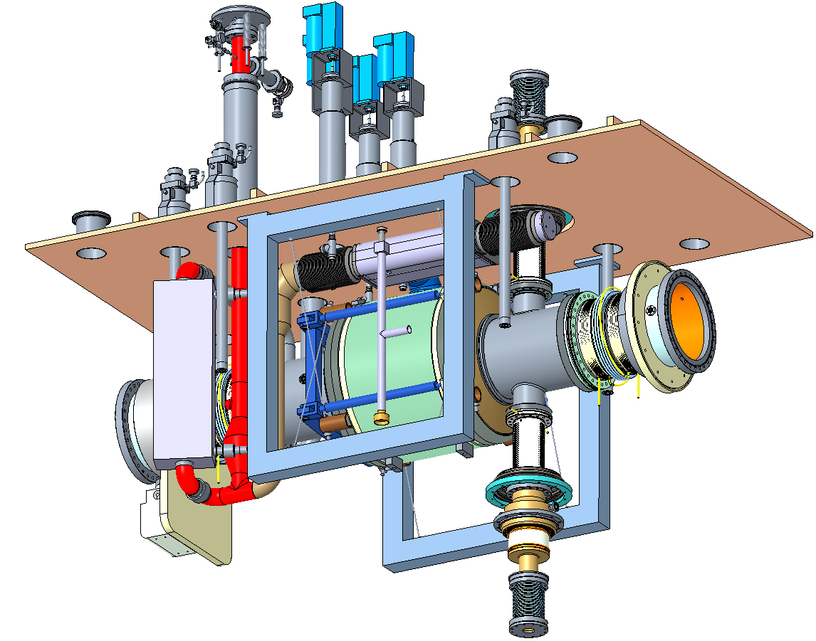
Cavity String and Top Plate Assembly
Instrument Feedthroughs
Cryo Valves
FPC
Pressure Safety Release
Supply/Return Helium Bayonets
Tuner Motor Interface
2-phase Helium Header
Cavity Tuner
2K Helium Vapor Return
2K/4.5K Heat Exchanger
Beam pipe Thermal Transition
String Support
Helium Liquid Level Tube
FPC Window

Slide 11
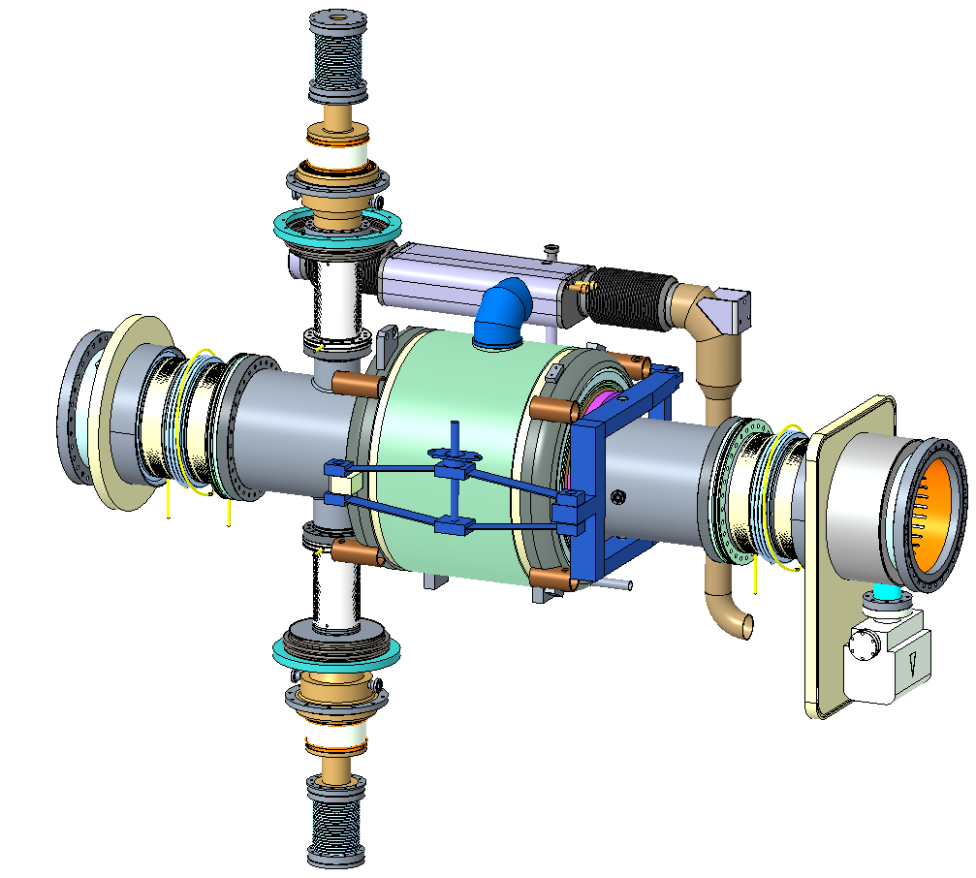
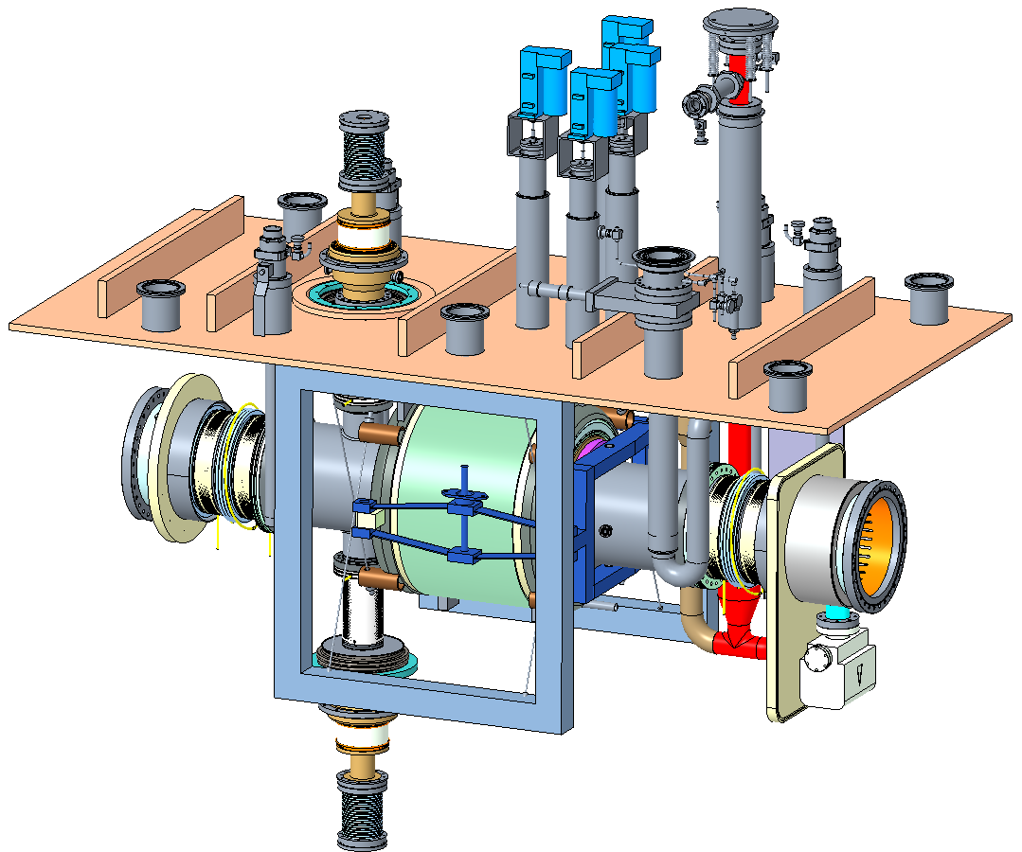
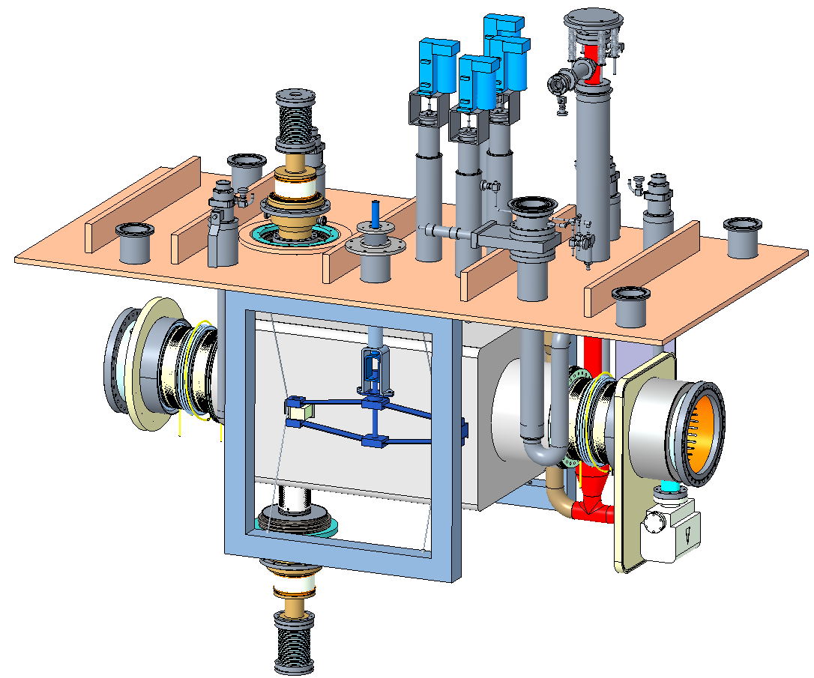
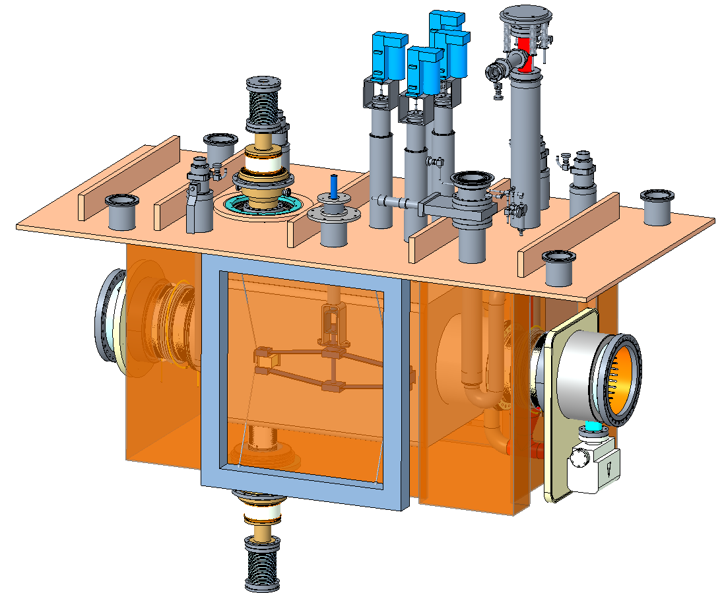
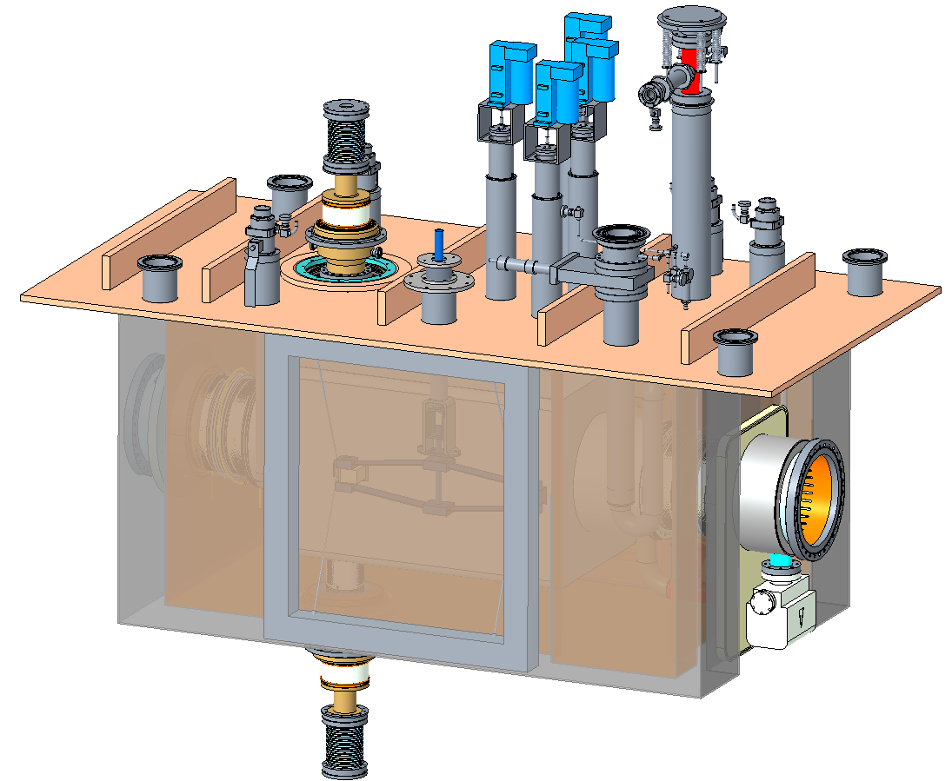
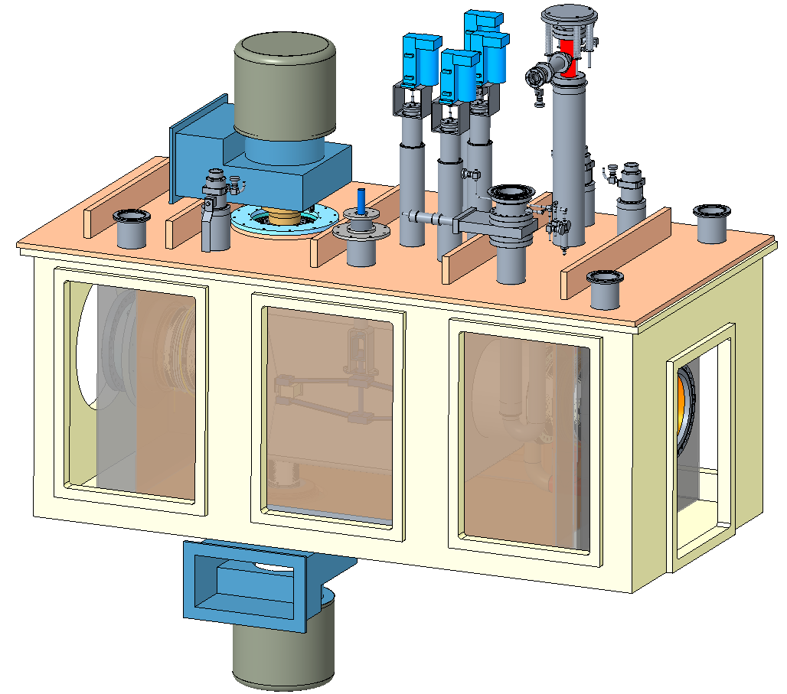
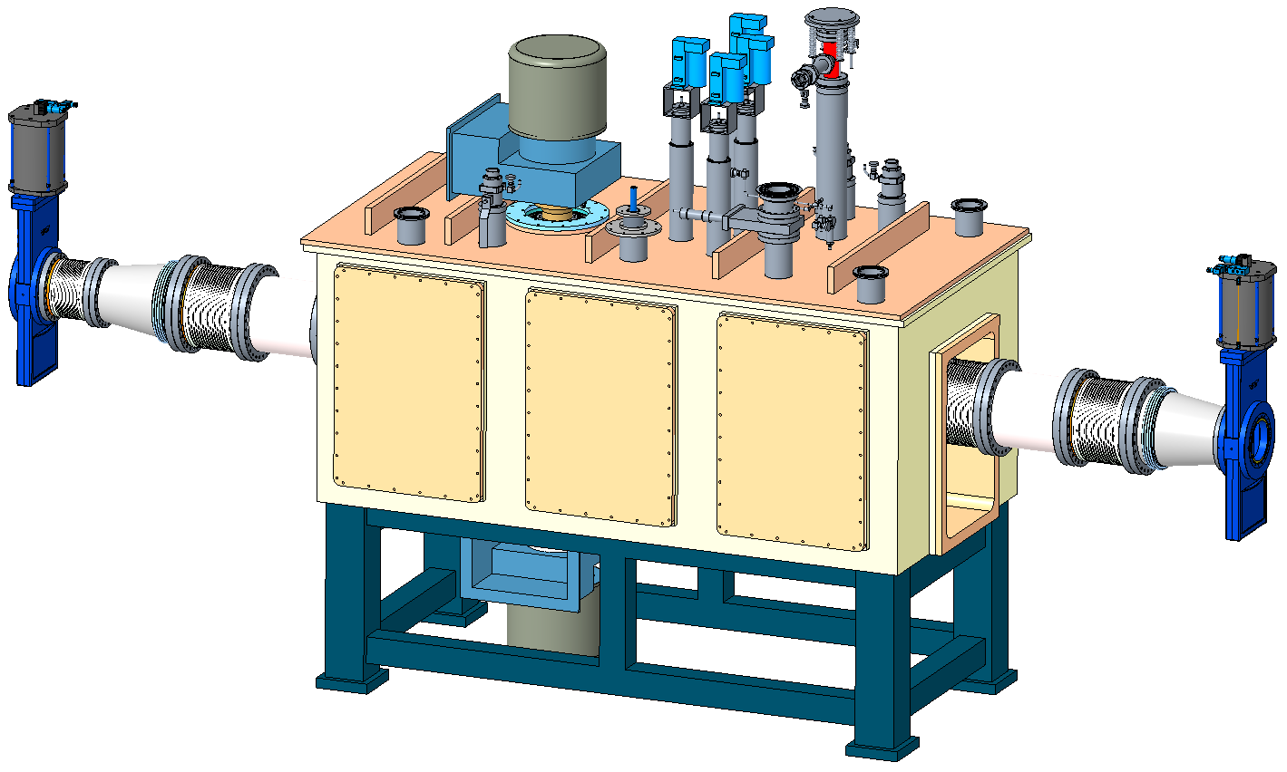
Cryomodule Build-up Sequence
Helium Header Integration
Top Cover Integration
Inner Magnetic Shield Installation
Thermal Shield Installation
Outer Magnetic Shield Installation
FPC Wave Guide Integration
Vacuum Closure, BLA and gate valve Integration

Slide 12
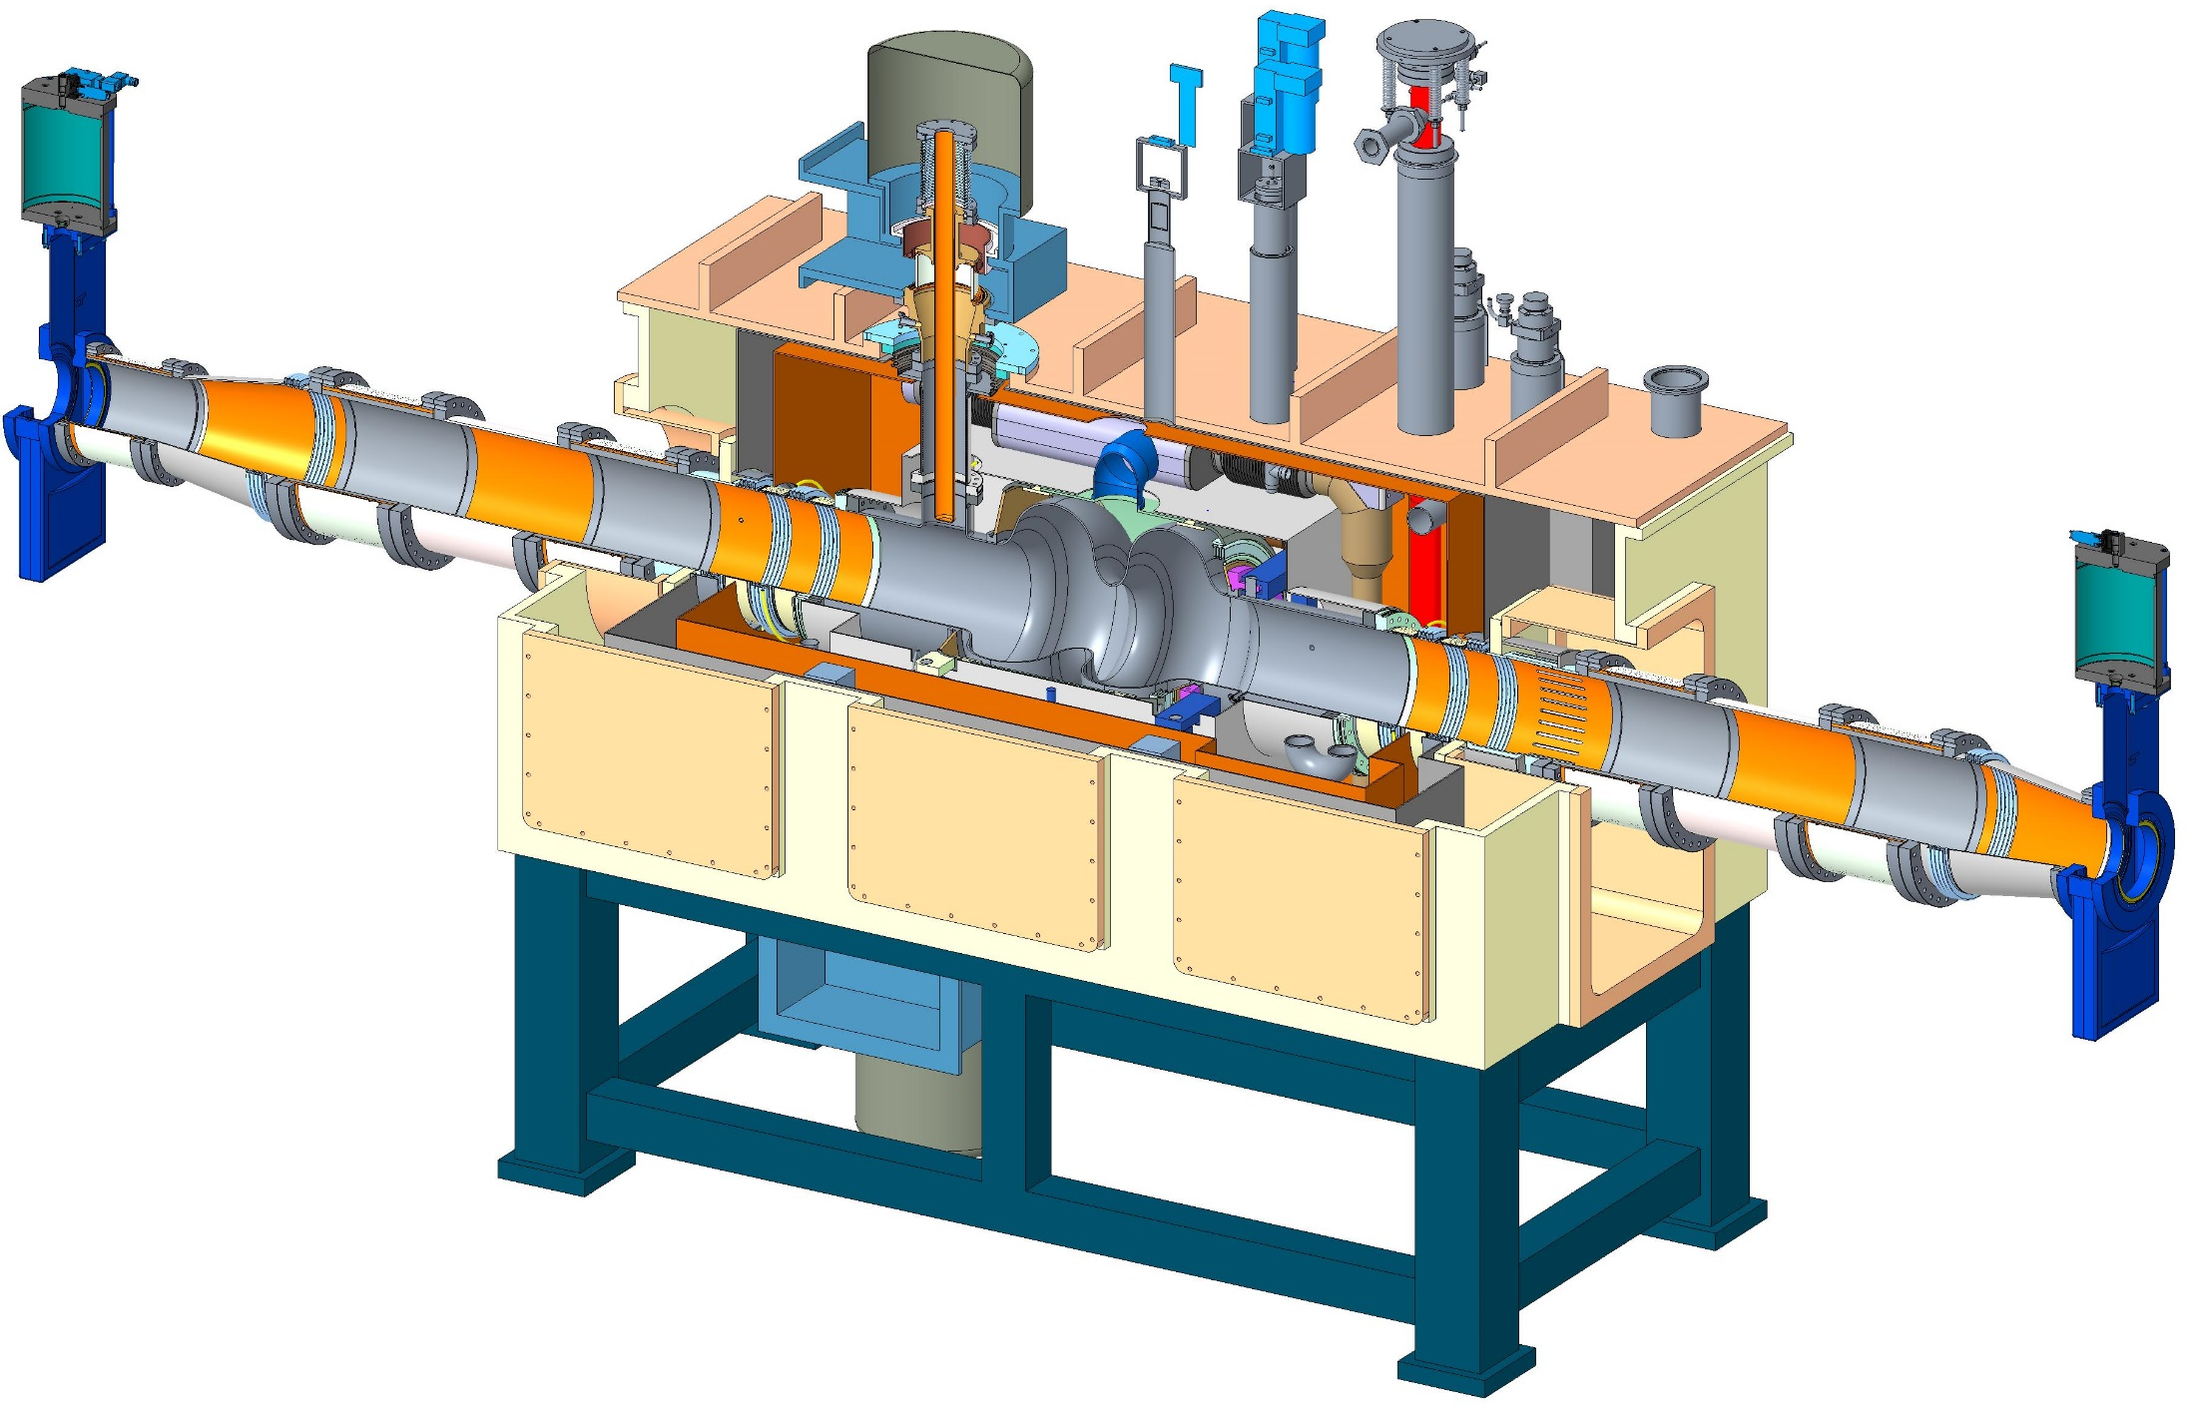
Cryomodule with BLAs
BLAs
BLAs
~5 m

Slide 13
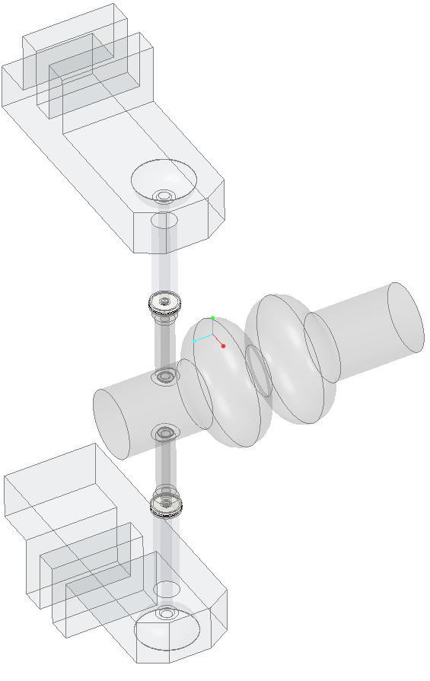
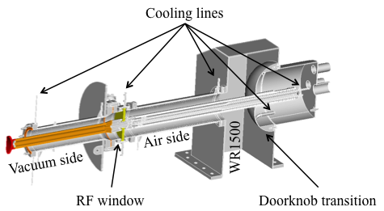
FPC R&D
Investigating the use of a stub tuner as impedance transformer in the fixed waveguide section for FPC Qext adjustment
FPC Qext has to be adjusted from 4E4 to 2.75E5 for various operation scenarios
Two fixed coupling 500 kW FPCs ordered for testing
Impedance transformer is currently under development
Stub Tuner
Stub Tuner

Slide 14
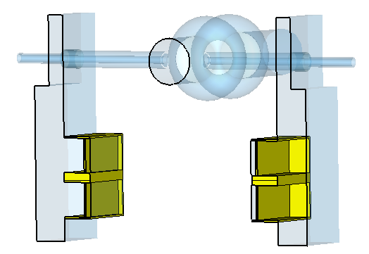
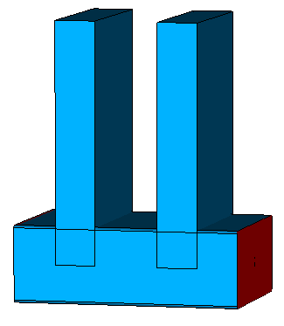
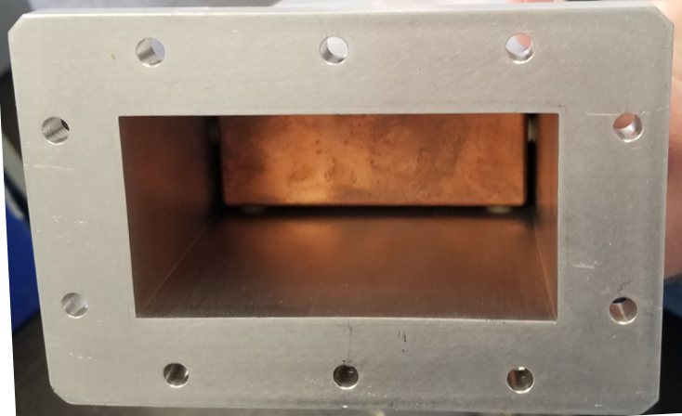
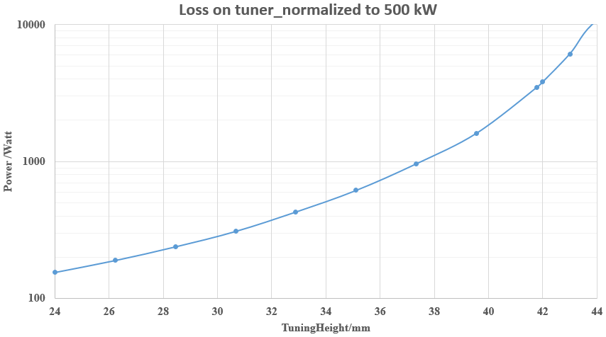
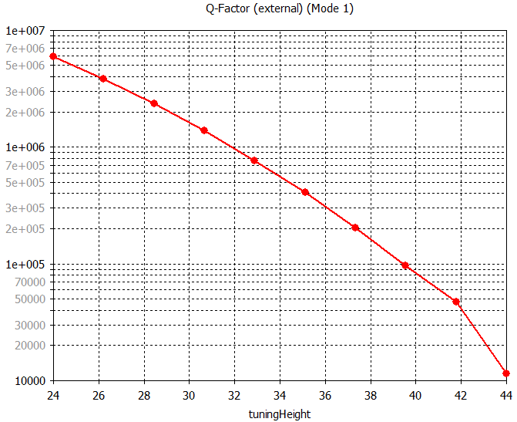
Stub Tuner Power Loss
Initial analysis shows maximum ~4 kW heat load from stub tuners before optimization
Varies with Qext adjustment
Tuning Height
Total Power Loss for both tuners
500 kW forward power
Q-Factor (external (mode 1)

Slide 15
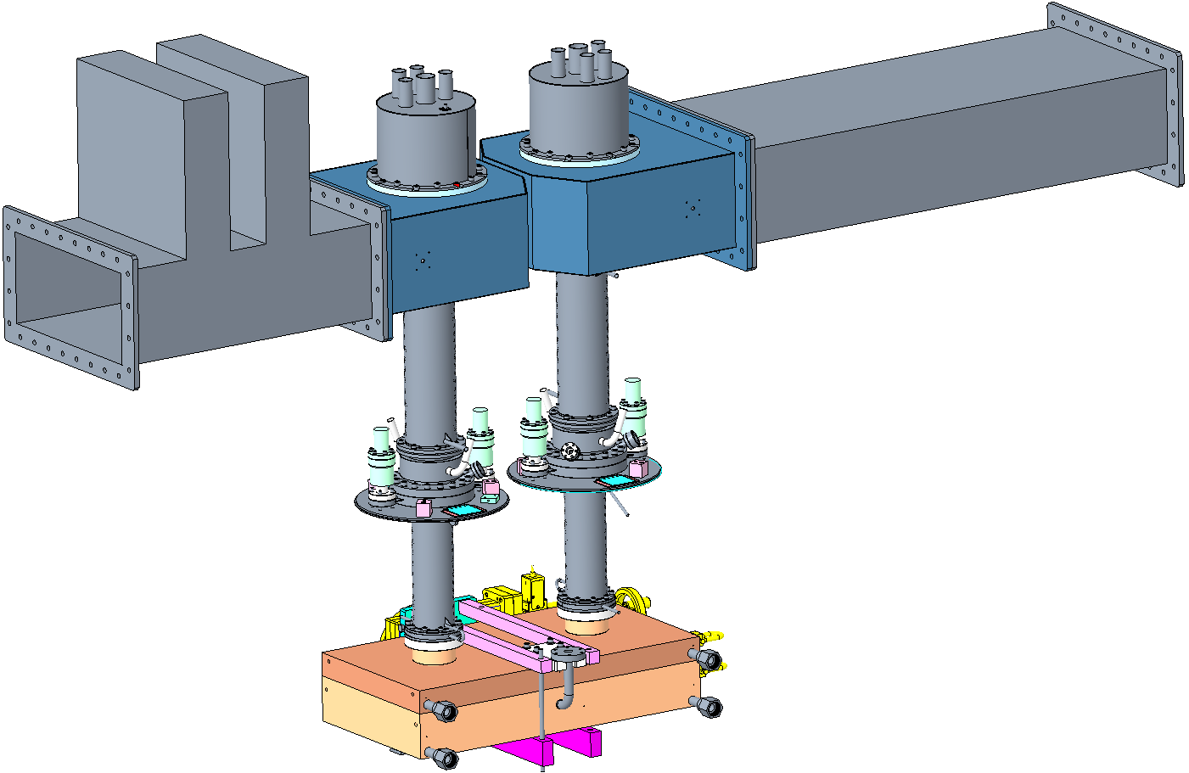
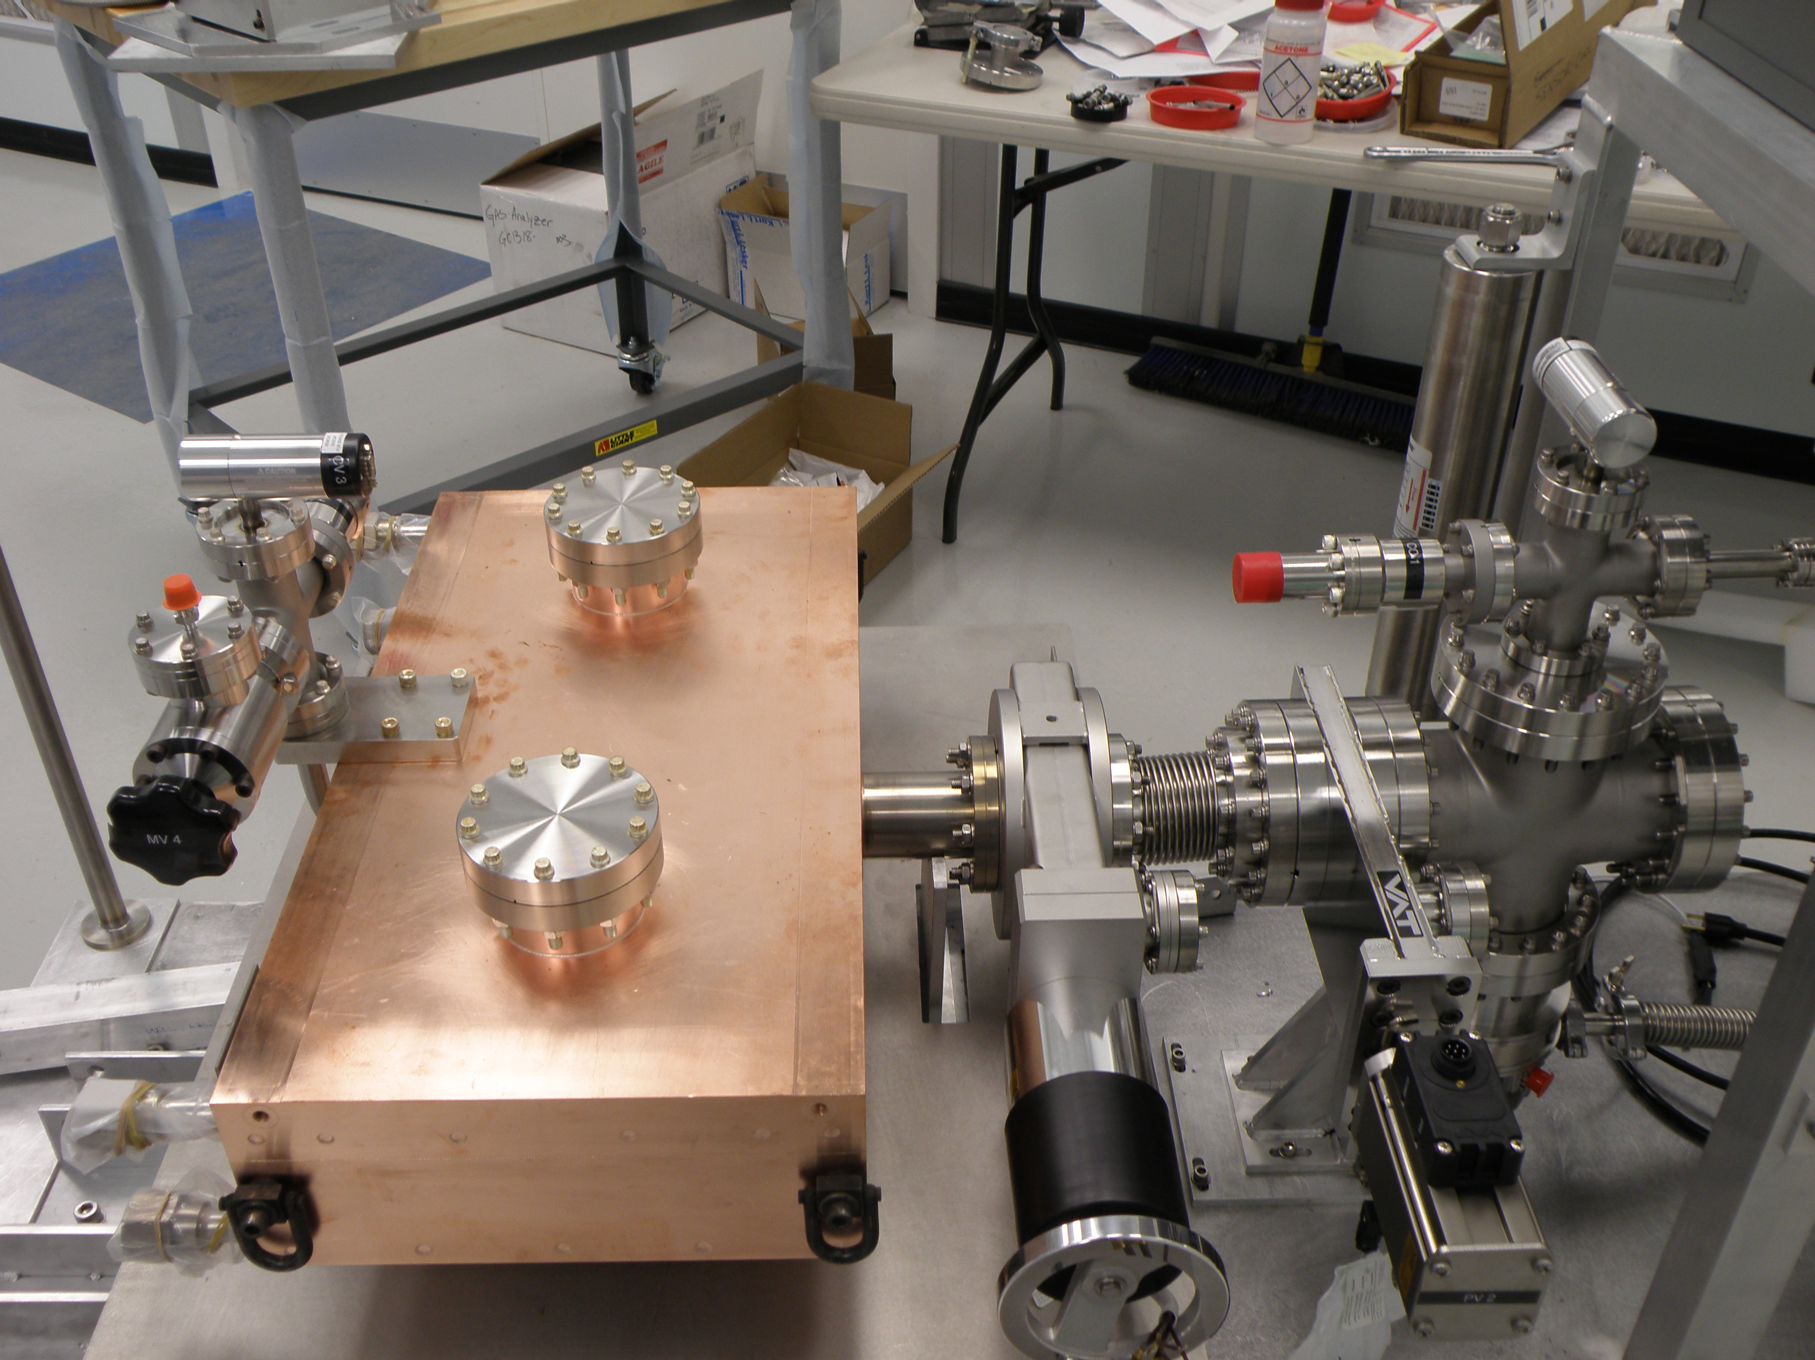
FPC R&D Status and Plans
Two 500 kW fixed FPCs have been ordered, delivery Spring 2019
The impedance transformer design and optimization is ongoing
Plan to condition the FPCs up to 500 kW in standing wave late 2019, with and without impedance transformer
Stub Tuner
Adjustable Short
Existing Waveguide
Conditioning Box
Waveguide Conditioning Box

Slide 16
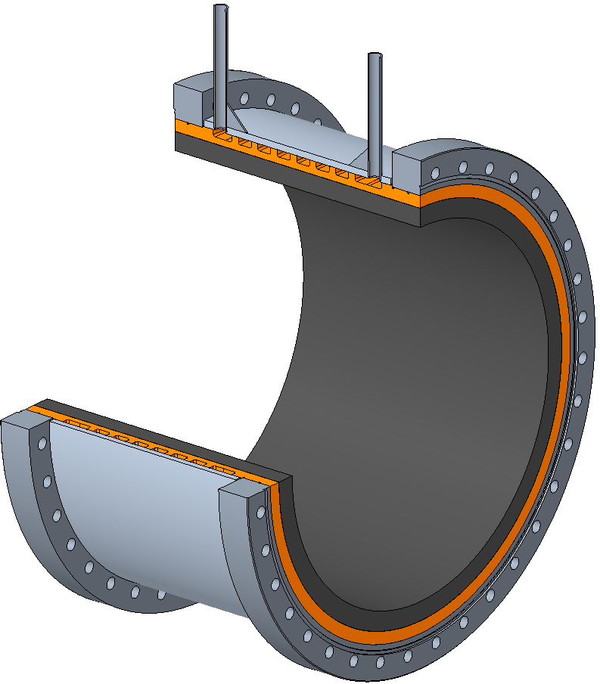
BLA R&D
OFE Copper Sleeve
Manufacture of a scaled up version of the BLAs developed at ANL for the APS upgrade
Qty 4 BLAs per cavity
80 kW HOM power/cavity → 20 kW each BLA
BLAs are at room temperature and are water cooled
Plan to test at high power (704MHz)
CoorsTek SC-35 SiC Cylinder
(~308 mm ID)
304 Stainless Steel Housing
RF model of the two-cell cavity with the SiC based BLAs*
*Physics design by Philipp Kolb

Slide 17
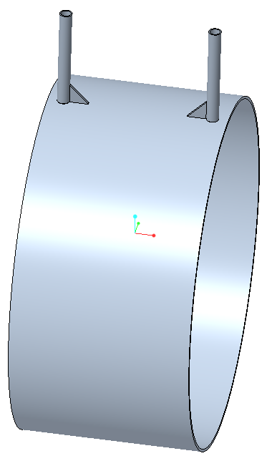
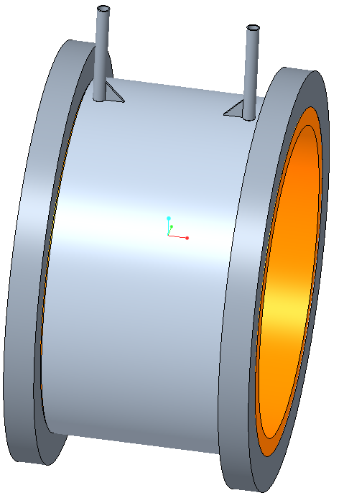
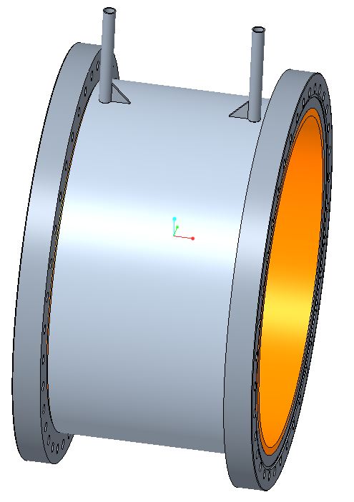
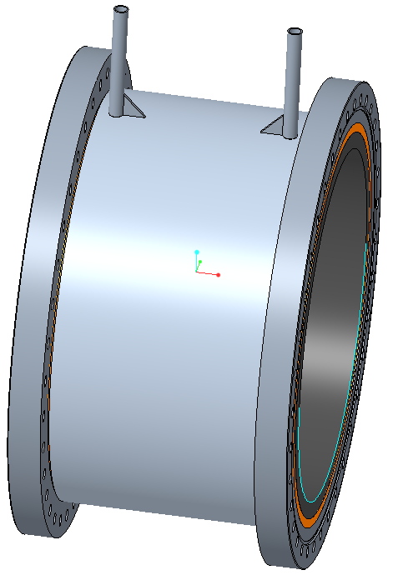
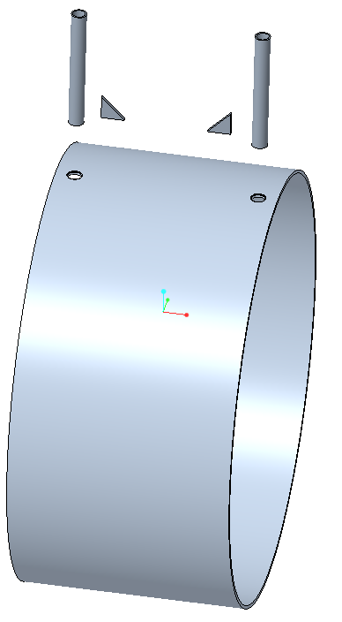
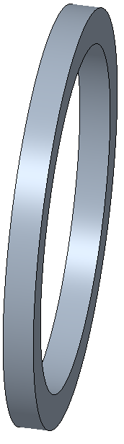
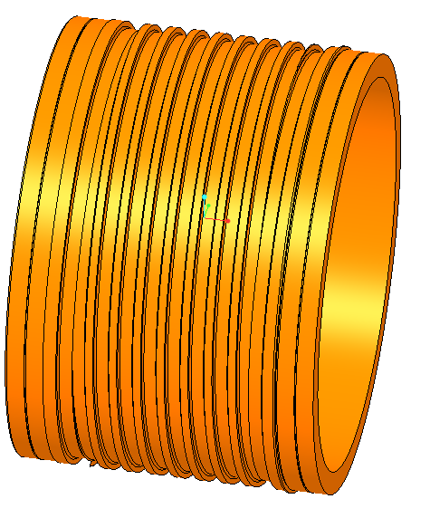

BLA Fabrication Plan
Weld Assembly
(~20 lbs.)
Braze Assembly
(~140 lbs.)
308.6mm ID
Machined Assembly
(~95 lbs.)
Shrink-fit Assembly
(~120 lbs.)
304mm ID
Machined Details
Machined Details
SiC Cylinder
(~25 lbs.)

Slide 18


Shrink Fit Analysis Details
0.005” radial gap
9.449” long
0.220” Thick SS
304 Stainless Steel
0.563” Thick SiC
100 °C
0.0025” radial
interference fit
0.400” Thick OFE Copper
20 °C

Slide 19


Shrink-fit Induced Stress
Elastic analysis:
Copper peak stress = 7,000 psi
Stainless Steel peak stress = 8,000 psi
SiC peak stress = 10,900 psi
Elastic-plastic analysis:
Copper peak stress = 5,000 psi
Stainless Steel peak stress = 7,000 psi
SiC peak stress = 9,240 psi
Material properties:
Annealed Cu yield ≈ 5,000 psi
S. Steel yield = 30,000 psi
SC-35 compressive strength = 98,000 psi

Slide 20


Shrink-fit Induced Copper Strain
Elastic analysis
Simulated elastic-plastic analysis
Small change in strain → Minimal plastic deformation in copper

Slide 21


Shrink-fit Induced SiC Surface Pressure
Elastic analysis
Simulated elastic-plastic analysis
Surface pressure range is 100 to 1,000 psi
→ Plan to increase copper and/or stainless thickness to increase surface pressure for increased conductive heat transfer

Slide 22
Heat Transfer Analysis Details
Water Cooling Specifications:
20 kW heat load, Q
20 °C water temperature rise, dT
20 °C inlet temperature, 40 °C outlet temperature (use 30 °C for calculations)
Minimum Mass flow rate, M(water) = Q/(Cp*dT) = (20,000J/s)/(4070.2J/kg-K*20K)= 0.246 kg/sec
Volumetric flow rate V(water) = M(water)/ρ = (0.246kg/s)/(.0009952kg/cc)= 247.2 cc/sec (3.92 gpm)
Flow velocity= 3.5 m/s → Heat Transfer Coefficient = 12,418 W/K-m^2
0.220” Thick
304 Stainless
CoorsTek SC-35 SiC
12.125” ID x 13.250” OD
0.400” Thick
OFE Copper
Helical Cooling Channel
0.50” wide x 0.225 high
X 33 ft long
9.449” Long

Slide 23


Heat Transfer Analysis Details
4.0 gpm @ 20 °C In
26 psi pressure drop
Surface Conductance between SiC OD and Copper ID: 1x10^4 to W/K-m^2 *
4.0 gpm @ 40 °C Out
@ 22 °C
@ 24 °C
@ 26 °C
@ 28 °C
@ 30 °C
@ 32 °C
@ 34 °C
@ 36 °C
@ 38 °C
W on inner surface
X4 = 20 kW Total Heat Load
*S.H. Kim, et. al., “Beam Pipe HOM Absorbers in Bunch Lengthening Harmonic Cavity Cryomodule for Advanced Photon Source Upgrade”, Collaboration Meeting with BNL, 4/27/2017

Slide 24

Thermal Analysis Results
60 °C Max Flange Temp
6 to 10 °C ΔT across SiC-Copper interface
77°C Max SiC Temp
→Plan to divide water cooling into two channels to symmetrize SiC cooling and reduce peak temperatures

Slide 25
Summary
eRHIC cavity and cryomodule design will continue to evolve as beam physics requirements mature
High power FPC testing planned for later in 2019
BLA manufacturing to begin Spring 2019 with high power testing planned for 2020

Slide 26
Thank you for listening!
Acknowledgements:
ANL: Sang-hoon Kim, Michael Kelly
BNL: Cliff Brutus, Philipp Kolb, Gary McIntyre, Scott Seberg, Kevin Smith, Wencan Xu, Alex Zaltsman
CERN: Eric Montesinos

