Slide 1
The LUXE experiment
Laser Und XFEL.EU Experiment
Florian Burkart (MPY1) for the LUXE collaboration
XFEL Machine Advisory Committee
Hamburg, 07/11/2018

Slide 2
General layout
Dipole
Experimental Area Hall
Triplet
1bunch
17.5 GeV e⁻
Linac
Kicker & Septa
Dipole
Dump
Kick out one bunch and send it to the experimental area.

Slide 3
Electron - Laser Collision
IP
Mirror
PDET
Laser
e⁺
Dipole
electrons
CAL
γCAL
γ
e⁺
γ
e⁻
Triplet
Mirror
pulse
e⁻
Dump
Dipole
EDET
E < 16 GeV
~ 20 m
~5 m
~15 m
tbd

Slide 4
Photon - Laser Collision
Collimation
Counter
IP
PDET
Mirror
Photon converter
e⁺
Laser
e⁺
Dipole
electrons
CAL
γCAL
γ
e⁺
γ
e⁻
Triplet
e⁻
Dump
pulse
e⁻
Dipole
Mirror
Dipole
Counter
E < 16 GeV
EDET
E < 16 GeV
5 m
15 m
5 m
10 m
tbd

Slide 5
General infrastructure requirements for LUXE
Electron beam line (~ 60 m)
Magnets (Fast kickers, septa, triplet, spectrometer)
Beam instrumentation
Collimator
Single bunch beam dump.
Space for 150 sqm Laserlab
Laser and laser transport
Detectors
General infrastructure:
Crane, power, water cooling, ventilation, IT
Shielding
Integration into XFEL Control and MPS system

Slide 6
Possible location at the XFEL
experiments
electron tunnel
electron switch
HED
photon tunnel
electron bend
MID
undulator
electron dump
SASE 2
3 – 24 keV
~
~
~
FXE
SPB
LINAC
17.5 / 14 / 10.5 GeV
SASE 1
3 – 24 keV
SASE 3
0.26 – 3 keV
SQS
SCS

Slide 7
Picture of XS1
Electron beam lines
XTD20
Dump line

Slide 8
XTD20 during construction (2014)
Crane shaft
Media shaft
Dimensions:
4.5 x 4.3 x 61 m

Slide 9
CAD Modell
XTD1
XTD2
XTD20

Slide 10
Possible location at the XFEL
experiments
electron tunnel
electron switch
HED
photon tunnel
electron bend
MID
undulator
electron dump
SASE 2
3 – 24 keV
~
~
~
FXE
SPB
LINAC
17.5 / 14 / 10.5 GeV
SASE 1
3 – 24 keV
SASE 3
0.26 – 3 keV
SQS
SCS

Slide 11
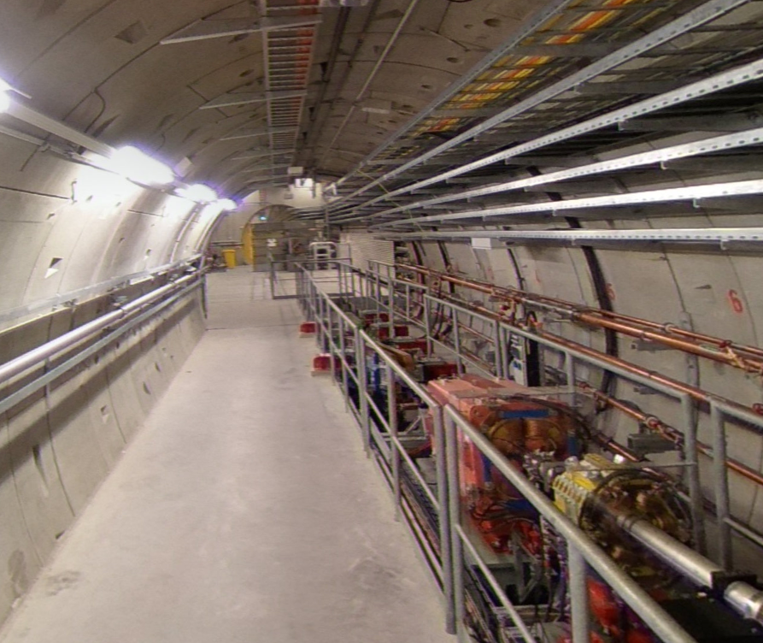
XSDU1

Slide 12
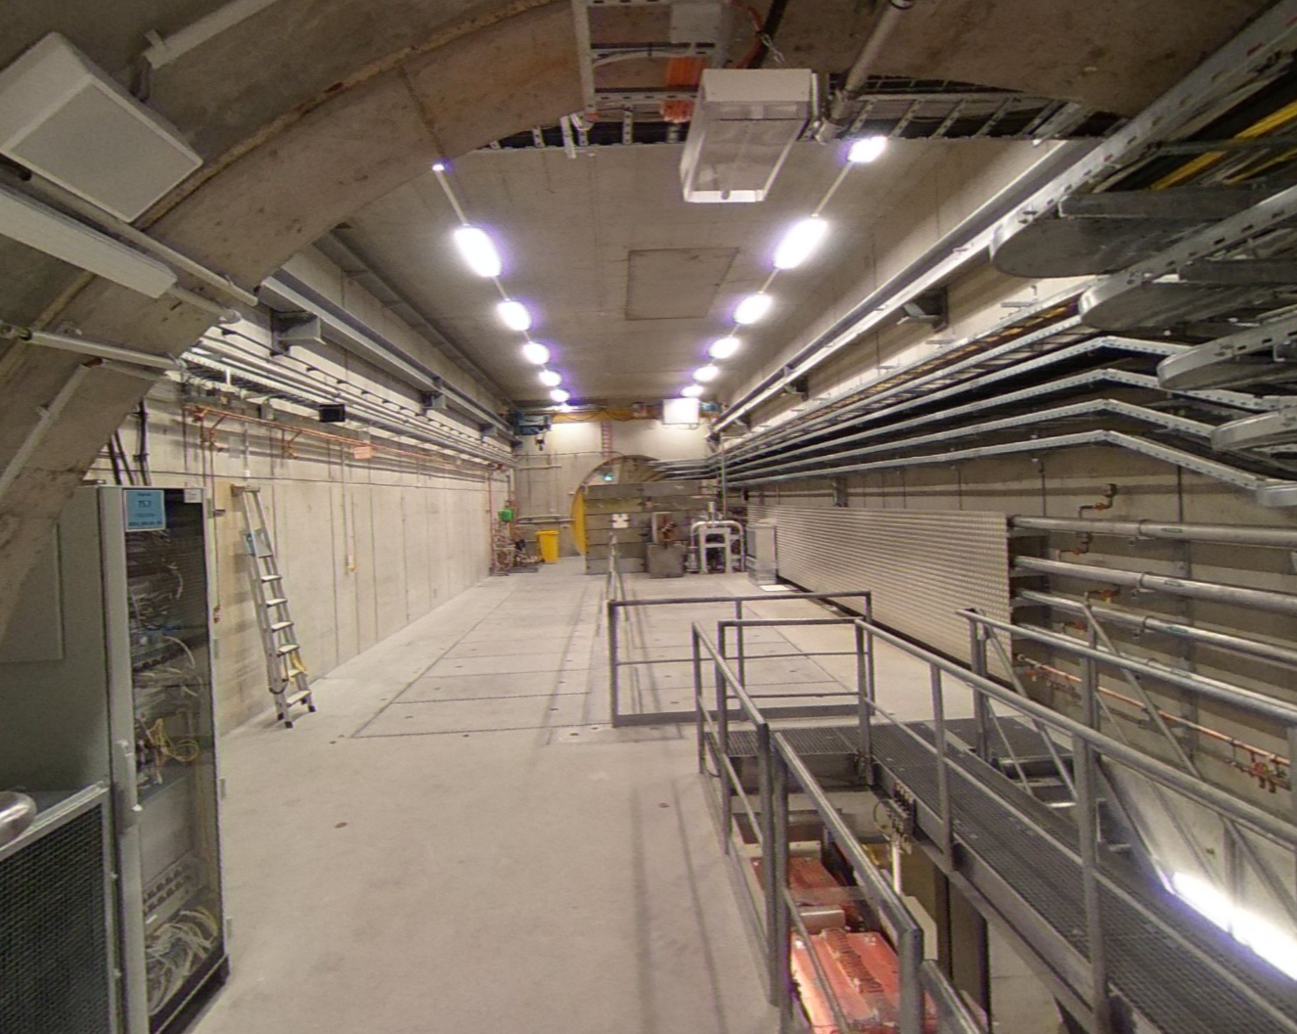
XSDU1 dump cavern

Slide 13
Location Considerations
XSDU1
Modification of beam line – downtime to be evaluated.
Potential impact on legal situation (additional extraction/beam dump, beam line) → plan-approval procedure.
Maybe radiation towards XTD7 → additional shiedling required.
New building at the surface.
Background from beam dump.
Already studied (optics, HW, …).
XTD20
Uses existing building and beam line design.
Major modification of extraction beam line - downtime to be evaluated.
Extraction and beam line already included in plan-approval.
Laser beam line transport via XS1 shaft.
Early implementation of the beam extraction for future XFEL upgrade and/or test beam area.
Additional demonstration of the flexibility of the facility.
New option to be studied.

Slide 14
Timeline and Outlook
First discussions with XFEL Directorate, Directorate supportive.
DESY directorate supportive.
Design study strongly supported via DESY strategy fund.
Funding received for laser development from Helmholtz Innovation pool.
Application for EU funding (ERC synergy grant, 14M€) foreseen next year.
Main challenge: Fit construction into XFEL schedule - under investigation.
Next steps: decide on location, preparation CDR, evaluate modification schedule, …

Slide 15
Conclusion
LUXE as QED basic research – would enlarge the scientific scope of XFEL.
Theory and accelerator community is very interested in conducting this experiment at the XFEL.
DESY and XFEL directorate supportive.
Design consideration with input from various DESY technical groups.
Layout and achievable parameters look feasible.
Possible location of the experiment found in XSDU1 or XTD20.
Major modification of extraction beam line needed.
Early implementation of the beam extraction for future XFEL upgrade and/or test beam area.
Integration, Installation and Design studies ongoing.

Slide 16
Direct comments from MAC – report under preparation
Very interesting project.
Timeline to be evaluated.
Difficult modification of the beam line!!
Check ”standard” beam parameters (14 GeV, 0.25 nC)
More studies needed – full start to end simulation, background studies.

