Slide 1
Study of phase transitions in PNIPAm-Au photonic crystals
Svetlana Dubinina¹,
supervised by Dmitry Lapkin², Ivan Vartaniants^{2, 3}
¹Moscow Institute of Physics and Technology, Moscow, Russia
² Deutsches Elektronen-Synchrotron DESY, Hamburg, Germany
³ National Research Nuclear University MEPhI, Moscow, Russia
Notes:
Good afternoon everyone! My name is Svetlana. And I am a summer student here.
Now I would like to present you my report on the project entitled “Study of phase transition in PNIPAm-Au photonic crysrtals”.

Slide 2

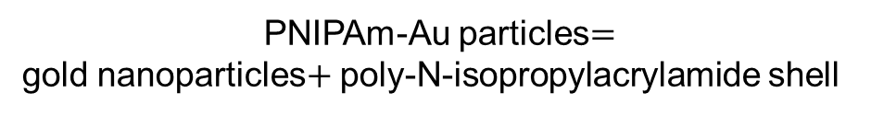

PNIPAm-Au particles
$$\sim 230 nm$$
PNIPAm-Au particles$=$
gold nanoparticles$+$ poly-N-isopropylacrylamide shell
shrinks and swells in response to temperature
the self-assembly of the PNIPAM colloids into crystal structures is completely controllable
$$32, 2±4,0 nm$$
study of phase transitions
Notes:
The aim of my work was analyze the structural evolution of colloidal photonic crystals formed by gold spherical nanoparticles modified with poly-N-isopropylacrylamide (abbreviated PNIPAm) upon incremental cooling and heating.
But in general why some changes in crystals structure are expected? According to previous studies The hydrogel shell of our particles is functionalized in such a way that it responds to raising and lowering of the temperature: it shrinks with temperature decreasing and swells when the temperature of the sample are increased.
Thus the self-assembly of the PNIPAM colloids into crystal structure is controllable (by temperature changes), so it is used for study of phase transitions.

Slide 3
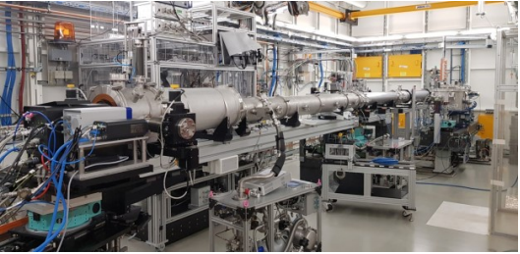
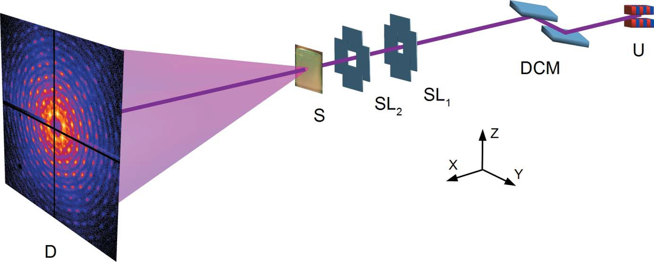
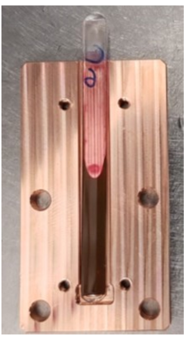
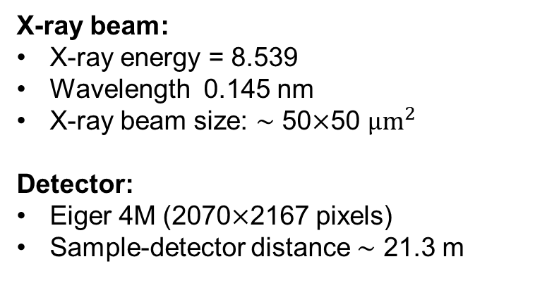
Experiment at P10 PETRA III
X-ray beam:
X-ray energy = 8.539
Wavelength 0.145 nm
X-ray beam size: $\sim$ 50$×$50 ${μm}^{2}$
Detector:
Eiger 4M (2070$×$2167 pixels)
Sample-detector distance $\sim$ 21.3 m
USAXS (Ultra-Small-Angle X-ray Scattering) setup
Diffraction in transmission geometry
Exposure time: 0.1 sec
Notes:
To investigate the evolution of soft photonic crystal structure in response to temperature changes an experiment at P10 Coherence Beamline at PETRA III using USAXS setup was performed.
The incident beam energy was 8.539 keV ( with the wavelength 0.145 nm), the beam size was 50×50 µm². Diffraction in transmission geometry was registered with Eiger 4M detector which was located at a distance of 21,3 m from the sample.
The sample aqueous solution (12.7 wt) was sealed in a glass capillary. The capillary was fixed in a massive copper frame with a window to exclude temperature deviations. Heating and cooling of the sample were provided by coupled Peltier element and thermostat. The temperature of the sample was controlled by a thermocouple.

Slide 4
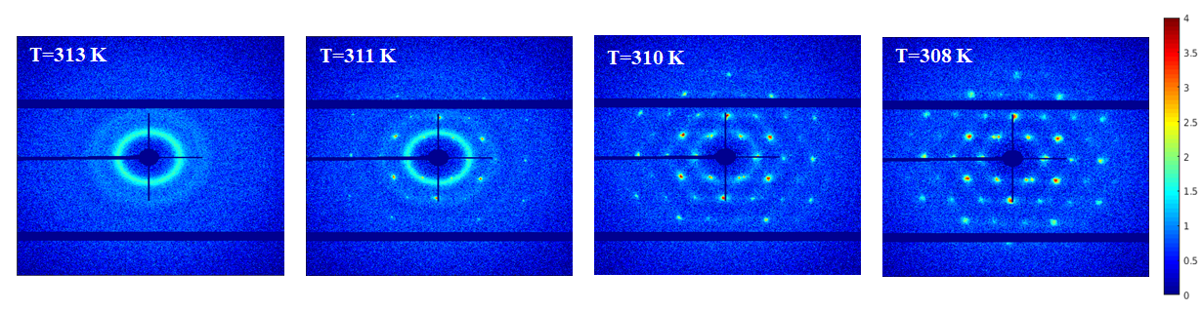
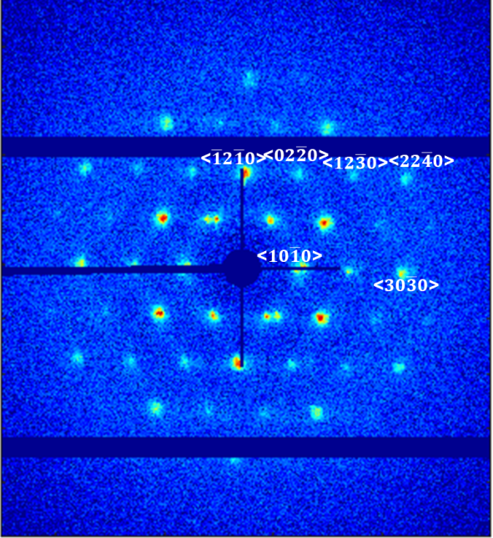
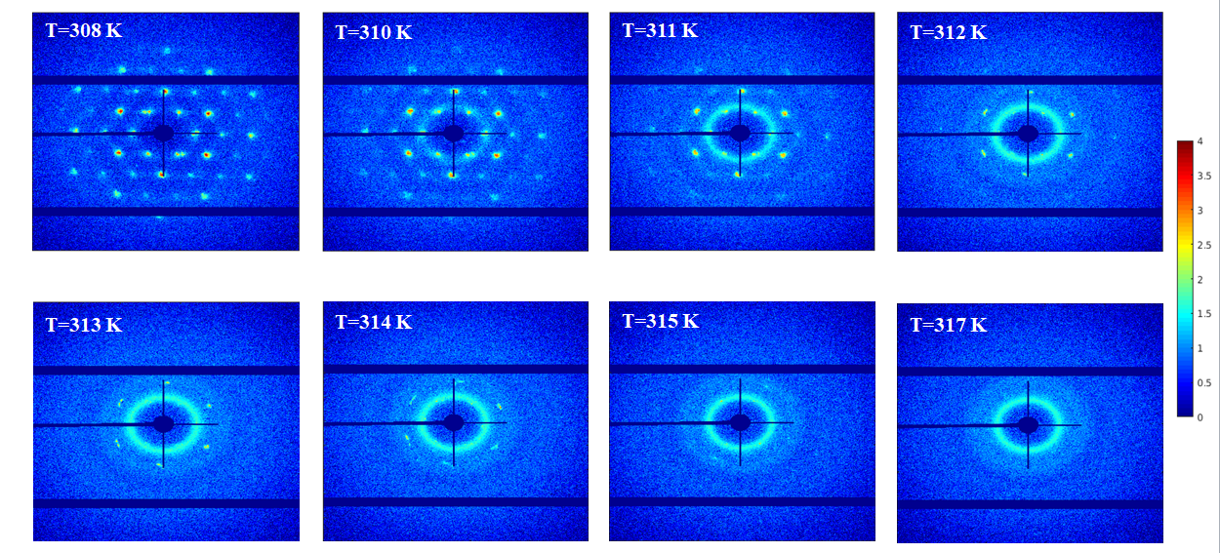

Diffraction pattern
Cooling experiment
Heating experiment
-1
0.05 Å
Notes:
We studied the crystallization of the solution during cooling and the subsequent melting of the obtained crystal. Thus, two datasets were analysed.
First dataset was obtained during cooling of the sample from 313 K down to 308 K and the second one was collected during heating of the sample from 308 K up to 317 K.
Broad and isotropic rings on the pattern at the beginning of the cooling series are evidence of the liquid state of the solution. The following appearance of Bragg peaks upon cooling indicates the sample crystallization.
(It is worth noting that there is a temperature range where the liquid rings coexist with the Bragg peaks, that means the sample crystallizes gradually.)
On the contrary, the Bragg peaks disappear during heating and turn into amorphous rings as it is expected for the crystal melting.
(The rate of temperature change was 0.1 K/min; diffraction patterns were collected every 30 sec)

Slide 5

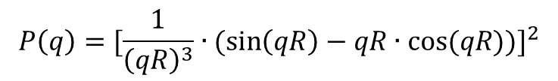
Form factor and structure factor
$$P\left(q\right)={[\frac{1}{{\left(qR\right)}^{3}}∙(\sin\left(qR\right)−qR∙cos⁡(qR))]}^{2}$$
$$I\left(q\right)=P\left(q\right)∙S(q)$$
Notes:
The measured intensity is a product of two main factors: form factor of an Au particle and structure factor (in our case we have hypothesis that this two factors are independent, so we could perform the measured intensity as a composition of form factor and structure factor).
The form factor is a footprint of the shape of the particles the sample consists of.
The structure factor comprises information about the superlattice structure.
Peaks at the small angles are conditioned by the structure factor.
To extract the structure factor, the measured intensity was divided by the form factor. An example of the obtained structure factor (angular-averaged) is shown in this slide.

Slide 6
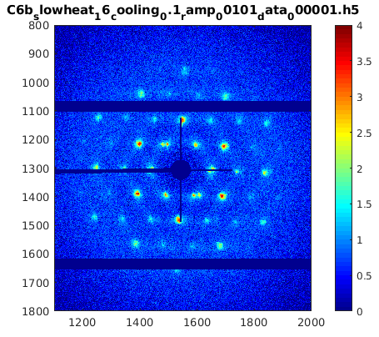
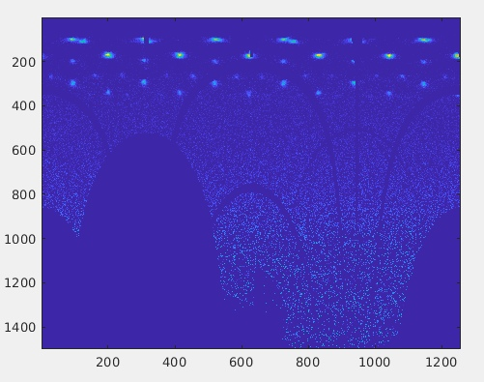
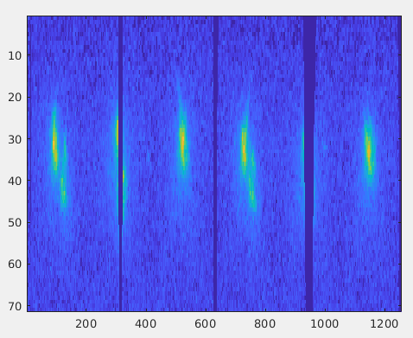
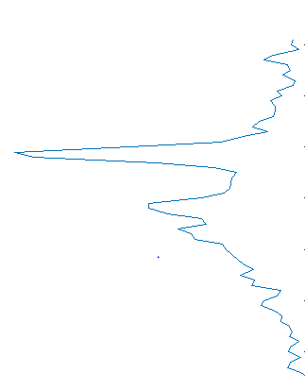
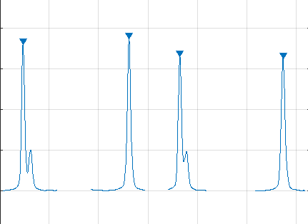







Bragg peaks fitting
$$q_{φ}$$
q
$$q_{φ}, pixels$$
$$q, pixels$$
${<S(q)>}_{φ}$,
$$arb. units$$
${<S(q)>}_{q}$,
$$arb. units$$
$$q, pixels$$
$$q_{φ}, pixels$$
Notes:
From here on we will analyze only the obtained structure factor for each temperature. All data were converted into polar coordinates.
For each ring only a corresponding region of the diffraction pattern was analyzed. The peaks were analyzed in two dimensions (radial and angular)
First of all we made data radial averaged and found the angular position of peak. During next step we made data (intensity) angular averaged and found the radial position of peak. Thus we know the position of peak in two directions.

Slide 7
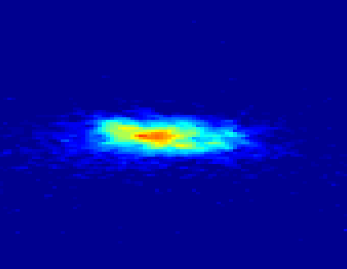
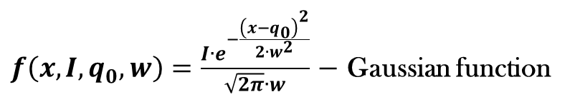



Bragg peak fitting
$$q, pixels$$
$$q_{φ}, pixels$$
$f\left(x, I,q_{0}^{}, w\right)=\frac{1}{π}∙\frac{I∙w}{{(x−q_{0}^{})}^{2}+w^{2}}$ $−$ Lorentzian function
$f\left(x, I,q_{0}^{}, w\right)=\frac{I∙e^{−\frac{{\left(x−q_{0}\right)}^{2}}{2∙w^{2}}}}{\sqrt{2π}∙w}$ $−$ Gaussian function
Notes:
After the coordinates of the peaks were found, the intensity profiles taken in the corresponding positions were fitted by Gaussian and Lorentzian in two directions.
Parameters of fitting are integral intensity, peak position and full width at half maximum.
We decided that Lorentzian function fitted intensity distribution with better accuracy, so here fitting with Lorentzian function are performed.

Slide 8






Temperature evolution of Bragg peak parameters: intensity and peak position
Cooling
Heating
<$10\overline{1}0$>
<$\overline{1}2\overline{1}0$>
<$02\overline{2}0$>
<$12\overline{3}0$>
<$30\overline{3}0$>
<$22\overline{4}0$>
Notes:
(The values of each parameter were obtained by averaging this parameter over all peaks in the ring.)
The following four parameters of the Bragg peaks as a function of temperature were analyzed: integrated intensity, Bragg peak position and full widths at half-maximum (FWHMs) in radial and azimuthal directions in reciprocal space.
Smooth transition from the liquid state to crystal form induces intensity changes. It can be seen from the figures in top row that with decreasing sample temperature the intensities of the Bragg peaks gradually grow. Fall of the intensity is observed during sample heating (Fig. 11b). This tendency points out to crystal melting.
According to our results, a slow growth of the peak positions while sample was cooled can be observed (Fig. 11c). The results of the sample heating experiment indicate a gradual increase, and then slight decrease of the value of this parameter

Slide 9
Temperature evolution of lattice parameter
Cooling
Heating
Notes:
Obtained peak positions were recalculated into the lattice parameter assuming the sample has an hcp structure.
The lattice parameter as a function of temperature is shown here.
As it follows from our analysis, when the sample is cooled the lattice shrinks, which is associated with termal compression.
In heating experiment the lattice shrinks gradually with increasing temperature from 308 to 310.5 K; but with subsequent heating it expands sharply.

Slide 10
Conclusion
Diffraction patterns were obtained for heating and cooling experiments with PNIPAm-Au particles
Bragg peaks were fitted with Gaussian and Lorentzian function
Temperature evolution of Bragg peaks parameters was studied:
intensity decreases during increasing temperature
peak broadens in heating experiments
unexpected behavior of FWHM in cooling experiments:
Bragg peaks get broader even with decreasing temperature
Lattice parameter analysis indicates the lattice compression during cooling experiment; in heating experiment the lattice shrinks gradually, but with subsequent heating it expands sharply

Slide 11
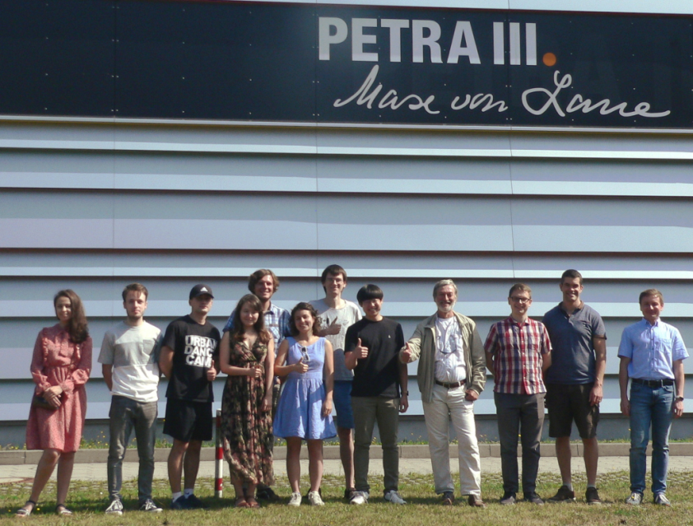
Acknowledgments
Coherent X-ray Scattering and Imaging Group at DESY
Prof. Dr. I. A. Vartanyants
Mr. D. Lapkin
Ms. N. Mukharamova
Mr. R. Khubbutdinov
Ms. D. Assalauova
Dr. L. Gelisio
Dr. Y-Y. Kim
Dr. J. Stellhorn
Dr. J. Carnis
And the whole organization team of the Summer School

Slide 12
Svetlana Dubinina
FS-PS
dubinina.sa@phystech.edu

Slide 13






Rings
<$\overline{1}2\overline{1}0$>
<$02\overline{2}0$>
<$12\overline{3}0$>
<$22\overline{4}0$>
<$10\overline{1}0$>
<$30\overline{3}0$>

Slide 14
Temperature evolution of Bragg peak parameters: FWHMs in radial and azimuthal directions
Cooling
Heating
<$10\overline{1}0$>
<$\overline{1}2\overline{1}0$>
<$02\overline{2}0$>
<$12\overline{3}0$>
<$30\overline{3}0$>
<$22\overline{4}0$>
Notes:
The width of peaks in the radial direction as well as in the azimuthal direction increases with the increase of the temperature for the sample heating experiment. This indicates a crystals melting.
Unexpected trends are observed in the evolution of the width of the Bragg peaks during the cooling experiment: with decreasing temperature, the peaks become wider for both directions. We consider that it could be connected with radiation damage.

