Slide 1
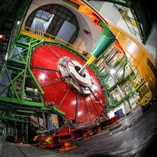
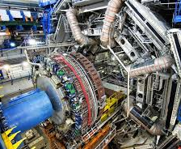
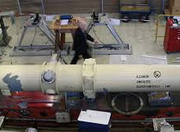
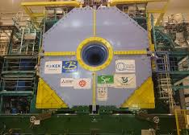
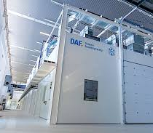
Detector Development at DESY: The Landscape
Ties Behnke
21-8-2019

Slide 2
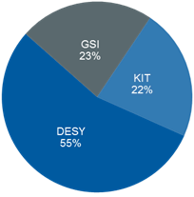
Matter and Technologies
The Helmholtz Context
Detector Development is done within Matter and Technologies, DTS
Facts and Figures
Participating centers: DESY, GSI with HIJ and HIM, KIT
Spokespersons: Marc Weber (KIT), Silvia Masciocchi (GSI)
Core-funded scientists: 55 FTE (2021) Core-financed costs: 12,7 MEUR (2021)

Slide 3
Results of the review in 2018
Scientific review February 2018, chair Hugh Montgomery
In terms of quality, .. the R&D programmes .. are outstanding.
The size of the current effort matches the requirements
A main asset are skilled and competent people
Need to identify in PP a future project
Get involved in R&D for future facilities
Strong link to DMA needed, strengthen DAQ aspects
Strong recommendation to apply for and implement the DDL (distributed detector laboratory)

Slide 4
Goals of DTS for PoF IV
Where do we want to be
Expand our expertise in semi-conductor sensor R&D, integration know-how, and system experience: expertise for the full life-cycle
Build up a strong basis for cryogenic detectors
Expand further our work on Silicon photonics
Maintain our breath of technologies to match the demands from MU and MML
Leverage our strength in system design, building and integration
Engineering
Materials
Testing
Commissioning

Slide 5
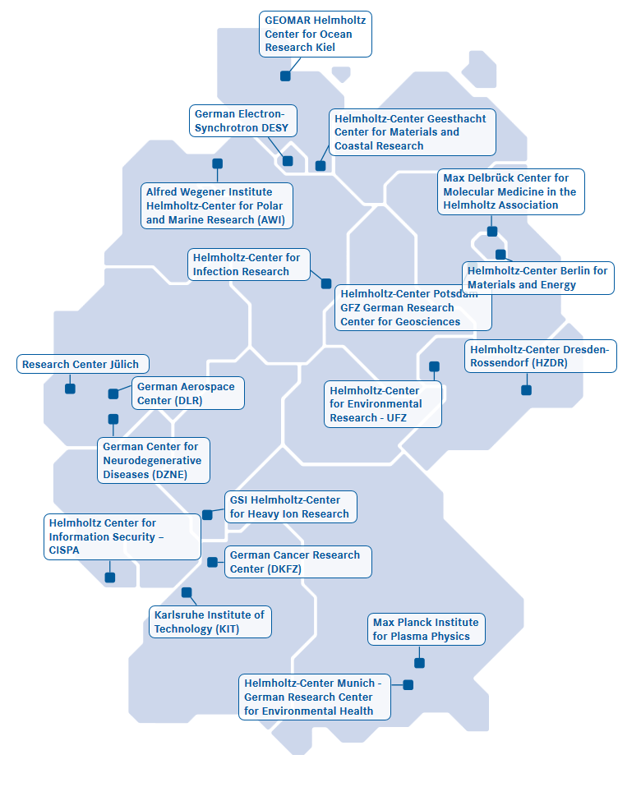
The DDL
Proposal to the Helmholtz Large Investment Fund
Vier Partner (DESY, GSI, HIJ, KIT)
Share important infrastructure for detector design, development, building
Assoziierte Institute:
University Heidelberg
CHyN Hamburg
PTB Braunschweig
IPHT Jena (Leipnitz)
Netzwerk mit anderen Partnern
Bonn University
Aachen University
Freiburg University
HLL Munich
Rutherford Lab, CERN, PSI, …
etc
DESY
HIJ
GSI
KIT

Slide 6
The DDL concept: all topics
Science driver
Challenge
Technology
DDL
Post-processing of detectors
Science with low-energetic X-rays
Low X-ray energy
Testing/ Test beams
Cryogenic detectors
High-Z Sensor materials
Ultimate resolution
Sensor Production
Ultra-fast detectors
Precision science
dead material, tiling, cooling
High spatial resolution
Science at highest energies
Advanced engineering methods/ materials
Integration/ Characterisation
Robust, stable detectors
Radiation hard sensor materials

Slide 7
The DDL @ DESY
Science driver
Challenge
Technology
DDL
Post-processing of detectors
Science with low-energetic X-rays
Low X-ray energy
Testing/ Test beams
Cryogenic detectors
Test beams
High-Z Sensor materials
Ultimate resolution
Sensor Production
Ultra-fast detectors
Precision science
Post processing
dead material, tiling, cooling
High spatial resolution
Science at highest energies
Advanced engineering methods/ materials
Integration/ Characterisation
Robust, stable detectors
Materials Lab
Environment test
Radiation hard sensor materials

Slide 8
Invest Money: Total DDL
Center | Invest/ kEUR
DESY | 12500
GSI | 4600
HIJ | 2600
KIT | 11900
SUM | 31600
Note: numbers are preliminary and might still change.
DESY FH participation:
Test beam
Engineering center
Characterisation and Testing
DESY AP participation
Extreme environments lab

