Slide 2
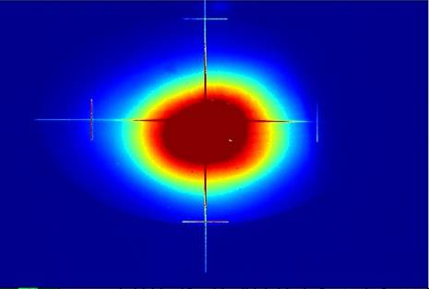
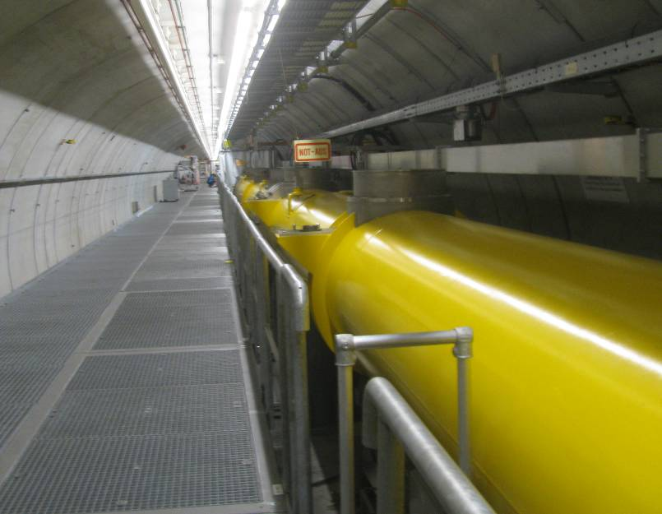
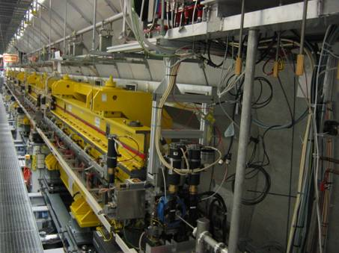
FLASH MPS Philosophy
Notes on Machine Protection for long bunch trains
Siegfried Schreiber
DESY
Workshop on Linac Operation with Long Bunch Trains
DESY
6-8 June 2011

Slide 3
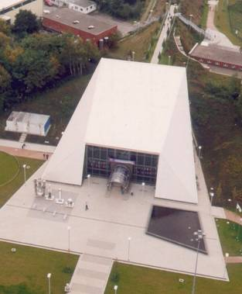
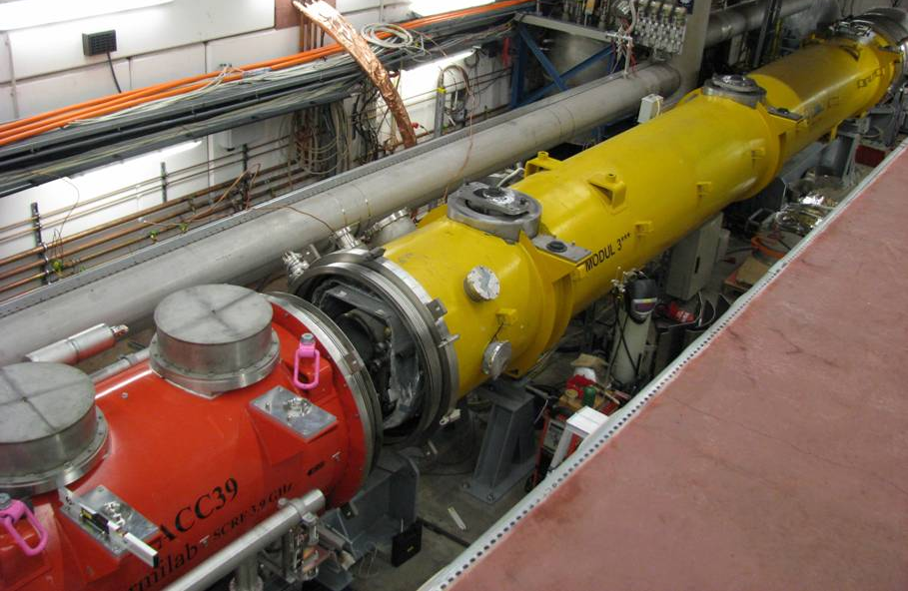
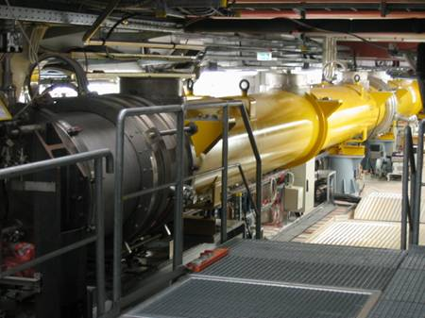
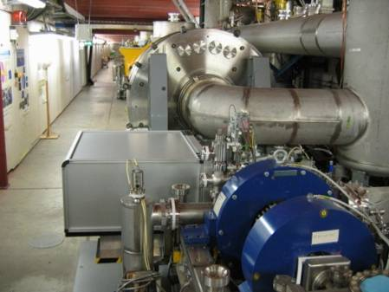
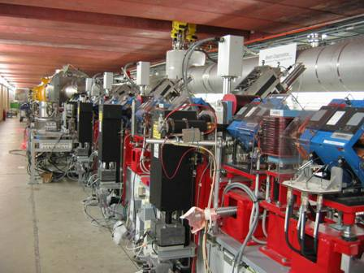
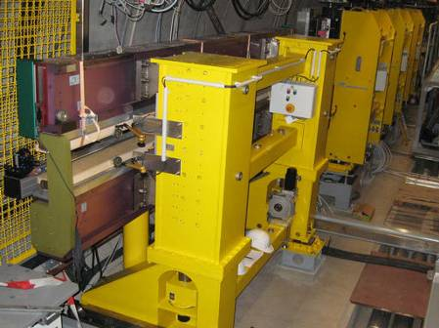
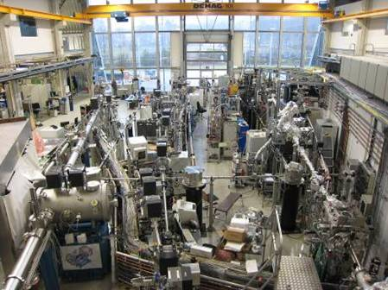
FLASH
RF stations
Diagnostics
Accelerating Structures
sFLASH
Undulators
Bunch Compressor
Bunch Compressor
LOLA
RF Gun
FEL Experiments
5 MeV
150 MeV
450 MeV
1250 MeV
Bypass
315 m

Slide 4
Why Machine Protection?
To protect machine components against beam induced damage
Cold vacuum/cavities
Collimators
Undulators
RF stations
Diagnostics
Accelerating Structures
sFLASH
Undulators
Bunch Compressor
Bunch Compressor
LOLA
RF Gun
FEL Experiments
5 MeV
150 MeV
450 MeV
1250 MeV
Bypass
315 m
Warm Sections
Destructive diagnostics: screens, LOLA, wires
Valves, Flanges
To protect against high activation of beamline components
To some extend: personnel safety

Slide 5
How do we measure beam losses?
Whole machine – positive measurement (signal must exist)
Compare charge reading source/dump with toroids
2UBC2
9DUMP
3GUN
12EXP
sFLASH
Undulators
Bunch Compressor
Bunch Compressor
LOLA
RF Gun
FEL Experiments
5 MeV
150 MeV
450 MeV
1250 MeV
Bypass
Direct losses at specific locations – negative measurement (best is, of signal is zero)
Beam loss monitors (BLMs) (scintillators plus photo multipliers)
Pandora System (gamma and neutron dose measurement for personnel safety)

Slide 6
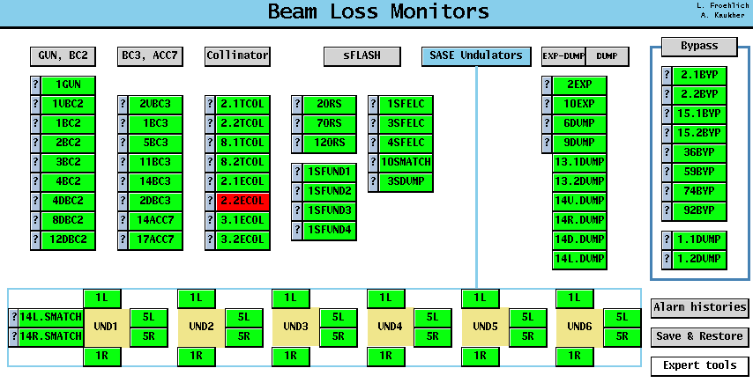
Many BLMs at places with potential losses

Slide 7
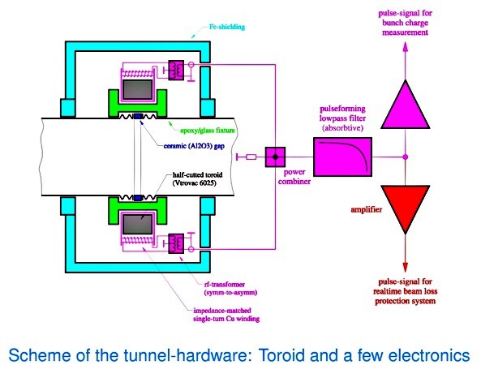
Toroids
Current pulse induced in a coil around the beampipe

Slide 8
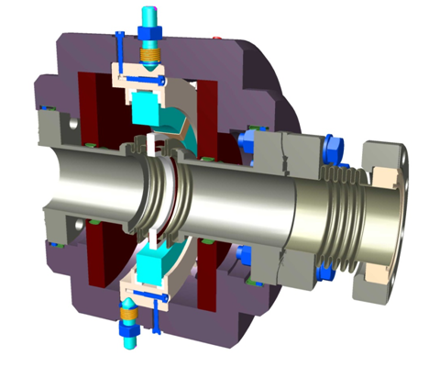
Toroids
Current pulse induced in a coil around the beampipe

Slide 9
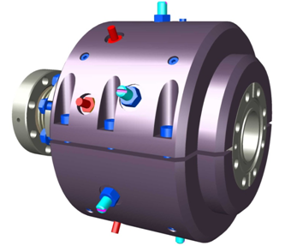
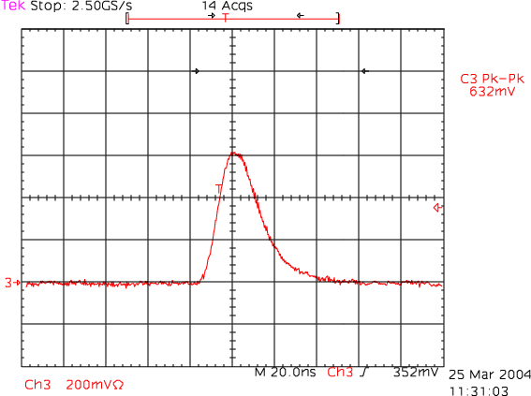
Toroids
Transformer output pulse length ~20 ns

Slide 10
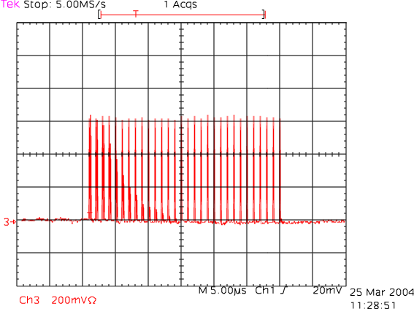
Toroids
Resolves individual bunches in the train (9 MHz possible with appropriate ADC)
40 ns
toroid signal of a single bunch
of a bunch train (30 bunches 1 MHz)

Slide 11
Toroid issues, TPS
Toroids need to calibrated
In principle easy: induce know current
Voltage droop to be accounted for
Resolution at FLASH now: 3 pC (< 1 pC for XFEL expected)
TPS: Four modes to produce interlocks:
“charge validation”: we need beam at T1 (absolute thershold)
Protect against timing issues
“single bunch”: every bunch is compared (relative, 10^{-2…3})
“slice”: a running slice of 30 us is compared (relative, 10^{-3…4})
“integration”: integrated charge loss (absolute, 10^{-3…5})
Sensitivity comparable to BLMs for very long trains

Slide 12
BLMs – Scintillators with PMs
Kay Wittenburg BLM tutorial

Slide 13
BLMs - SEMs
Kay Wittenburg BLM tutorial

Slide 14
BLM issues
BLMs are difficult to calibrate
Wittenburg: “Each BLM at different locations needs its special efficiency-calibration in terms of signal/lost particle. This calibration can be calculated by use of a Monte Carlo Program with the (more or less) exact geometry and materials between the beam and the BLM. For the simulation it might be important to understand the (beam-) dynamics of the losses and the loss mechanism.”
The location has to be chosen carefully
Showers of loss sources are long ranged and may be seen by several BLMs – difficult to know where losses actually occurred
BLMs are very sensitive to small losses

Slide 15
Why do we need all three types?
We need toroids:
BLMs do not cover every meter of the machine
Especially cold sections are not covered
BLMs are difficult to calibrate absolutely and it is almost impossible to give an ‘integrated loss’ number (dynamic range, overlap of showers)
(eg. you lose the beam in the gun: most BLMs show zero == good)
We need BLMs:
Toroids do not cover the whole machine either – example: dump line
BLMs are much more sensitive to single bunch losses than toroids
Especially important for undulator protection (10⁻⁵ type losses)
We need Pandoras:
For personnel safety – must be independent of machine MPS

Slide 16
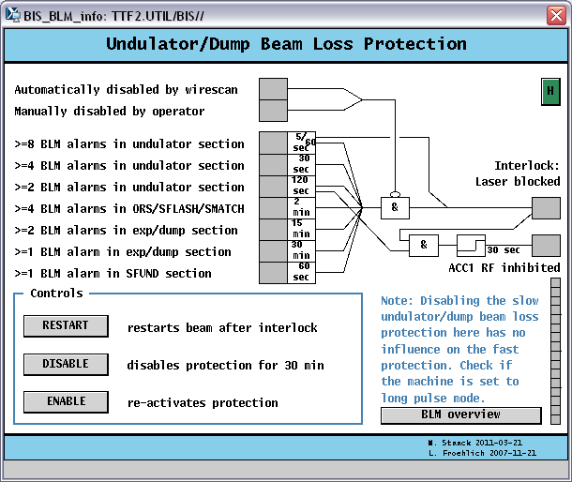
Action to be taken on losses
Predictable losses (insertion of screens, valves etc)
Action: reduce to short pulse mode or beam off (laser shutter)
Slow losses at undulators
Action: reduce allowed beam on time according to severity of losses (laser shutter)
Severe losses with long bunch trains
Action: stop beam as fast as possible
Method: fast optical element in injector laser beam (Pockels cell ~ns gate)
Reaction time (mostly cable length) 3 μs

Slide 17
Problems occurring when switching off beam
RF Gun off
Switch off is fast (within 2 μs)
Thermal effect: it takes more than 20 min to recover
ACC1 (or other modules off)
Slow decay time of field ~500 μs:
darkcurrent of rf gun is lost during ramp down and triggers additional losses
Laser:
Laser shutter: slow (~second)
Laser Pockels cell: fast (~ns)
Problem: Pockels cell before booster amplifier → thermal effects in amplifier and most important in frequency conversion stage (IR → green → UV)
Restart only possible after warm up ~200 seconds

Slide 18
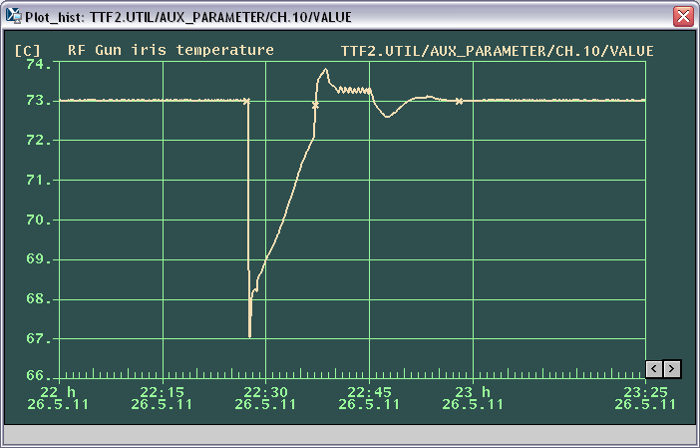
RF gun trip
RF switched off (klystron 3 trip) at 22:27 -> 23:01 h temperature stable again: 30 min

Slide 19
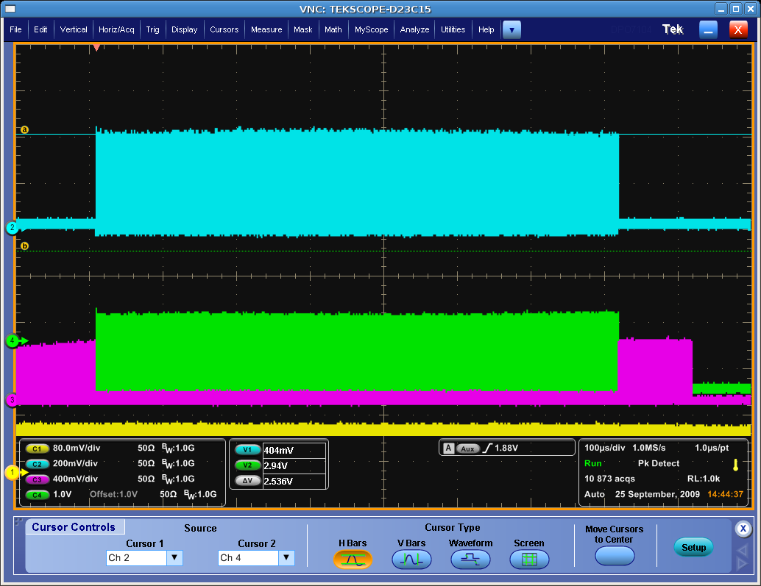
Effect of MPS trips on laser 2
Laser 2 runs with flat train, 3 MHz, 800 us length
Photodiodes:
UV (262 nm)
Green (532 nm)
IR (1047 nm)

Slide 20
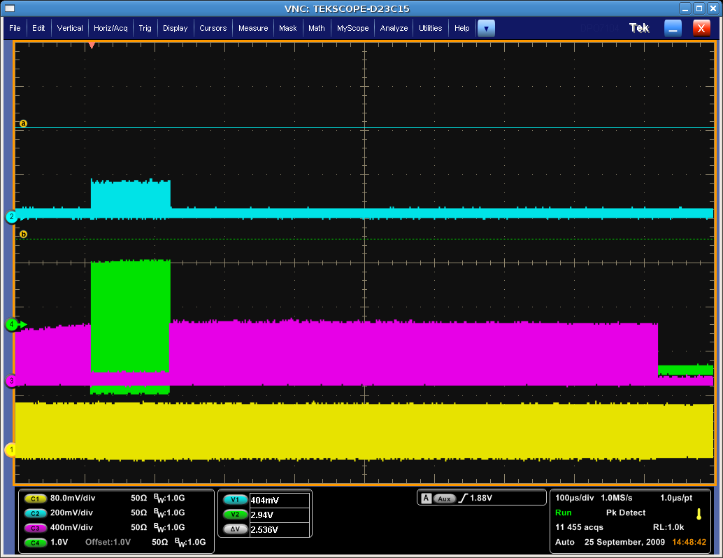
MPS sends a trip to the laser Pockels cell
UV out decreases by a factor of 2 or so
Photodiodes:
before
UV (262 nm)
now
Green (532 nm)
IR (1047 nm)

Slide 21
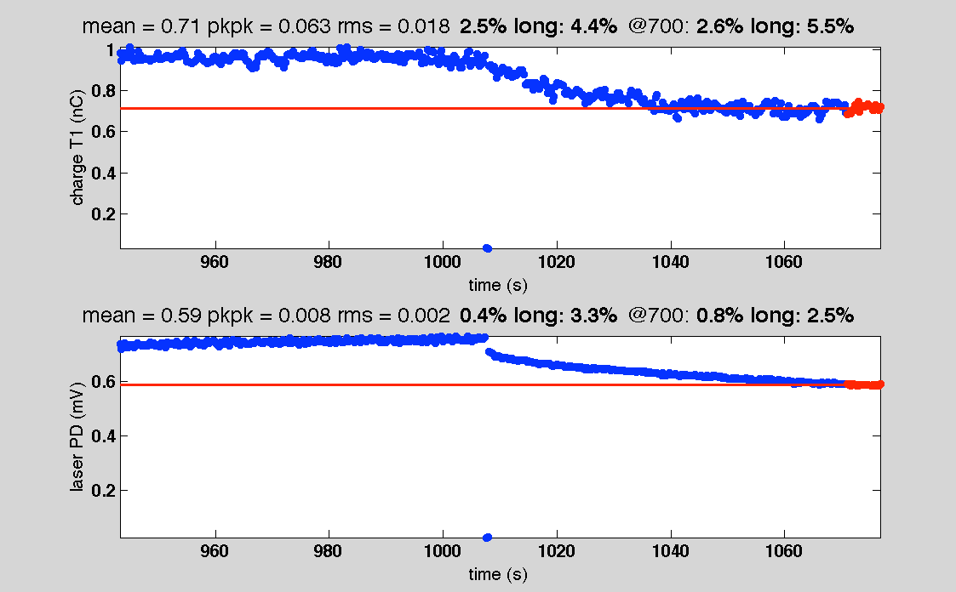
BBO transient and relaxation
Old BBO (with increasing damage)
Clear transient, relaxation ~200 sec, determined by the BBO temperature stabilization system
Charge step 30 %
Transition 1 → 30 bunches

Slide 22
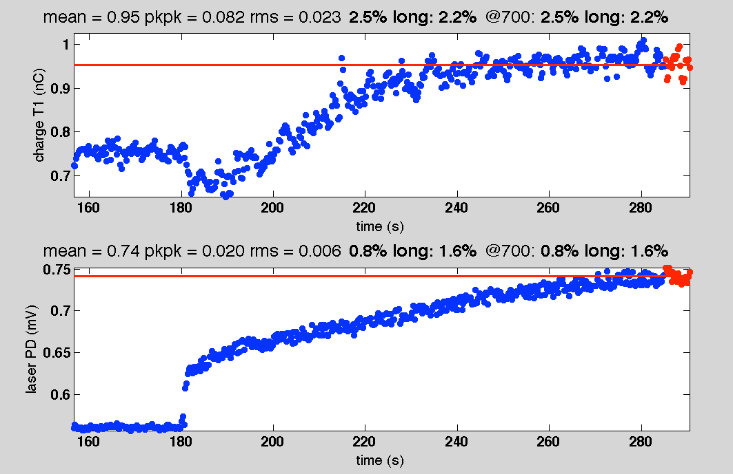
BBO transient and relaxation
Old BBO (with increasing damage)
Charge step 30 %
Transition 30 → 1 bunches

Slide 23
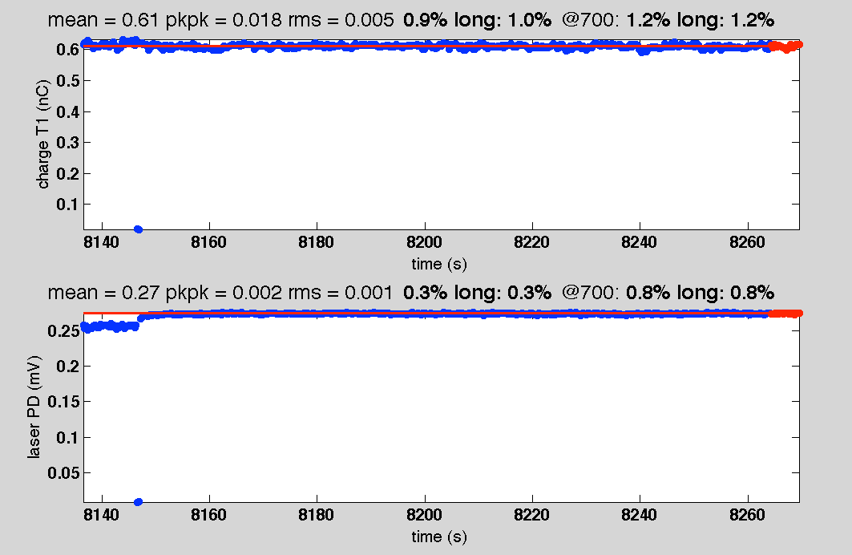
BBO transient and relaxation
New BBO (no damage)
Effect is much reduced
Transition 1 → 30 bunches

Slide 24
Effect of MPS trips on laser 2
Following an MPS trip signal to the pulse train
The UV energy decreases by more than a factor of 2 due to a phase mismatch in the BBO
Tuning the BBO would bring the energy back
If one now switches back to a long train, the energy would not recover immediately
It requires a couple of minutes to stabilize before the initial energy is back
Due to heat absorption in the BBO crystal (also due to damages in the crystal)

Slide 25
Instabilities after a trip
Instabilities induced by a simple trip somewhere in the train
A cut in the bunch train causes changes of temperature load on
RF to modules (transition in beam loading)
Laser: since we cut before last amplifier, load change effects the laser stability as well, most important conversion into UV
Transition to stable state may take a few 100 seconds
A change or fluctuation in beam loading causes LFF algorithms to react and to adapt to the new situation → this may take a few shots as well
These effects together may lead to a catastrophic failure (burst of trips which can only be cured by operator action), since wrong beamloading and badly adaption (cause eg by temperature effects) cause losses which themselves induce more instabilities and so on

Slide 26
What could we do?
What one typically does by hand:
relax some key interlocks (TPS/some BLMs) in order to let the system stabilize without cutting into the train
Let LFF and temperature stabilize long pulse train
Than put the hard threshold back
Keeping fingers crossed, that the beam stays like this the next hours

Slide 27
Issues to solve – besides the TPS upgrade
Reduce temperature effects
Laser: different switch off technique (UV kicker?) wait for stabilization before release
Kickers to intermediate dumps (?)
Stabilize heat load on waveguides and couplers (heaters)
Adaptive thresholds
Carefully evaluate BLM thresholds to allow adaptation
Redesign of beamline with larger acceptance and or revaluate BLM positions or thresholds
Even with a the best beam and even with single bunches, we fight with losses: a design issue?

