Slide 1
The LHC RF
operation with beam
M.E.Angoletta, L. Arnaudon, P. Baudrenghien, T. Bohl, A. Butterworth, F. Dubouchet, J. Ferreira-Bento, D. Glenat, G. Hagmann, W. Hofle, M. Jaussi, P. Maesen, T. Mastoridis, J. Molendijk, J. Noirjean, A. Pashnin, D. Stellfeld, D. Valuch, U. Wehrle, F. Weierud
LLRF 2011, Desy
P. Baudrenghien CERN-BE-RF

Slide 2
Outline
The way it was intended to work
The way we operate it
Experience with beam
Coping with the nominal single-bunch intensity
RF noise
Transient beam loading compensation
Longitudinal emittance growth
Bunch profile
Surviving a klystron trip
Longitudinal stability
The (near) future
Conclusions

Slide 3
The way it was intended to work

Slide 4
RF challenge
The LHC is a high-current collider (>0.5 A DC nominal )
The high-current is a challenge: The Cavity impedance must be reduced by order of magnitudes to keep the beam stable and control transient beam loading
The lifetime in collisions is another challenge: RF noise must be minimized
Fortunately the design was good…
Low R/Q Superconducting Cavities are used for their low impedance for a given accelerating voltage
Cavities are single-cell, each with a private klystron. That gives much flexibility for improving performances using LLRF loops
Movable coupler allow for high bandwidth when needed (damping of injection transients) and high voltage during physics

Slide 5
Cavities
Two independent rings
8 RF cavities per ring at 400.790 MHz
Super Conducting Standing Wave Cavities, single-cell, R/Q = 45 ohms, 6 MV/m nominal (34 cm gap)
Conditioned to 2 MV
Movable Main Coupler (20000 < Q_{L} < 80000)
Mechanical Tuner range = 100 kHz

Slide 6
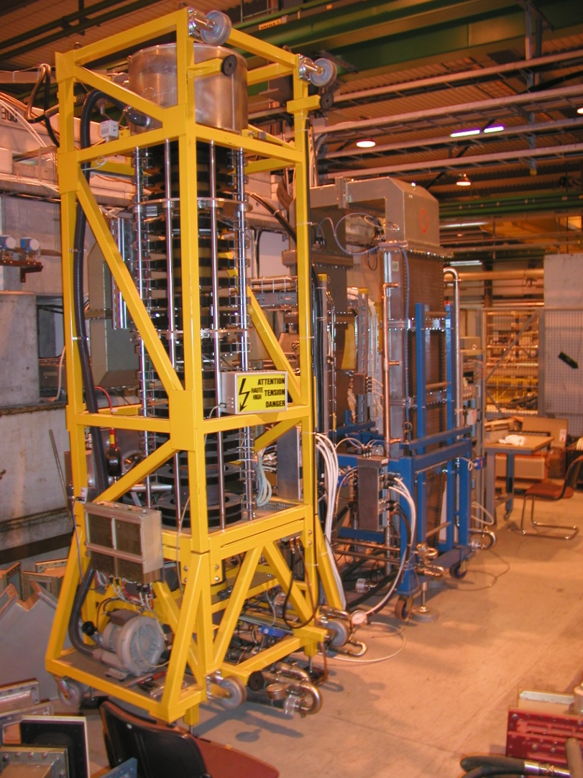
Klystron
1 klystron per cavity
330 kW max (58 kV, 9 A)
130 ns group delay (~ 10 MHz BW)
In 2010 and 2011 the DC settings have been reduced to 50 kV, 8A to protect the collectors
This results in 200 kW max RF power

Slide 7
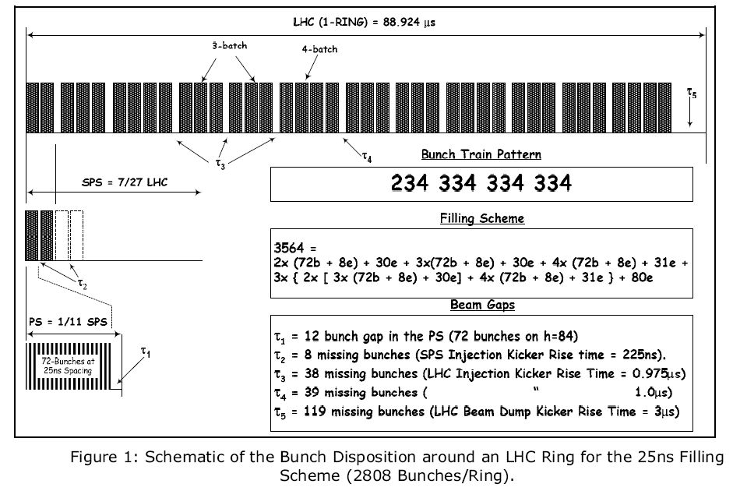
Beam structure
It takes 12 SPS cycles to fill one LHC ring
The SPS receives 2 to 4 batches from the PS, with each batch containing 72 bunches
Nominal LHC bunch pattern. Notice the 3 μs long gap for the risetime of the beam dump kicker and the ~1 μs long gaps for the risetime of the LHC injection kicker. Shorter gaps (225 ns long) are needed to accommodate for the risetime of the SPS injection kickers.
There is much flexibility with the injector chain and the RF must accommodate with it.

Slide 8
Transient Beam Loading during filling
During filling, the field in the empty buckets is perturbed by the beam in the filled buckets
Q=60000, 0.5 A DC -> each cavity presents a 2.7 MΩ impedance at resonance -> 2.7 MV beam induced voltage compared to 2 MV RF voltage (per cavity)
In the case of optimum detuning for the average beam current, and without compensation, the peak phase modulation on the RF voltage caused be a beam gap is [Boussard]
This effect is minimized by using superconducting cavities: Low R/Q (45 Ω) and high voltage
During filling, worst case is 50% duty cycle I_{b}, t_{gap}~50 μs and we get 80 degrees phase modulation for 0.5 A RF current and 1 MV/cavity
This causes an injection phase error if injection phase is kept constant, and then emittance blow-up through filamentation
Decision: Keep voltage constant over one turn, during filling. Strong RF feedback
[Boussard] D. Boussard, RF Power Requirements for a High Intensity Proton Collider, PAC, San Francisco, 1991

Slide 9
Modulation of collisions point
During physics phase modulation on the RF voltage causes displacement of the collision point
With the nominal scheme, the longer gap is the 3 μs long abort gap and it causes a maximum displacement of the collision vertex by 3 mm (1 A RF current, 2 MV/cavity)
Symmetry limits the effect in ATLAS and CMS
So we could let transient beam loading phase-modulate the Cavity voltage during physics and we will modulate the voltage set-point accordingly in the future (2012). That will save klystron power
In 2010 and 2011 we kept the voltage constant (amplitude and phase) over one turn

Slide 10
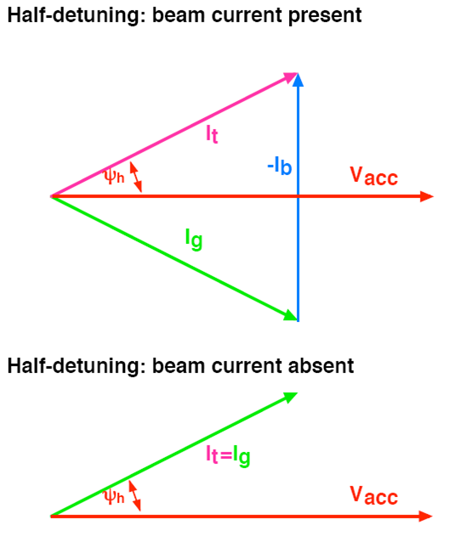
Half detuning
For a constant RF voltage (amplitude and phase), the klystron demanded power will be different in the beam-on segments and in the no-beam segment
This power depends on the cavity tune. The “Half detuning” scheme makes the demanded power equal during beam and no-beam portions
Once the half-detuning policy is enforced, klystron power is uniquely dependent on the RF voltage, beam current and cavity loaded Q

Slide 11
The way we operate it

Slide 12
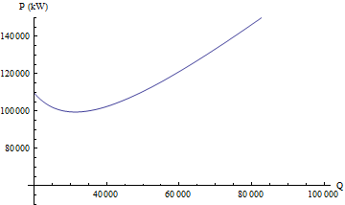
Injection
Needed klystron power vs. QL
At injection a low QL is favorable as it limits the power needed to damp injection errors (fast modulation of the cavity phase) via the Main Phase Loop or the longitudinal damper. We use QL=20000
The voltage needed is small: The injector provides 0.5-0.7 eVs bunches (1.5-1.7 ns 4-sigma bunch length) to be captured in the 400 MHz system. The matched voltage is ~ 3 MV
In 2010 we used 3.5 MV total. The LHC Beam Loss Monitors see radiations from the injection septa and that would trigger a beam dump on occasion.
In 2011 we use 6 MV total. Capture losses are below 0.5 %
For nominal beam (25 ns spacing, 1.1E11p/bunch, 1.2 ns 4-sigma length, fb=0.75), with QL=20000 and 0.75 MV/cavity, we have a klystron power = 110 kW, for -6.4 kHz detuning
Filling takes 15-30 min

Slide 13
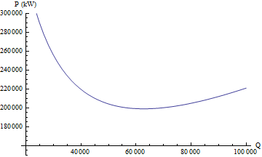
Physics
Needed klystron power vs. QL
Physics is performed at 3.5 TeV/beam (design figure is 7 TeV)
Lifetime is limited by Intra-Beam Scattering (IBS) and beam-beam effects. To limit transverse emittance growth (and resulting drop in luminosity), the longitudinal emittance must be maximized
We use 1.9 eVs longitudinal emittance at 3.5 TeV (design is 2.5 eVs at 7 TeV), in a 4.7 eVs bucket (12 MV total).
The 4-sigma bunch length is 1.2 ns at the beginning of physics
For nominal beam (25 ns spacing, 1.1E11 p/bunch, fb=0.75), with QL=60000 and 12 MV total (1.5 MV/cavity), we have a klystron power = 200kW, for a detuning of -3.2 kHz
We stay in Physics for 10-15 hours … if the beam is not dumped accidentally

Slide 14
Ramping
Ramping must make the transition between 0.5 eVs (injection) and 1.9 eVs (physics)
Increase of emittance during the ramp is essential for longitudinal stability
We raise the RF voltage linearly through the ramp, from 6 MV to 12 MV
We keep the bucket filling factor (ratio of emittance to bucket area) constant using longitudinal emittance blow-up
The couplers are moved from the QL=20k position to QL=60k at the start of the ramp. They remain at 60k through the ramp and in physics
The ramping takes 11 min

Slide 15
Experience with beam…
1. Coping with the nominal single-bunch intensity

Slide 16
Ramping nominal bunch intensity without blow-up
Inject 1.1E11, 1.2-1.3 ns long, 0.3-0.4 eVs
Capture with 5 MV (matched voltage ~ 3 MV)
Raise voltage to 8 MV before start ramp. Ramp with constant 8 MV
Very unstable. The bunch shrinks down to < 0.5 ns and we lose Landau damping
May 15th2010. First attempt to ramp nominal intensity single bunch. Bunch length during ramp. The longitudinal emittance is too low (<0.4 eVs). The bunch becomes unstable

Slide 17
Single-bunch longitudinal stability
Broadband stability criteria
The offending impedance is the 0.06 Ω inductive impedance of the chamber
The RHS is proportional to
Without blow-up the threshold quickly decreases during the acceleration ramp
With a blow-up that keeps bunch length constant (for example), the threshold increases linearly with the RF voltage
See: E. Shaposhnikova, Longitudinal Beam Parameters during acceleration in the LHC, LHC Project Note 242, Dec 2000

Slide 18
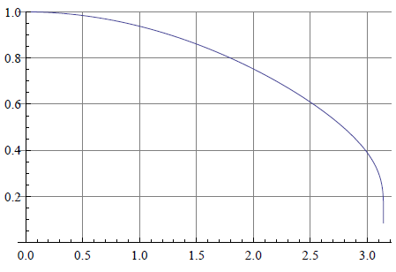
Longitudinal emittance blow up
Phase noise spectrum
Inspired from the method used in the SPS [Tuckmantel]
We apply Phase noise in the cavity field
We use a Rectangular Phase Noise Power Spectral density that excites only the core
hit: 6/7 f_{s} < f < 1.1 f_{s}
corresponds to a 1.20 ns window in the core
and follow f_{s} along the ramp
from Hz to Hz
Algorithm to adjust the amplitude of the excitation x_{n} from a measurement of the instantaneous bunch length (mean) L_{n} and comparison to target L₀
Target bunch length L₀ set at 1.2 ns
Part of the bunch excited
[Tuckmantel] J. Tuckmantel et al., Study of Controlled Longitudinal Emittance Blow-up for High Intensity LHC beams in the Cern SPS, EPAC 08, Genoa

Slide 19
Functions
Excitation spectrum follows the synchrotron frequency
The gain is increased during the ramp as the sensitivity to phase noise decreases
The target length is increased at the beginning of the ramp to avoid undershoot
Synchrotron freq plus lower and upper frequency limits of the flat noise PSD
Algorithm gain g during ramp
Target bunch length during ramp

Slide 20
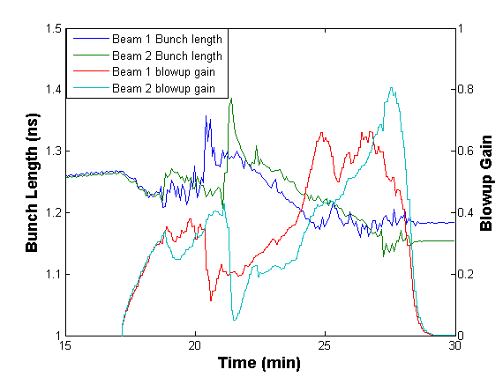
Ramping…
Bunch length (mean over 1380 bunches/beam) and amplitude of the phase noise excitation during the ramp.

Slide 21
Reproducibility
Bunch length evolution (mean over 1380 bunches/beam) for a few ramps

Slide 22
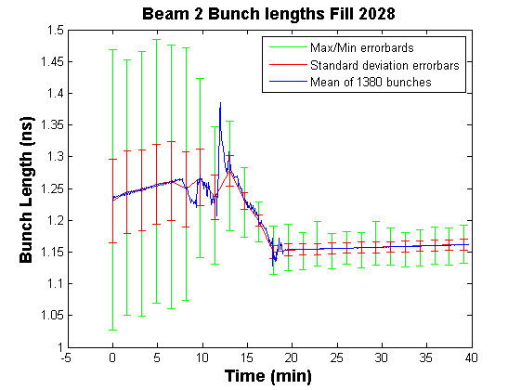
Bunch length equalization
Statistics on bunch length (mean, min, max and standard deviation errorbars) during the ramp

Slide 23
Experience with beam…
2. RF noise

Slide 24
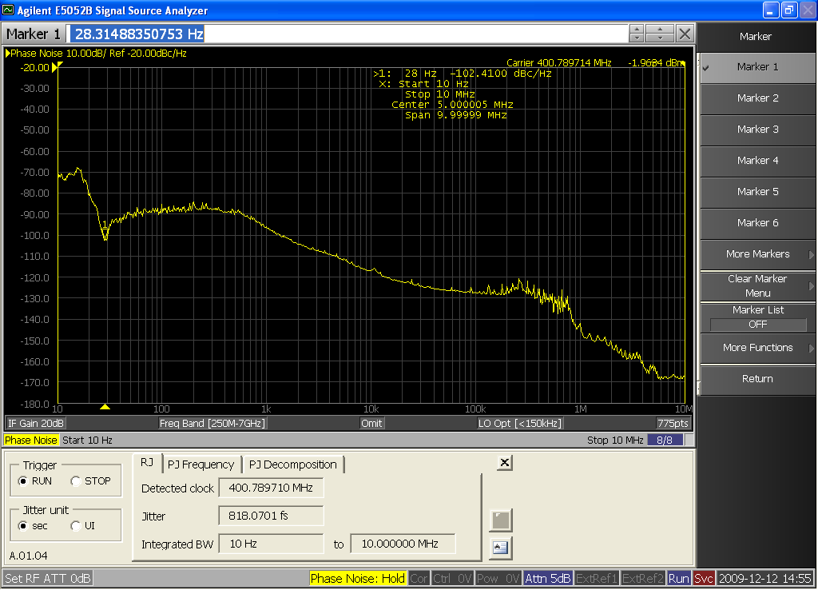
Phase noise
-125 dBc/Hz noise floor
SSB Phase noise (in dBc/Hz) of the Vector Sum of the eight cavities B2 with beam at 3.5 TeV.
800 fs jitter integrated from 10Hz to 10 MHz
The beam samples the RF field at the revolution frequency. It therefore reacts to the phase noise in all synchrotron sidebands (aliasing) -> we must sum noise contributions over all n frev +- fs bands
We measure a noise level of ~ -125 dBc/Hz from 10 kHz to 500 kHz.
For comparison the Tevatron RF phase noise is -106 dBc/Hz [Zhang]
Four-sigma bunch lengthening caused by RF noise ~ 2.5 ps/h
[Zhang] X. Zhang et.al., Generation and Diagnositc of uncaptured beam in the Fermilab Tevatron and its control by electron lenses, Physical Review Special Topics Accelerators and Beams, 2008

Slide 25
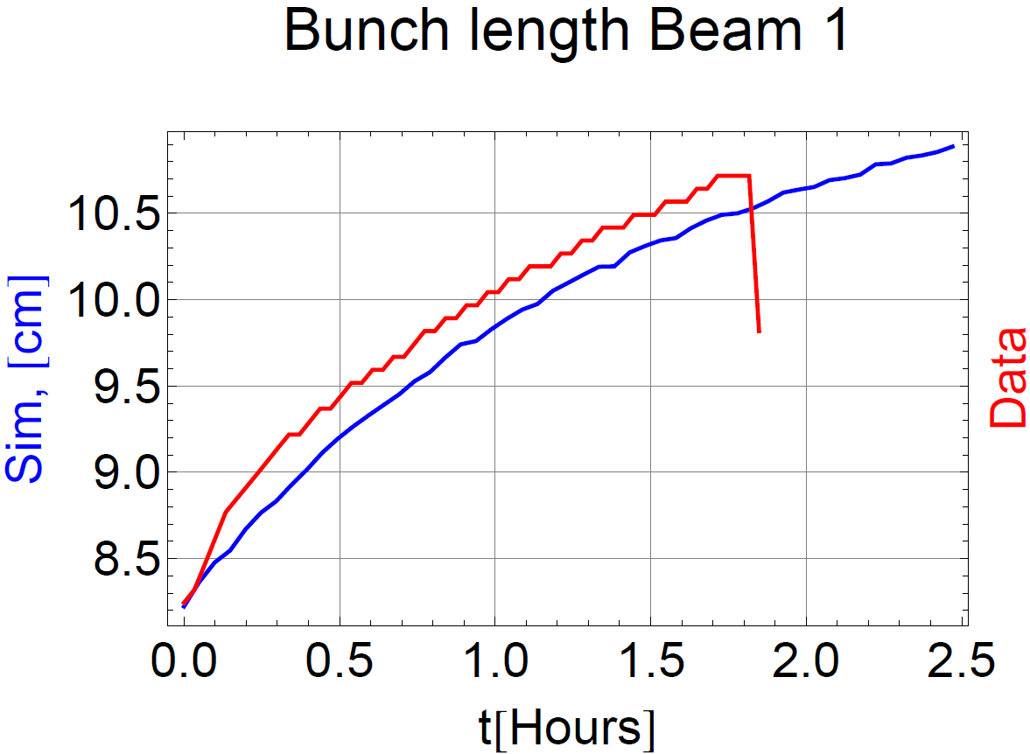
Intra-Beam Scattering
IBS acts in all the three planes (horizontal, vertical and longitudinal)
It is the process that affects luminosity lifetime the most
In the longitudinal plane it causes (4-sigma) bunch lengthening with a rate of ~30 ps/h at the start of physics, down to below 10 ps/h after 10 hours of physics
The RF noise effect is much weaker (< 2.5 ps/h)
450 GeV conditions. Measured bunch lengthening compared to an exclusively IBS model. Very good fit (except for the first 10 min). Courtesy of T. Mertens, CERN/BE/ABP.
More on RF noise in Themis talk RF System Models and longitudinal beam dynamics
on Wednesday

Slide 26
Experience with beam…
3. Transient beam loading compensation
3. Transient beam loading compensation

Slide 27
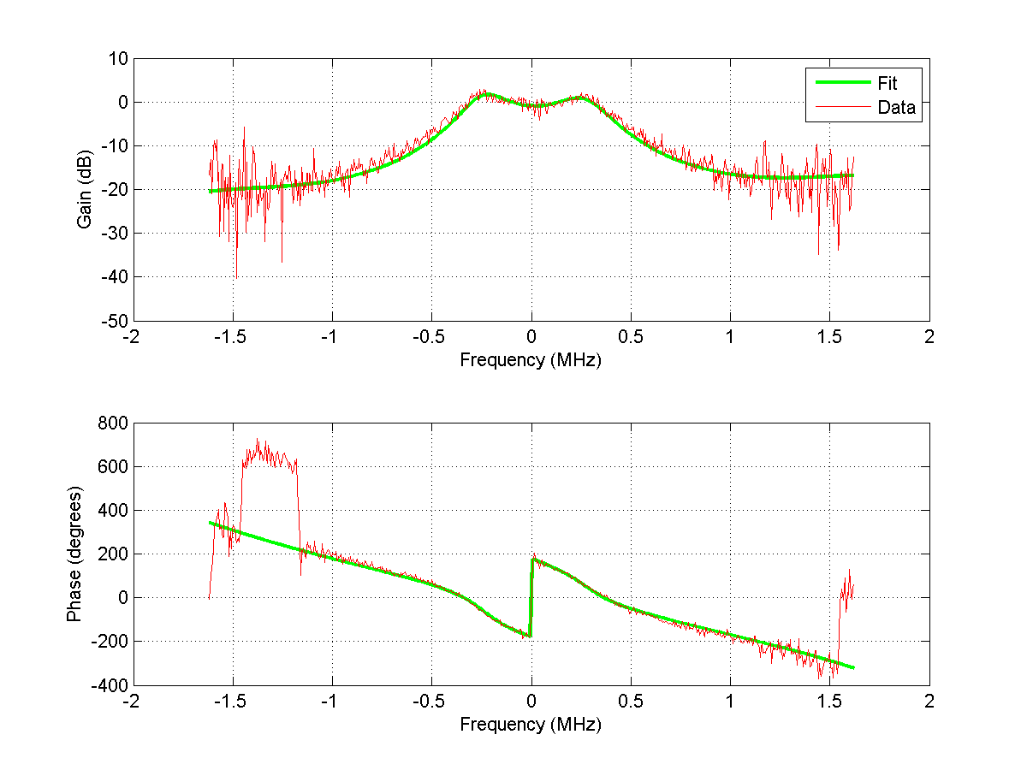
RF feedback
Each cavity has a strong RF feedback. The loop delay has been kept minimal to allow for an high gain (650 ns, including klystron group delay and LLRF)
The cavity QL is reduced to ~600 (700 kHz 2-sided BW), independent of the coupler settings:
Open Loop gain ~20 for QL=20000
Open Loop gain ~ 60 for QL=60000
In physics (QL=60000), the cavity impedance is effectively reduced from 2.7 MΩ down to 45 kΩ
A 1-T feedback with 20 dB gain will further reduce the impedance in a 1.5 MHz 2-sided BW. It is not operational yet
RF feedback closed loop response
More on the 1-T fdbk in Themis talk LHC Matlab tools and 1-Turn feedback commissioning
on Tuesday

Slide 28
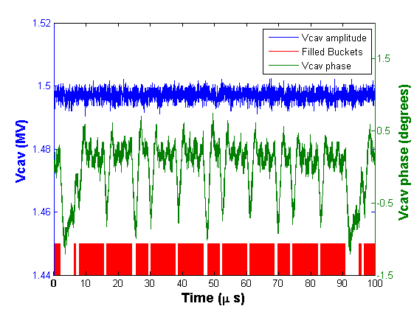
Cavity field with 1380 bunches
~ 0.5% pk-pk amplitude variation
~ 0.3 A DC current
(LHC nominal = 0.55 A)
~ 1 degree pk-pk phase variation
3.5 TeV conditions: Amplitude and phase of the cavity field over one turn, with 1380 bunches (55% nominal intensity).

Slide 29
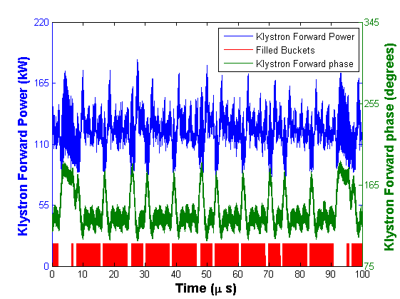
Klystron current with 1380 bunches
~ 0.3 A DC current
(LHC nominal = 0.55 A)
The power does not change much between beam and gaps. But significant peaks are observed at the transitions
60 degrees phase change between beam and gaps
3.5 TeV conditions: Klystron power and phase of the klystron forward current (measured in the waveguide) over one turn, with 1380 bunches (55% nominal intensity).

Slide 30
Experience with beam…
4. Longitudinal emittance growth

Slide 31
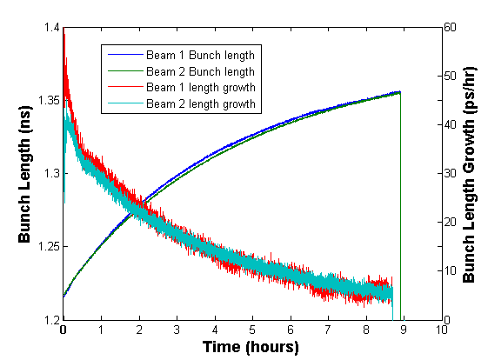
Bunch length evolution in Physics
A typical fill: 1380 bunches. 3.5 TeV conditions with fixed 12 MV RF. The bunch length starts at 1.22 ns and, after almost 9 hours of physics, ends-up at 1.35 ns. The bunch length growth is mainly due to IBS. It decreses from 30 ps/h to 8 ps/h. The first 30 min after collisions are always very perturbed (scraping of the off-momentum particles, probably due to beam-beam tune shift)

Slide 32
Experience with beam…
5. Bunch profile

Slide 33
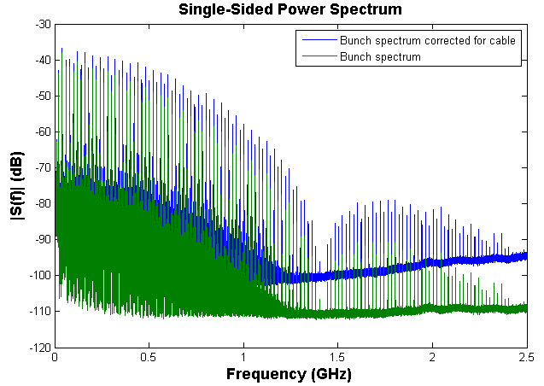
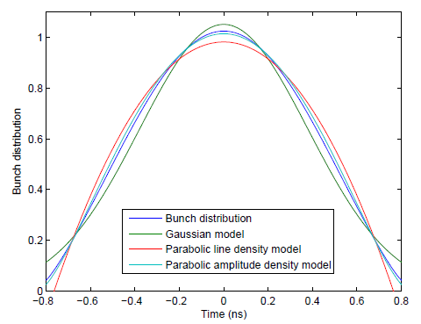
Bunch profile in physics
Left: Bunch spectrum measured with a 3 GHz BW Pick-Up, and a 500 m long 1 5/16” flexwell. In blue, data after correction for the cable loss. 1380 bunches in physics, 50 ns spacing.
Rigth: Reconstruction of the average longitudinal bunch profile by inverting the corrected spectrum. Comparison with a few classic shapes show a good match with the Parabolic Amplitude Density model

Slide 34
Experience with beam…
6. Surviving a klystron trip and RF performances

Slide 35
Klystron trip
When a klystron trips
The beam induced voltage in the idling cavity may lead to a quench (if it exceeds the 2 MV conditioning level)
The reverse power extracted from the beam, and dissipated in the load may exceed its rating (rated 300 kW CW)
The first limitation came from the load power
When we exceeded 1100 bunches, mid-June 2011, we linked the klystron surveillance to the beam dump system
From then on, the trip of a single klystron would dump both beams

Slide 36
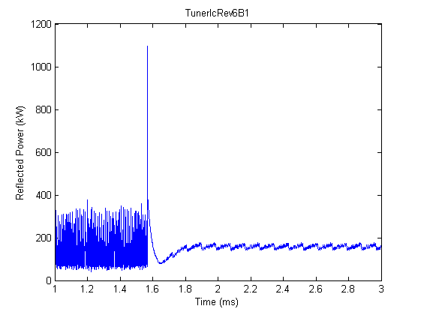
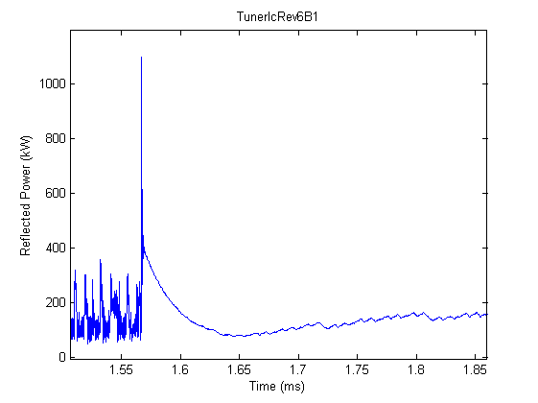
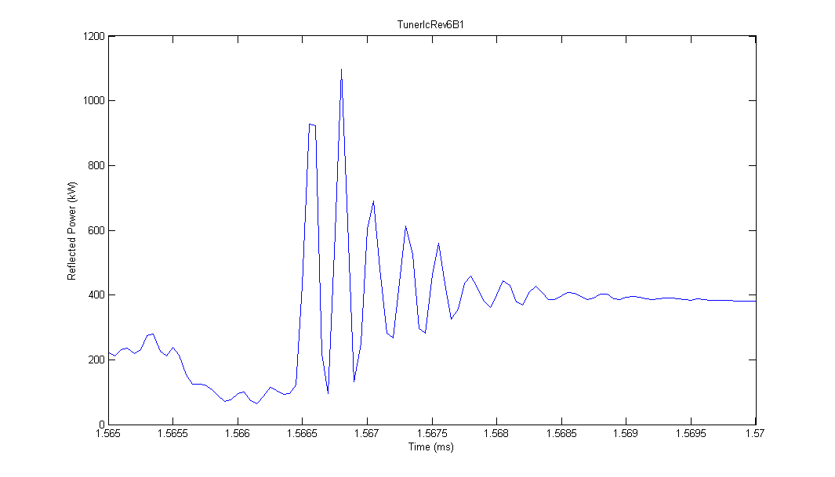
Klystron trip with 1100 bunches (June 2011)
We observe a very large spike peaking at 1.1 MW, followed by a decaying transient with 20-30 microsec time constant, then a slow decay to reach the steady level
The 20-30 μs time-constant decay starts at 400 kW level and disappears in ~50 μs. This power spike is the dumping of the cavity stored energy (~20 J), not a large energy. Frightening peak but it cannot damage the coupler.
The 1.1 MW peak actually is a ~4 MHz ringing that decays in 2 microsec. It corresponds to the discharge of the klystron bunching cavity (around 405 MHz). Again frightening but very short -> no damage
The slow drift from the ~180 kW to the steady 110-130 kW is probably caused by circulator match transients as the power flow is inverted. To be confirmed. Worrying because it lasts long enough to damage coupler.
The two spikes are not an issue. Only the “baseline” can damage coupler or load when increasing intensity

Slide 37
Fills terminated by an RF fault
From July 14th till Oct 14th , the LHC had 84 Physics fills
Of which 12 were dumped by the RF
3 on Klystron Filament Current interlock
2 on Loss of Cryo Conditions
1 on Klystron Power Supply fault
1 on HOM Temperature too high. Probably a false alarm
1 on Controls Communication lost
1 on Klystron Vacuum
3 not documented sufficiently to be identified

Slide 38
Experience with beam…
7. Longitudinal stability

Slide 39
Coupled-bunch instabilities
The growth rate and tune shift of coupled-bunch mode l (dipole only) can be computed from the cavity impedance
With ω=(p h+l) ω_{rev}+ω_{s}. For a cavity at the fundamental, only two terms in the above infinite sum are not negligible: p=1 and p=-1
The impedance Z(ω) is modified by the LLRF loops. The above equation can be used to analyze different configurations
Stability is preserved if the growth rate is significantly smaller than the tune spread:
With L the 4σ bunch length

Slide 40
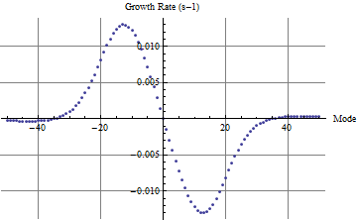
3.5 TeV conditions
We consider 1.2 ns bunch length (4 sigma) and nominal beam current 0.58 A DC, Q=60000, 14 MV
The synchrotron frequency is 31 Hz. Δω_{s}/4=7 s⁻¹
With RF feedback only, the maximum growth rate is 0.013 s⁻¹ per cavity (and the max tune shift 0.07 Hz) while the tune spread is 4.4 Hz. The corresponding mode number is ~ -12.
So the 8 cavities will give a total growth rate of 0.1 s⁻¹ that is a good order of magnitude below Δω_{s}/4=7 s⁻¹. GOOD!
If a cavity trips during physics, it sits, without impedance reduction, at the 3 kHz detuning. Its contribution to the growth rate jumps to 1 s⁻¹, with 1 Hz tune shift, still OK given Δω_{s}/4=7 s⁻¹
Growth rates for 1 cav at 3.5 TeV with nominal current and 14/8 MV
Conclusion: Very large stability margin

Slide 41
450 GeV conditions
More on growth rate estimation in Themis talk RF System Models and longitudinal beam dynamics
on Wednesday
1.5 ns bunch length (4 sigma) and nominal beam current 0.58 A DC, 4 MV , Q=20000
The synchrotron frequency is 46 Hz. The Landau damping Δω_{s}/4=16 s⁻¹
So the 8 cavities will give a total growth rate of 1.6 s⁻¹ or 0.8 s⁻¹ (10 kHz or 5 kHz detuning), that is still comfortably below the 16 s⁻¹Landau damping. Notice however that the margin is reduced compared to 3.5 TeV. The 1-T feedback would help at injection
If a klystron is out-of-order, we would park the corresponding cavity at the maximum (~100 kHz) offset. The resulting growth rate is comparable to the 16 s⁻¹Landau damping
Conclusion:
Cavity trip towards the end of filling is fatal at nominal intensity (with half detuning). OK at half nominal
Should we modify the Tuning system (Half-Detuning algorithm) during filling?
Refill with 1 line off not possible much above ½ nominal

Slide 42
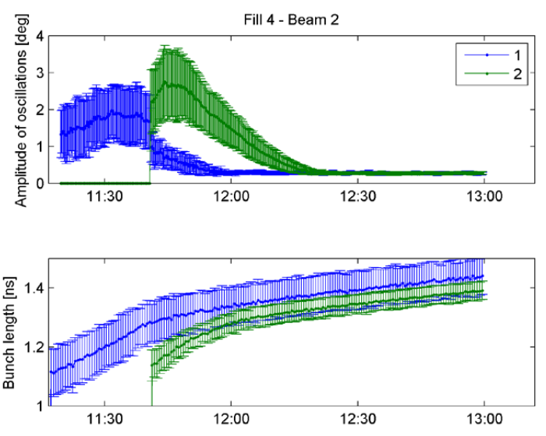
Long-lasting dipole oscillations at injection
At the injection of each batch we observe long lasting, small amplitude (1-2 degrees) dipole oscillations
The amplitude of these oscillations grow for ~ 10 min, then they are damped with a very long time constant (30 min)
In the first 10 min, the growing oscillations are causing fast longitudinal emittance growth
Injection of a 12b train followed by 36b.
Top: Amplitude of dipole oscillations (min, max, mean) .
Bottom: Bunch length (min, max, mean)

Slide 43
The (near) future
25 ns bunch spacing
Modulation of RF voltage
Longitudinal damper
Batch per batch blow-up

Slide 44
25 ns bunch spacing
In 2010 we have operated with 150 ns bunch spacing, reaching 360+ b/beam
Begin 2011 we spent a week “scrubbing” with 50 ns spacing at 450 GeV, then have operated with 50 ns for the rest of the year
We now experience with 25 ns. We have so far stored 700+ bunches at injection energy, and ramped 60b per beam. The issue is e-cloud. Scrubbing is hopefully the solution
For optimized luminosity the 25 ns spacing is not necessarily better
Injectors can do much better with 50 ns spacing (~ 30-40 % higher bunch intensity)
As luminosity scales linearly with the number of bunches, but quadratic with the bunch intensity (at constant transverse emittances), the 25 ns scheme does not have an evident advantage
Tests will continue with 25 ns and decision for the 2012 run will be taken during the shutdown
25 ns operation is more demanding for the RF, because of the higher beam current: In physics we need 200 kW RF, compared to the 140 kW with 50 ns

Slide 45
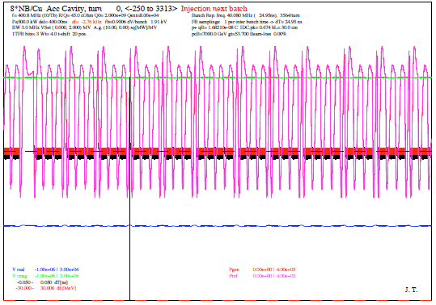
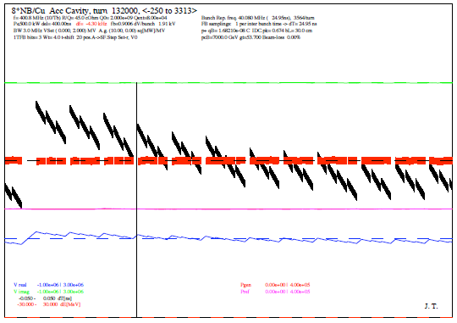
Modulation of the cavity field set point
Modulate the voltage set-point along the turn to minimize the power peaks required to compensate the transient beam loading
Was used at PEP-II
Results in less than +- 10 ps modulation of bunch spacing, and thus 3 mm maximum displacement of the collision vertex
Bunch phase (black bands) and energy deviations (red bands), klystron power (pink) , cavity voltage (I,Q) green and blue.
Left: The cavity phase is kept constant along the turn, resulting in large power transients
Right: The cavity phase is modulated along the turn. The bunches are not strictly equi-spaced, resulting in a lowered and constant klystron power
See J. Tuckmantel, Adaptive RF Transient reduction for High Intensity Beams with Gaps, EPAC 2006

Slide 46
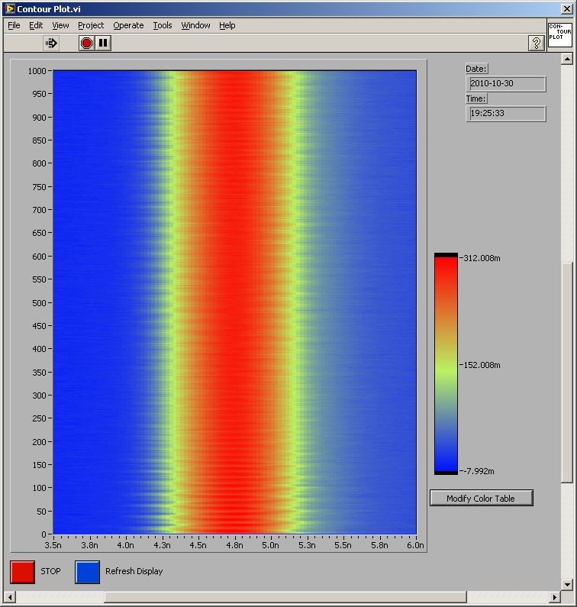
Longitudinal damper
The Main Beam Phase loop considers the average over all bunches. For the first injected batch, it will damp any phase or energy error via a proper modulation of the RF frequency
As more batches are injected, it considers the average only
Long Damper: Damp the injection phase/energy error batch per batch
In the LHC we could use the 400 MHz cavities as damper. We can change the RF phase in the 1μs gap between circulating and incoming batch
Each cavity can give a 50 kV step in the 1μs gap
With 8 cavities we can give momentum kick 0.4 MeV/c per turn (50 kV/cav)
Given the 46 Hz synchrotron freq, that is 100 MeV/c per synchrotron period (bang-bang regime)
At 450 GeV/c that is Δp/p = 2.2E-4
We can reduce the energy error by 1/3 bucket half height in 1 synchrotron period. GOOD
Oct 30, 50 ns spacing, 12 bunches per inj, injection transient 7th bunch 4th batch, 1 ms between traces, dipole oscillation (+- 100 ps, ~45 Hz frequency) lasting for 1 s with reduction by ~ 2 only

Slide 47
Batch per batch blow-up at injection
The transverse emittance grows much during the 15-30 min injection plateau, and that limits peak luminosity. It is believed to be caused by IBS
It could be limited if the longitudinal emittance is increased immediately after each injection
Strategy
Inject 0.5-0.7 eVs bunches and capture each batch (288 b) with 6 MV RF
Selectively blow-up the emittance of the last injected batch in the few tens of seconds between successive injections in one ring
That calls for a gating of the phase noise excitation in the 1 μs long gap between batches. Should be OK given the RF fdbk closed loop BW
How much to blow will be a trade-off between debunching (as we keep the RF voltage constant) and benefits in the transverse plane (reduced transverse emittance growth)
More on sophisticated phase noise excitation schemes in John’s talk An extended baseband network analyzer for the digital LLRF on Tuesday

Slide 48
Conclusions

Slide 49
A typical fill
Fill 2208, Oct 13,2011
Physics during ~14 hours, till the instantaneous luminosity was divided by ~2
Such a fill produces ~ 0.1 fb⁻¹ integrated luminosity for CMS and ATLAS
1380 bunches, 50 ns spacing 1.3-1.4E11 p/bunch at start physics

Slide 50
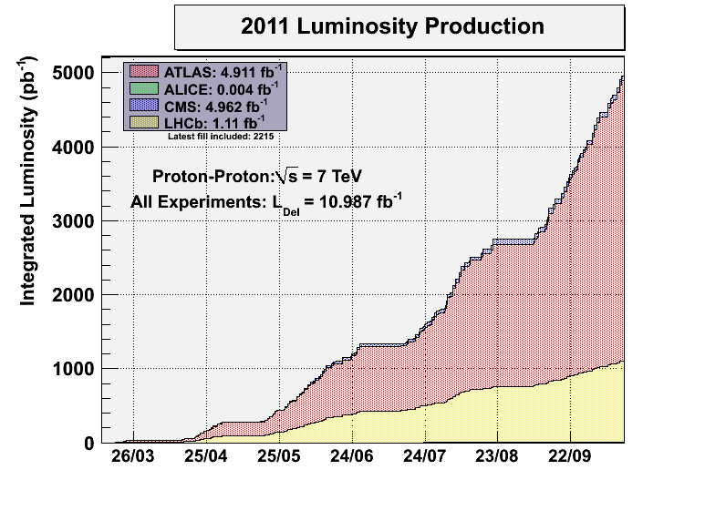
Integrated luminosity
Further increase in bunch intensity from the injectors comes with transverse emittance increase
Every 6 wks we have a 5-days MD block followed by a 5-days technical stop and re-starting
Cruising at 0.1 fb⁻¹ per fill, one good fill every ~30 hours…
Maximum nbr bunches (50 ns spacing) reached (1380)
By the end of the month (when we will revert to Pb-Pb physics), the LHC will have accumulated more than 5 fb⁻¹ integrated luminosity in both CMS and ATLAS. The target for 2011 was 1 fb⁻¹. To-day each fill produces ~ 0.1 fb⁻¹

Slide 51
Give us the Higgs….
…future will tell…
…but in the meantime…
thank you very much for your attention!

