Slide 1
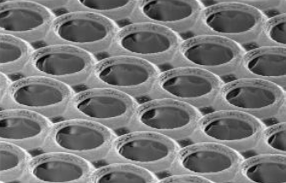


Pixelized gaseous detectors
Helmholtz Alliance “Physics at the Terascale”
4th Detector Workshop DESY 18.3.2011
Klaus Desch
University of Bonn

Slide 2
Motivation
Micro-structuring of semiconductor detectors led to breakthrough in
charged particle tracking → silicon strip + pixel detector
Q: Can gaseous detectors also benefit from extremely fine-grained readout?
A1: (for thin planar detectors)
diffusion of drifting electrons limits spatial resolution
→ typical diffusion coefficient D ~ o(100) μm/√cm
→ o(30) μm for single electron after 1 mm drift
+ average over o(10) electrons for a single tracklet
→ o(10) μm single point for a thin planar detector („GOSSIP“)

Slide 3
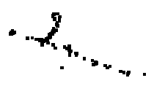
Motivation
Q: Can gaseous detectors also benefit from extremely fine-grained readout?
A2: (for long drift distances, e.g. TPC)
→ to first order no advantage over pad-based r/o for p-resolution but
- identify (and remove) short δ-tracks for track reconstruction
- clearly superior for double track resolution (dense jets...)
- lower occupancy → BG tolerance
- dE/dx by cluster counting
- (potentially simpler readout)
A3: (for x-ray photon identification, BG suppression, rare event searches)
→ clear distinction of photons / m.i.p.s / alphas / ...
→ reconstruction of photoelectron „tracks“

Slide 4
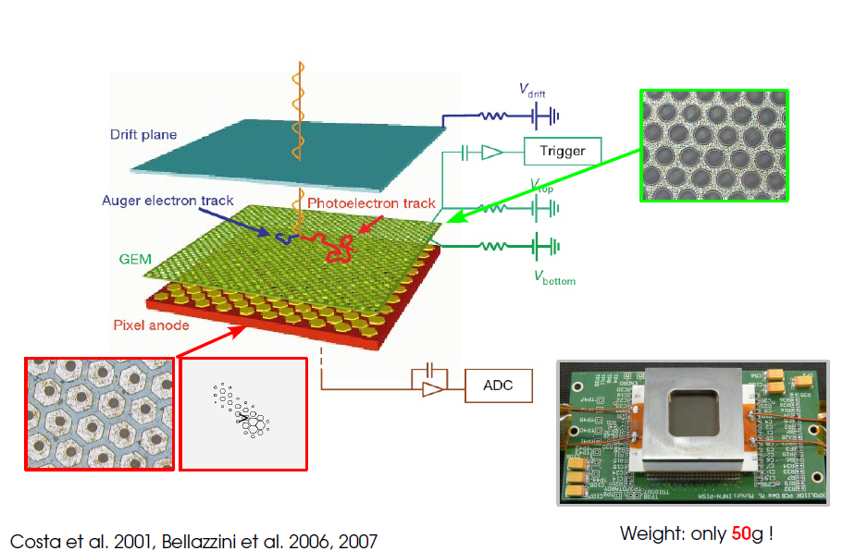
Detector Technologies
Clearly, micro-structured readout needs micro-structured gas-amplification
MPGDs (GEMs, Micromegas)
Pioneering example: Bellazini et al (X-ray polarimeter using 1 „special“ GEM +
dedicated CMOS pixel chip)

Slide 5
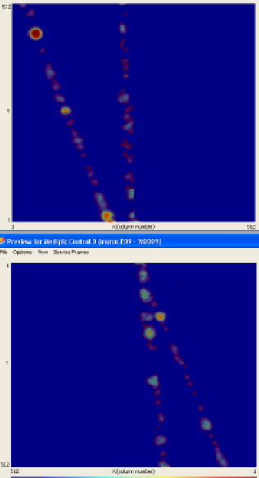
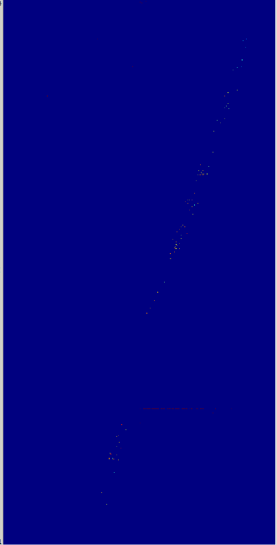
Detector Technologies
First „large area“ ( 2.8 x 5.6 cm², 500k „channels“) tracking devices (EUDET):
3-GEM
8 Timepix
InGrid
8 Timepix
NIKHEF
Saclay
Twente
Bonn
Freiburg

Slide 6
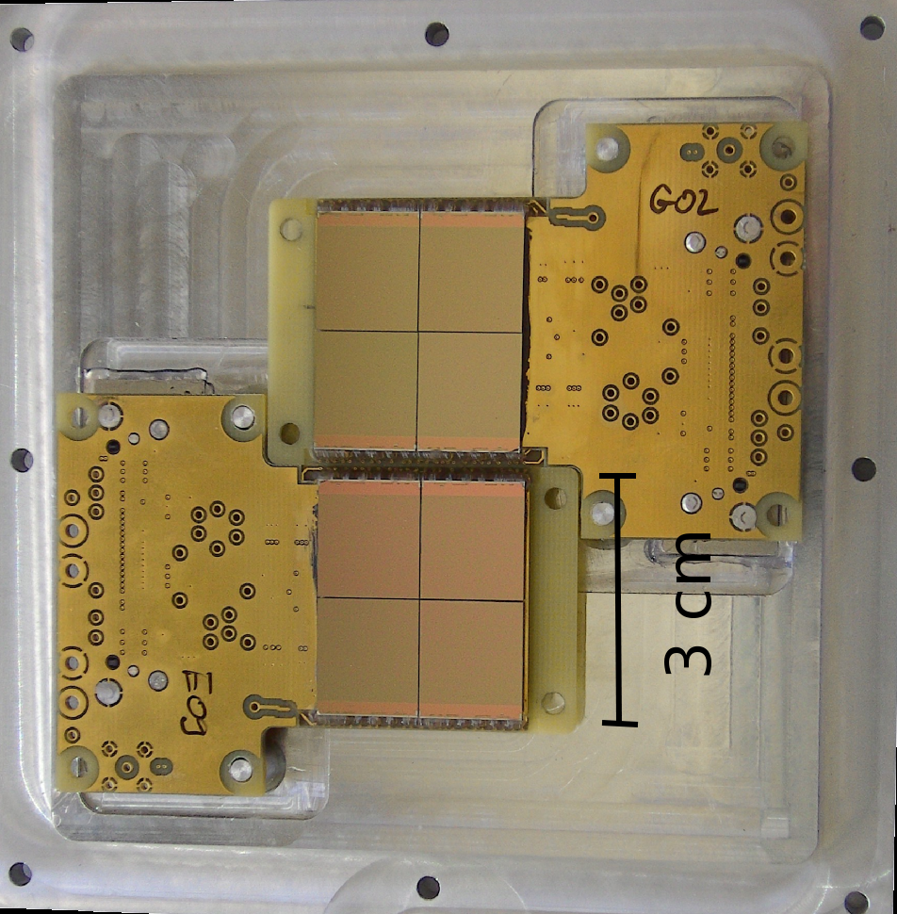

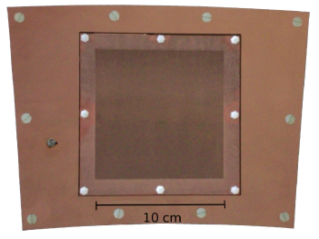
Detector Technologies
3-GEM
8 (2x4) Timepix
InGrid
8 Timepix „Octopuce“
underneath
a 3-GEM
stack
NIKHEF
Saclay
Twente
Bonn
Freiburg

Slide 7
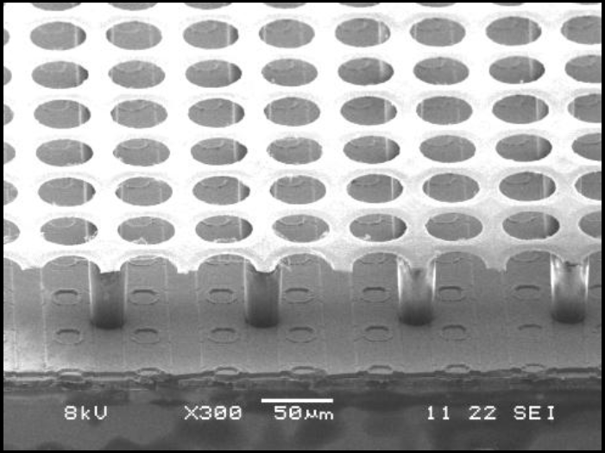
Detector Technologies
Both GEMs and InGrids work nicely
Major GEM advantage: amplification field(s) seperated from CMOS electronics
Major GEM disadvantage: diffusion in GEM stack spreads charge over
o (100) pixels → need (very) high gain
Look at InGrids
= a micromegas grid produced
through postprocessing
on a CMOS substrate
(so far, the Timepix chip)
pioneered by
NIKHEF + Twente U. (Mesa+)

Slide 8
How is it done?
1. Preliminary analysis and cleaning of chip surface
2. Deposition of protection layer
3. Deposition (spin coating) of
SU-8 (50 μm polymer photoresist)
4. Exposition and baking of SU-8
5. Deposition of thin Al film (critical)
6. Patterning of Al to form the Grid
Chip
7. Development of SU-8

Slide 9
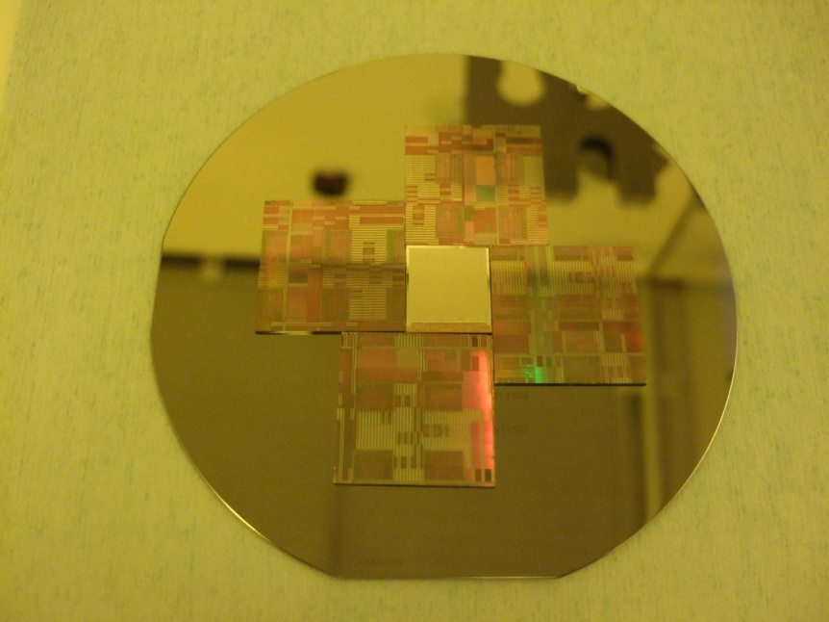
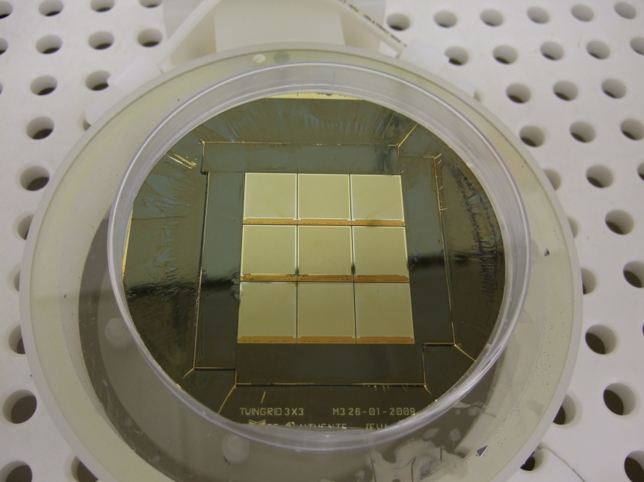

Single chips / 3x3 chip squares at Twente
facilities at Twente U can (at most) handle 4 inch wafers
practically at most 3x3 chips can be handled at once
several days of processing (+ working) time for one run
Try to find a place which can manufacture Ingrids on a 8 inch wafer scale
Best candidate currently: (Berlin)

Slide 10
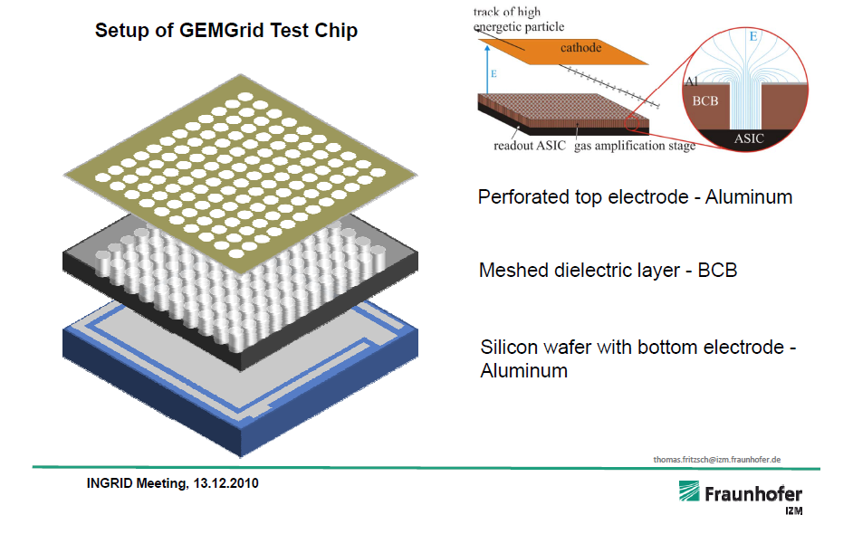
1st attempt at IZM: „GEMGrids“
Technically simpler – BCB can be etched
Avoid cross-linking of photo-resist during Al sputtering

Slide 11
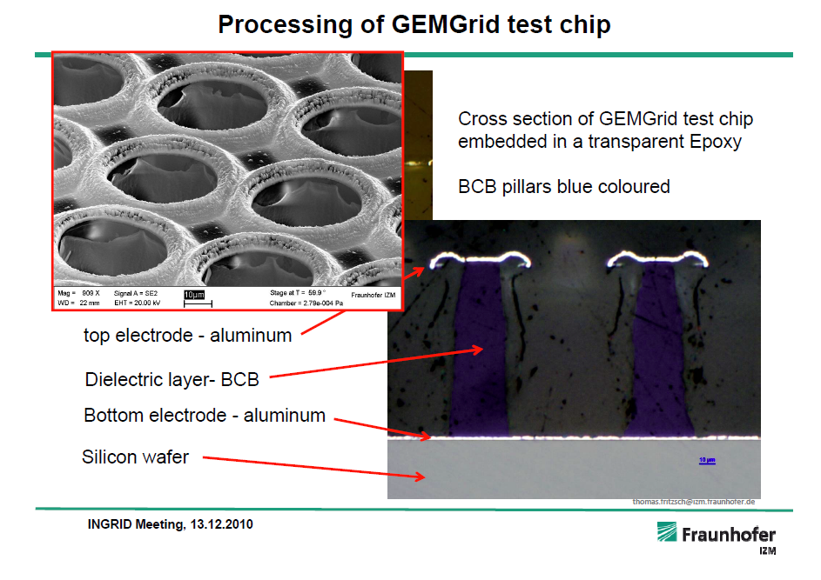
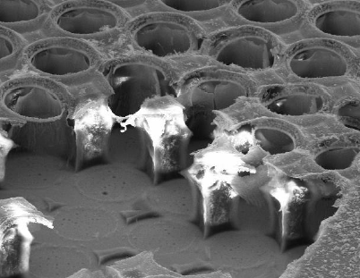
1st attempt at IZM: „GEMGrids“

Slide 12
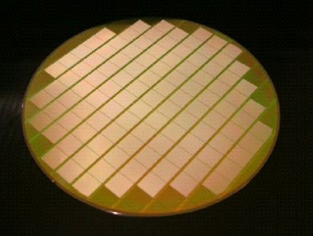
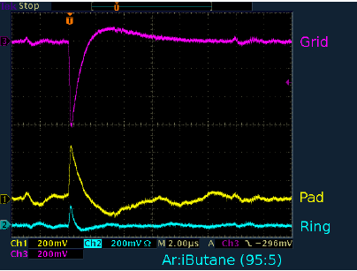
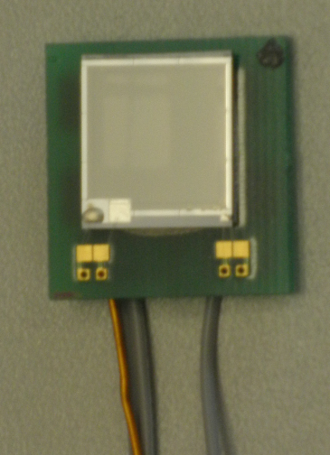
„GEMGrids“ – work (in principle)
first signals
seen in Bonn setup
with 55-Fe source
challenges / problems
limited yield (~ 1 / 6 structures working so far...)
sparking at the edges
limited HV → limited efficiency to be understood
T. Krautscheid, Bonn

Slide 13
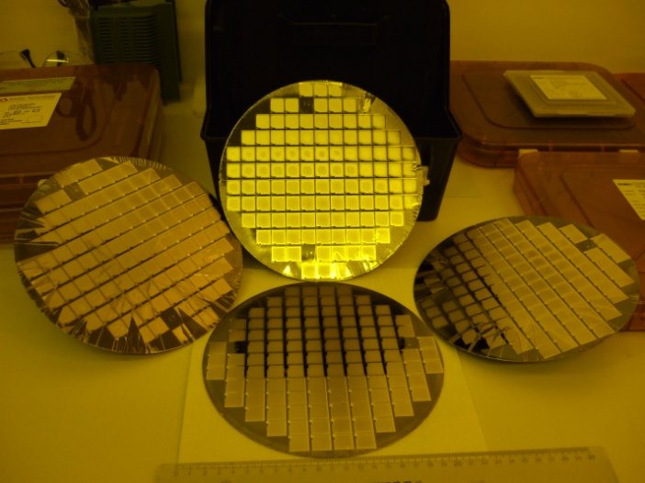
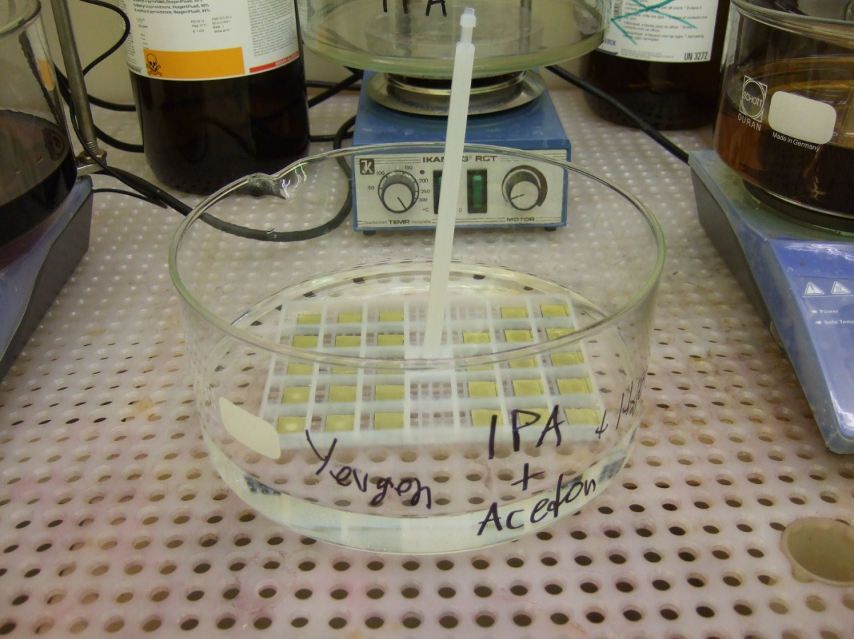
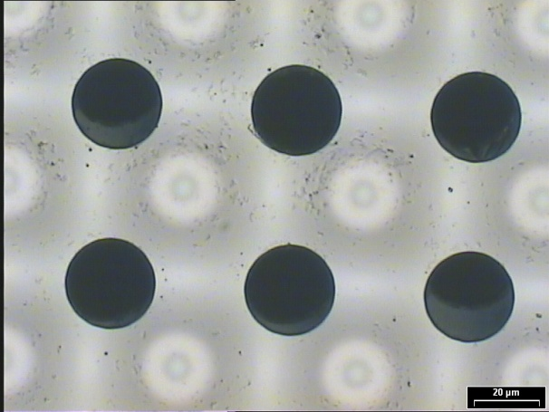
2nd road at IZM: Ingrids
transfer original „Twente“ process to 8´´
very successful 1st attempt
on dummy wafers
development after dicing
IZM+Y.Bilevych,Bonn
extremely regular...

Slide 14
Steps to go
mask design for Timepix wafer (done)
spark protection layer (proven materials aSi, Si_{x}N_{y}) not available at IZM
patterning of protection layer (shadow mask)
→ hope for 1st Timepix wafer processed in next few months

Slide 15
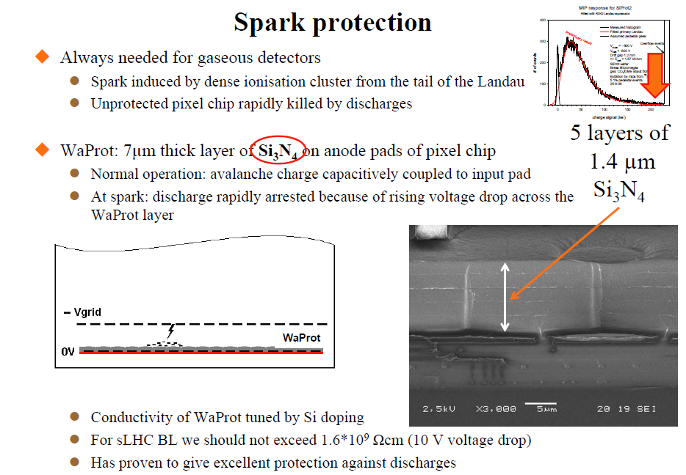
Protection of CMOS chip
potential showstopper: sparks, large signals, HV breakdowns can kill
input stage of CSA of CMOS pixel chip → protection
on chip?
on detector: SiProt
Amorphous Si or Si_{x}N_{y}
7 μm protection layer
- finite (but large) resistivity (10¹¹-10¹⁴ Ωcm)
reduce local E-field
charge-up at high rate → reduction of signal
vital for stable operation (unprotected Ingrids
typically die after few h from α-induced discharges)

Slide 16
Radiation damage and ageing?
„Sensor“: No radiation damage of (gas can be replaced)
CMOS: same as for Si pixels (go to small feature sizes)
Ageing of amplification strucuture?
In general, planar structures more robust than wires (no 1/r dependence of E-field)
Preliminary tests done at NIKHEF:
Irradiation with 8 keV X-rays:
No rate effects up to anode current density of 0.2 μA / mm²
➔ very fast track counting possible!
After 0.3 Coulomb/mm2:
➔ (eq. 3.7 x 10¹⁶ MIPs/cm²)
deposit of carbon polymer on anode is clearly visible. Micromegas is clean (?!)
Little deposit on cathode, and……
Chamber still worked!
H. van der Graaf, NIKHEF

Slide 17
Readout chips
Timepix as main work horse so far
Limitations
designed for imaging
no sparse readout (want on-chip 0 suppression)
can measure only time or charge (TOT) for a given pixel (want both)
time (=z position) accuracy limited by clock frequency (~50 MHz)
Timepix-2 (IBM 130nm) under design by Medipix-3 collaboration
(designed by CERN,NIKHEF,Bonn)
- completely data driven readout (compatible with both LHC and LC conditions)
- on pixel fast (640 MHz) oscillator (only active if hit)
- Si through via capability for backside connection (no wire bonds inside gas volume)
(some compromises to also serve e.g. LHC-b Velopix needs, e.g. leakage current comp.)

Slide 18
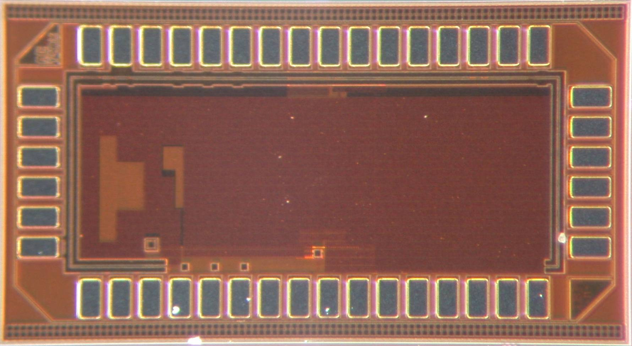
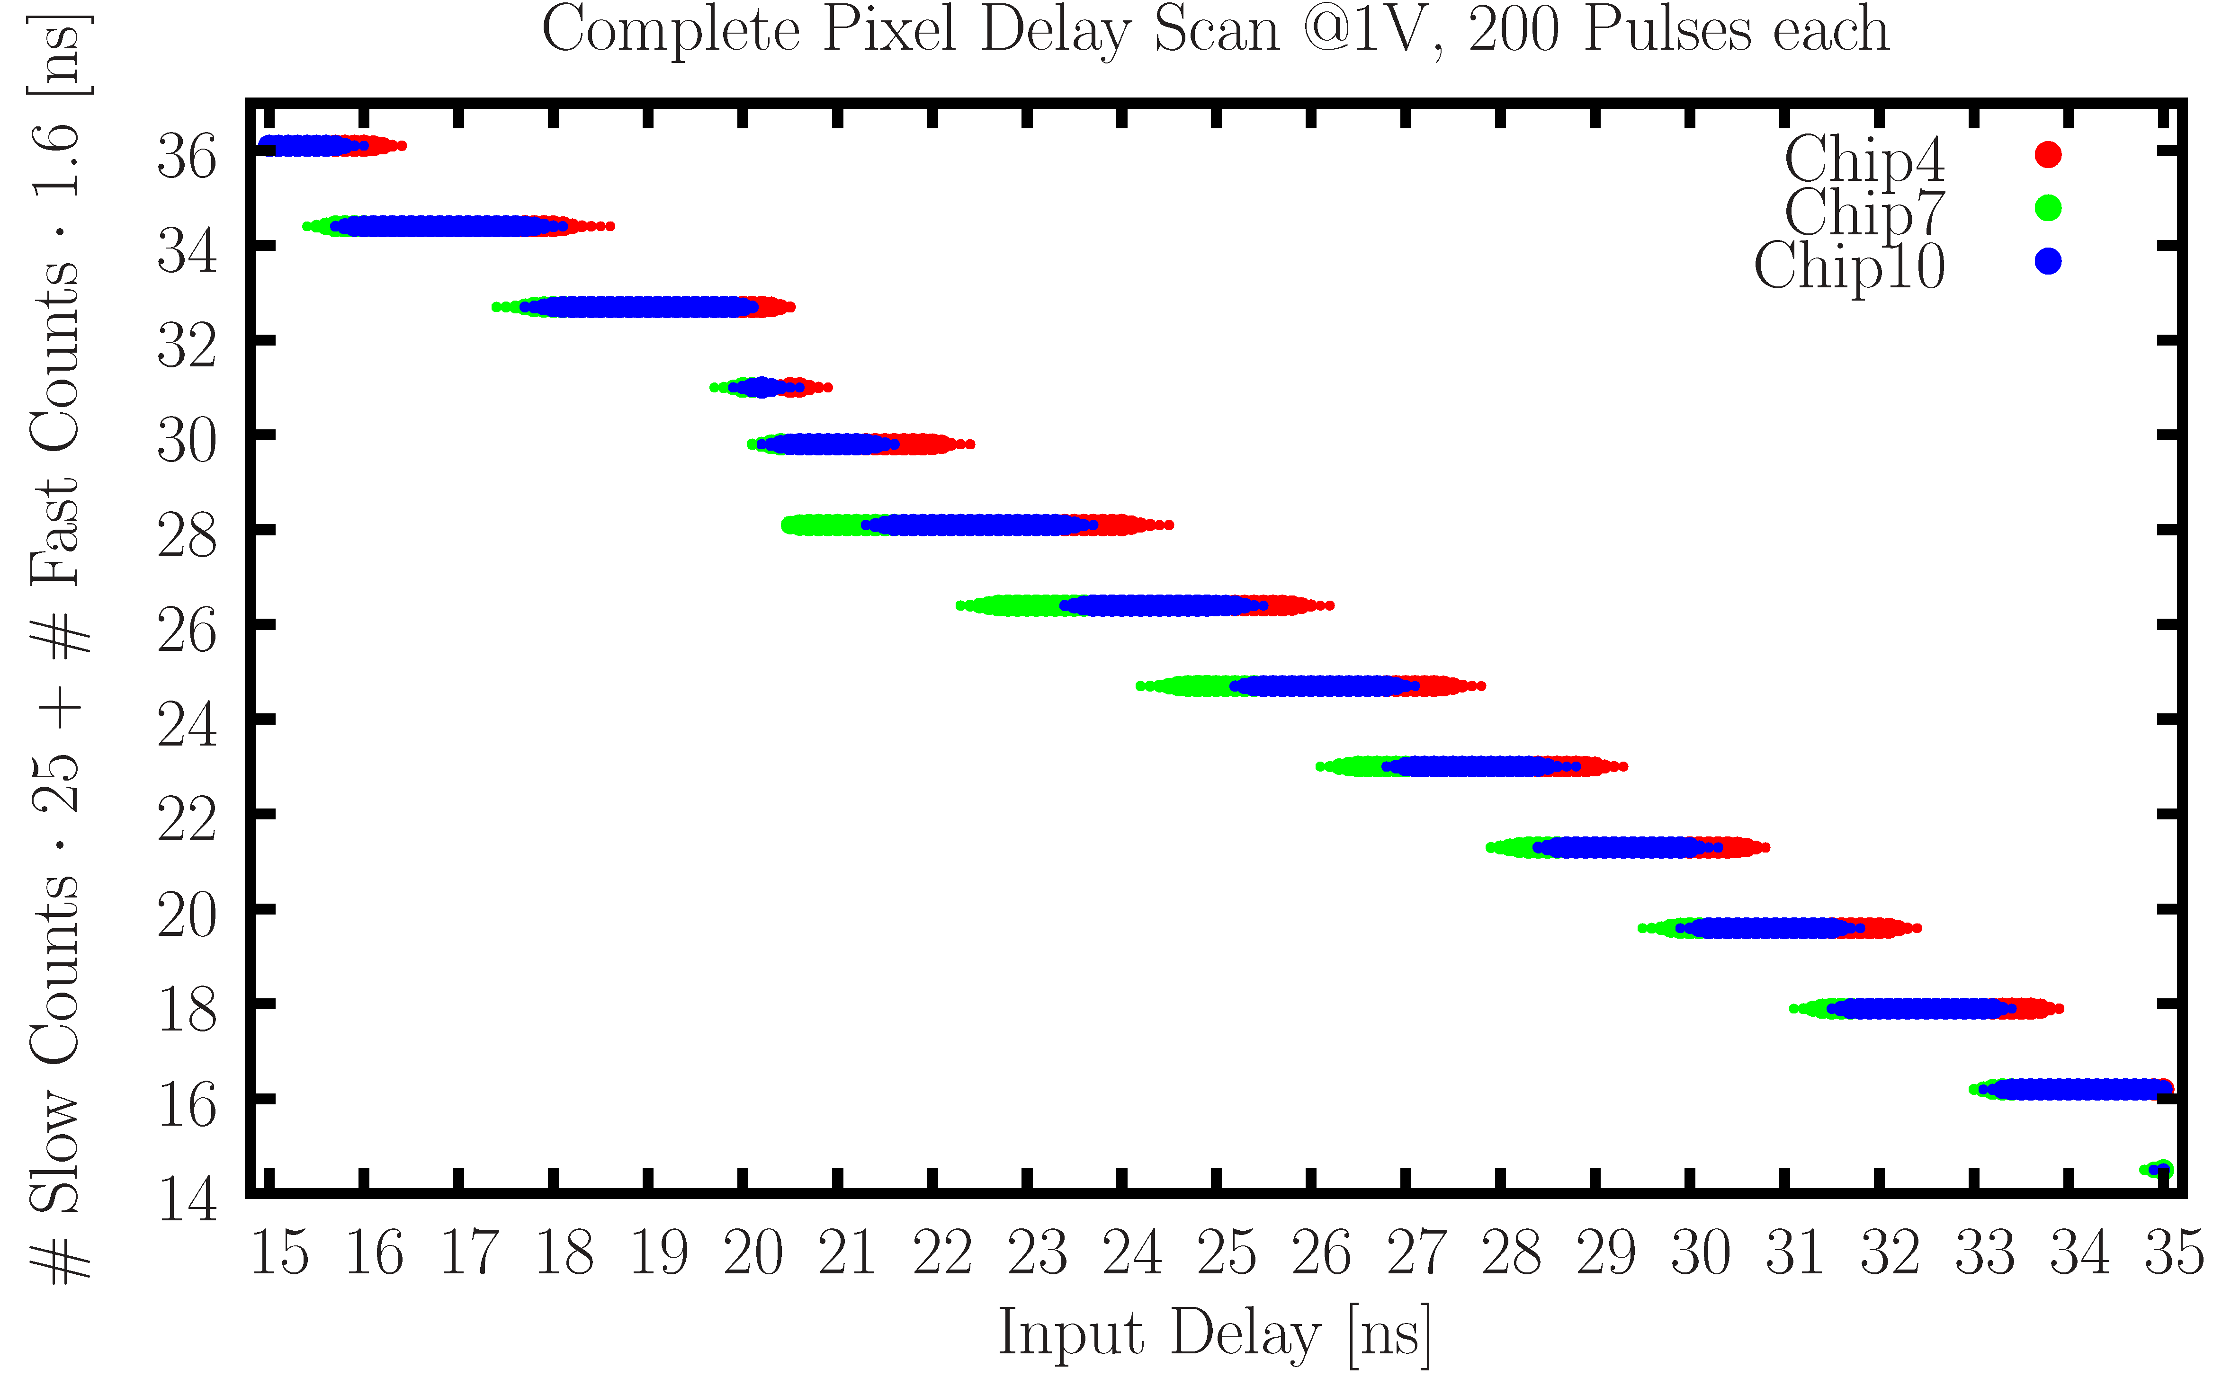
GOSSIPO-3 test chip
small test chip (NIKHEF,BN) to test basic features of single pixel cell
2mm
1mm
Fast oscillator works as expected
→ 1.6 ns time resolution

Slide 19
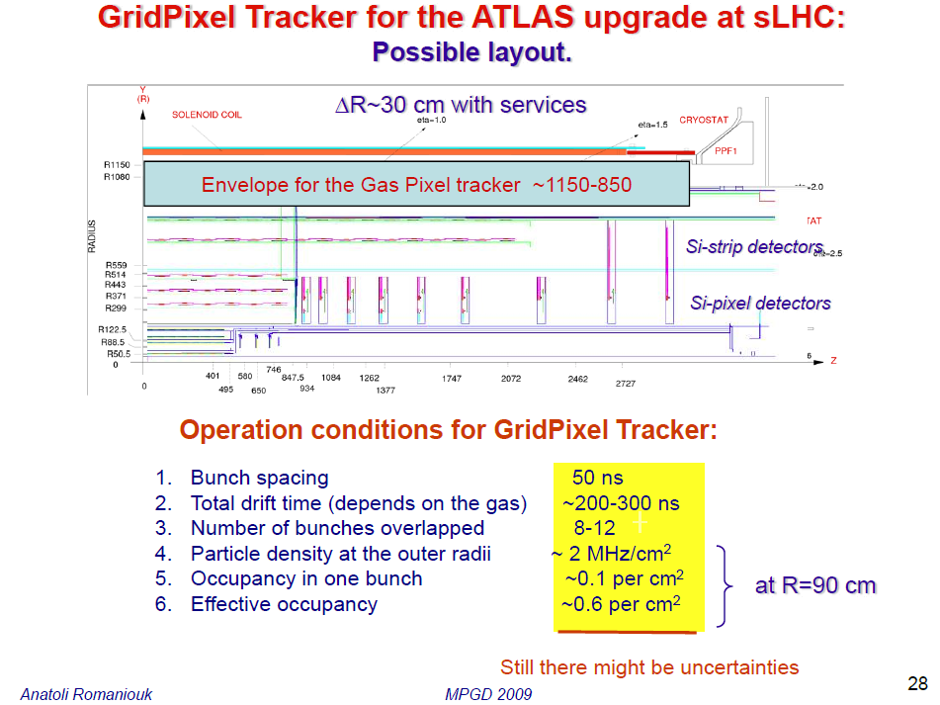
Ideas for ATLAS: GridPix Tracker

Slide 20
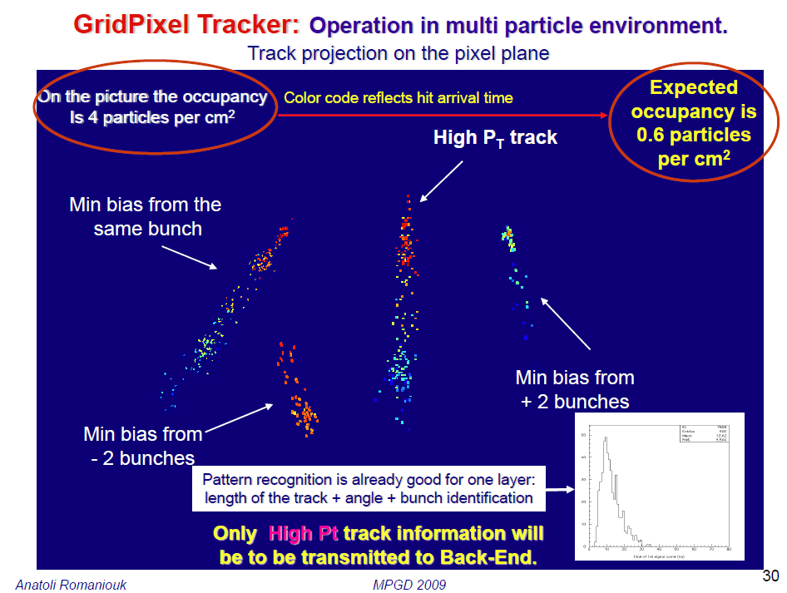
Ideas for ATLAS: GridPix Tracker

Slide 21
Ideas for ATLAS: GOSSIP Vertexdetector
van der Graaf
Gas On Slimmed Si-Pixels
MIP
MIP
InGrid
Cathode foil
CMOS pixel chip
CMOS pixel array
Drift gap: 1 mm
Max drift time: 16 ns

Slide 22
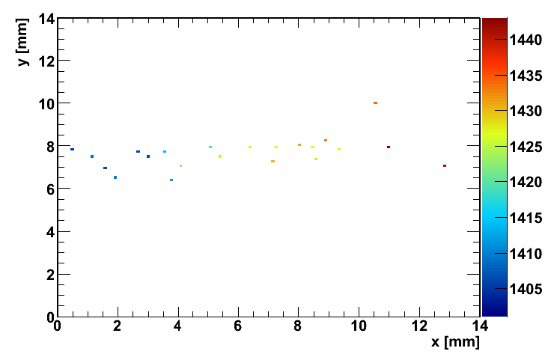
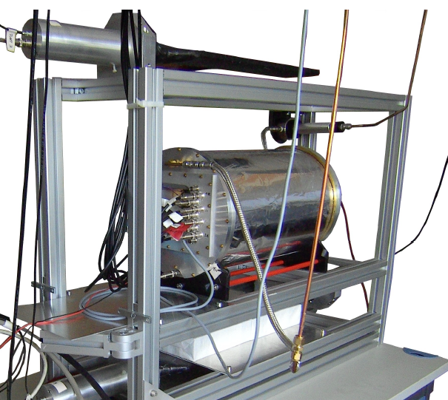
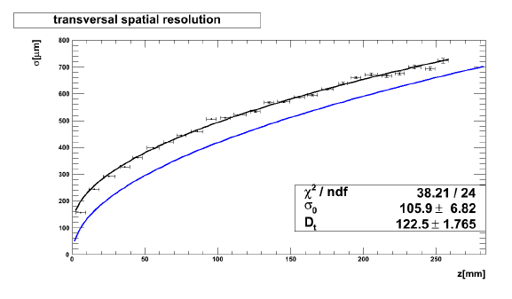
First „Twente“ InGrids at work in Bonn
single InGrid in TPC protoptye
cosmic track
in He/CO₂ 70/30
(not yet fully
efficient)
very preliminary

Slide 23
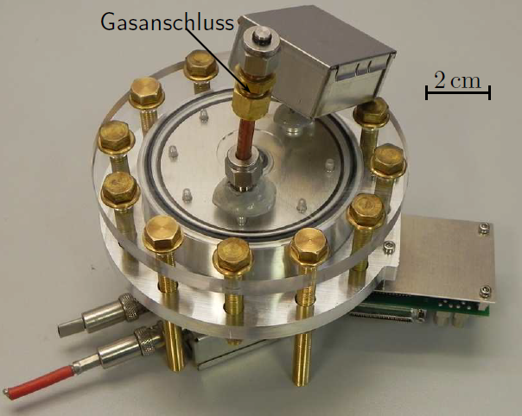
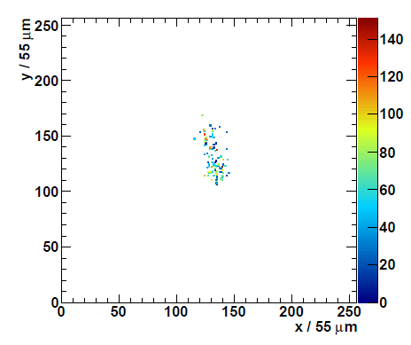
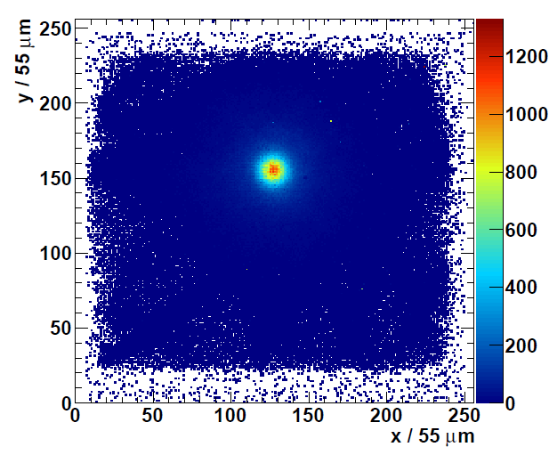
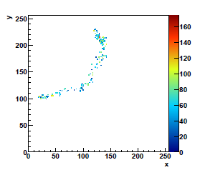
First „Twente“ Ingrids at work in Bonn
X-Ray detector for rare event searches
(CAST)
Photoelectron-“Track“
single InGrid
2 cm drift gap
Gas: He-Isob 95/5
later: Xe
Background
image of ⁵⁵Fe source

Slide 24
Summary and Outlook
Pixelized gaseous detector are still in their infancy
Fascinating potential
- TPCs
- planar vertex / tracking detectors
- TR (identification of single TR photons along with the track)
- X ray polarimetry / WIMP searches / UV photon detection ...
Proofs of principle done
Lots of work ahead – expect full InGrid+Timepix wafer soon,
Timepix2 submission by e.o.y.
Synergy with aspects of Si-pixels (thinning, STV, common ASICs, ...)
Lot of fun ahead... interested to join?

