Slide 1
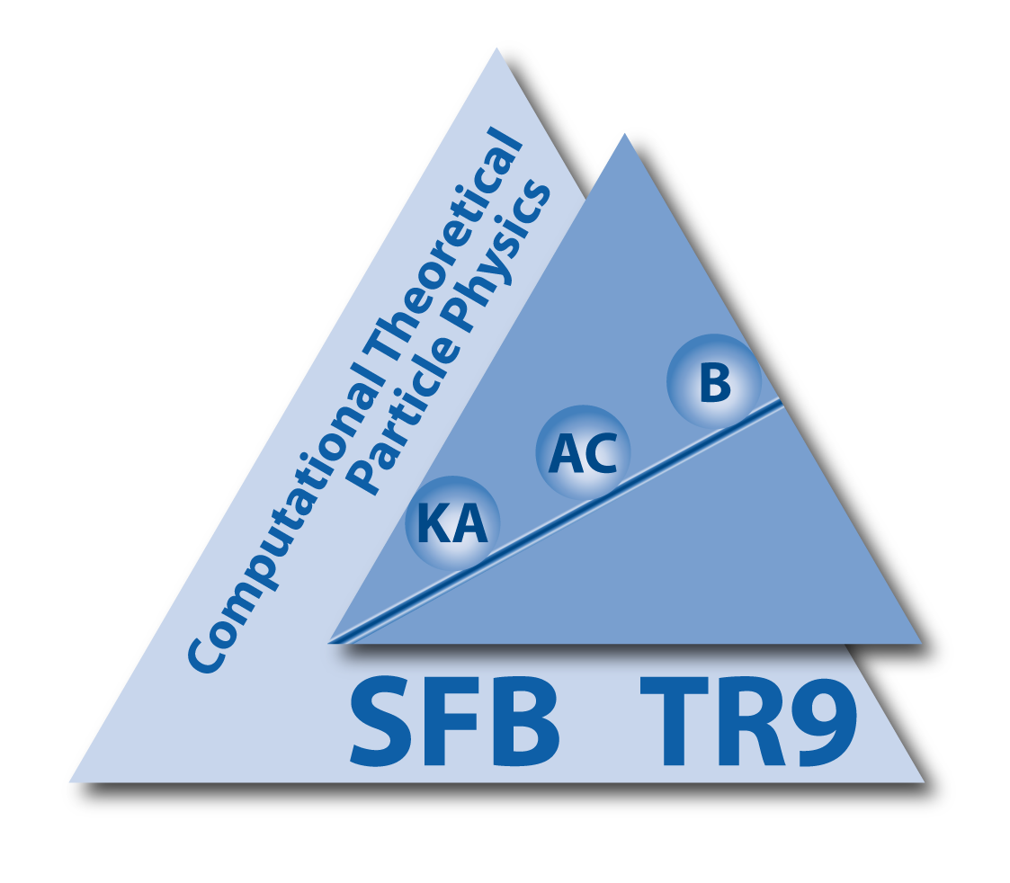
Improving Predictions for Squark and Gluino Production at the LHC
with the Help of
Soft Gluon Resummation
Anna Kulesza
AK and L. Motyka, Phys. Rev. Lett. 102, 111802 (2009), Phys. Rev. D 80 (2009) 095004
W. Beenakker, S. Brensing, M. Krämer, AK, E. Laenen and I. Niessen,
JHEP 12 (2009) 041, JHEP 08 (2010) 098, arXiv:1110.2446 [hep-ph]
W. Beenakker, S. Brensing, M. Krämer, AK, E. Laenen, L.Motyka and I. Niessen, IJMP A26 (2011) 2637
W. Beenakker et al., arXiv:1106.5647 [hep-ph]
5th Annual Workshop of the Helmholtz Alliance “Physics at the Terascale”, Bonn, 7.12.2011

Slide 2
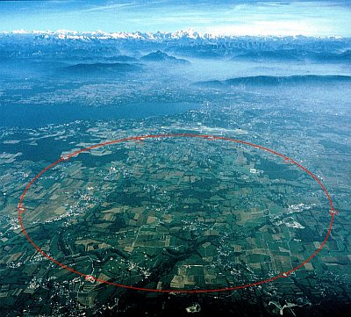
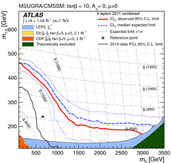
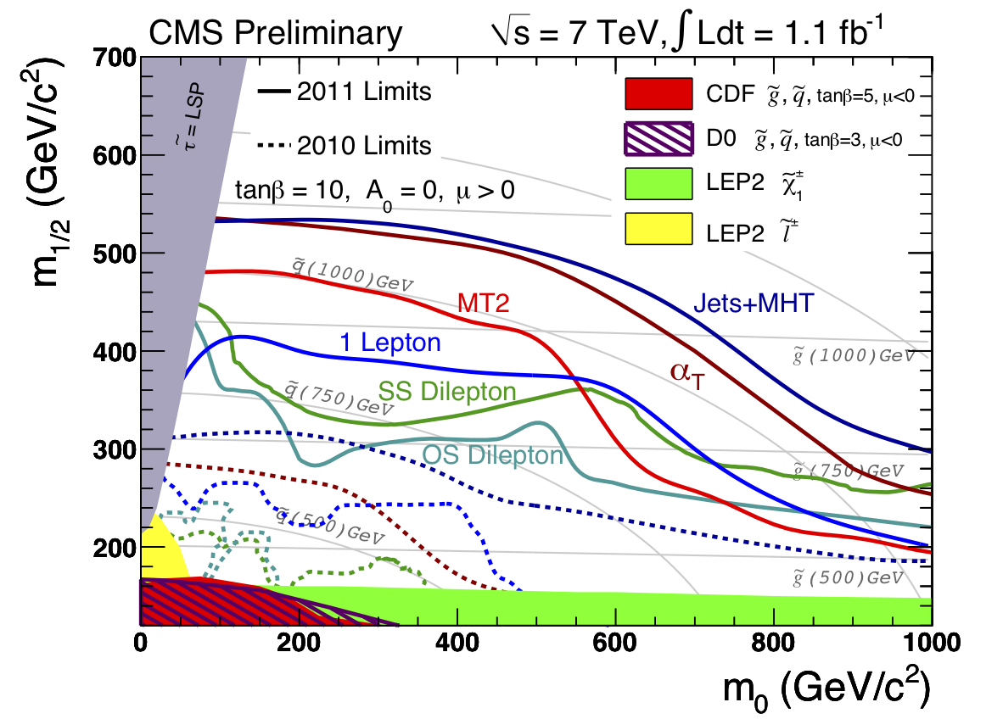
LHC Searches
MSUGRA, MSSM, parameter space
R symmetry

Slide 3
Partonic subprocesses
[Kane, Leveille'82][Harrison, Llewellyn Smith'84][Dawson, Eichten, Quigg'85]
Leading Order = O(α_{s}²)

Slide 4
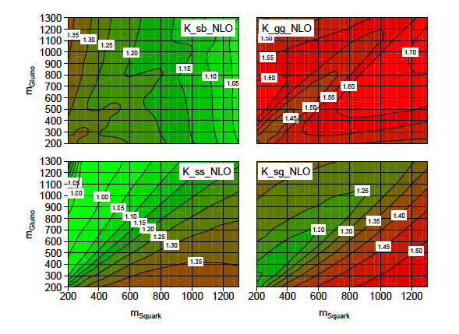
LO vs NLO
NLO SUSY QCD K-factors, LHC @ 7 TeV
[Beenakker, Höpker, Spira, Zerwas’97]
K_xx_NLO=σ ^{NLO}_{xx} /σ ^{LO}_{xx}
Large NLO K-factors, in particular for gluino-pair and squark-gluino production
SUSY-QCD: only m_{squark} and m_{gluino} dependence
plot courtesy of S. Brensing
Currently used for determining exclusion limits : NLO SUSY-QCD predictions

Slide 5
NLO At Threshold
Large masses of SUSY particles ⇒ production close to threshold
General structure of the NLO correction in the threshold limit
Soft/collinear gluon emission
Coulomb gluons

Slide 6
NLO At Threshold
Large masses of SUSY particles ⇒ production close to threshold
General structure of the NLO correction in the threshold limit
Soft/collinear gluon emission
Coulomb gluons
Large corrections in the limit of threshold production

Slide 7
Higher Orders At Threshold
Soft/collinear gluon emission
Coulomb gluons
At higher orders:
Both types of corrections can be resummed to all orders

Slide 8
Higher Orders At Threshold
Soft/collinear gluon emission
Coulomb gluons
At higher orders:
Both types of corrections can be resummed to all orders
Here: N(N)LL resummation of soft gluon corrections

Slide 9
Higher Orders At Threshold
Soft/collinear gluon emission
Coulomb gluons
At higher orders:
Both types of corrections can be resummed to all orders
→ LO Coulomb corrections (α_{s}/β)^{n} resummed for and
→ Subleading Coulomb corrections and bound state effects analysed in NRQCD @NLO for and
[Hagiwara, Yokoya’09] [Kauth, Kühn, Marquard, Steinhauser’10-11] [Kauth, Kress, Kühn’11]
Here: N(N)LL resummation of soft gluon corrections
[Kulesza, Motyka’09]
Resummation of soft and Coulomb corrections together [Beneke, Schwinn, Falgari’09], applied to
at NLL
[Beneke, Schwinn, Falgari’10]

Slide 10
Resummation for Squark and Gluino Production
Resummation performed in the space of Mellin moments taken wrt. 4m²/S
log(β²)↔log(N)≡L
sums up LL: α_{s}^{n} log ^{n+1} (N) NLL: α_{s}^{n} log ^{n} (N)

Slide 11
Resummation for Squark and Gluino Production
Resummation performed in the space of Mellin moments taken wrt. 4m²/S
Squark and gluino production: 2⥴2 processes with non-trivial color structures:
soft wide-angle emission can change the colour structure of the underlying hard scattering; enters at NLL accuracy
log(β²)↔log(N)≡L
sums up LL: α_{s}^{n} log ^{n+1} (N) NLL: α_{s}^{n} log ^{n} (N)

Slide 12
NLL Resummation for 2→2 processes with colour and massive final states
[Kidonakis, Sterman'96-97][Bonciani, Catani, Mangano, Nason'98]
In appropriately chosen colour basis
At NLL, need 1-loop anomalous dimensions matrices for all colour structures ✔
Resummed expression matched with to the full NLO result ⇒ NLL+NLO
Soft, wide-angle emission, process dependent
N-moments of LO
Soft-collinear radiation from incoming partons, universal, known
Soft anomalous dimension matrix
[AK, Motyka’09] [Beenakker, Brensing, Krämer, AK, Laenen, Niessen’09]

Slide 13
NLL+NLO RESULTS FOR 7 TEV
(for 14 TeV, see e.g. W. Beenakker, S. Brensing, M. Krämer, AK, E. Laenen, L.Motyka and I. Niessen, IJMP A26 (2011) 2637)

Slide 14
Total NLL+NLO production rates
Width of the bands: theory error due to scale variation
0.5 < μ/m < 2,
68% C.L. pdf error and α_{s} error
MSTW 2008
Most precise predictions for squark and gluino production rates currently available

Slide 15
NLL Corrections
[W. Beenakker, S. Brensing, M. Krämer, AK, E. Laenen, L.Motyka and I. Niessen’11]
MSTW 2008
Soft-gluon resummation enhances the cross sections
Highest corrections for the gluino-pair production: 20% correction to the NLO results for m_{gl}= 1 TeV
For the squark-gluino channel, NLL correction reaches 10% at m_{sq}= m_{gl}= 1 TeV

Slide 16
Scale variation
[W. Beenakker, S. Brensing, M. Krämer, AK, E. Laenen, L.Motyka and I. Niessen’11]
Squark-gluino production
Gluino-pair production
MSTW 2008
MSTW 2008
Significant reduction of the scale dependence for NLL+NLO compared to NLO, especially for gluino-pair production

Slide 17
Theory Error
[W. Beenakker, S. Brensing, M. Krämer, AK, E. Laenen, L.Motyka and I. Niessen’11]
Squark-gluino production
Gluino-pair production
Width of the bands: combined theory error due to scale variation
0.5 < μ/m < 2,
68% C.L. pdf error and α_{s} error
Significant reduction of the FULL theory error due to reducing the scale variation!

Slide 18
Tevatron Searches
NLL+NLO analysis also performed for production of squarks and gluinos at the Tevatron
CDF mass limits revisited
[Beenakker, Brensing, Krämer, AK, Laenen, Niessen‘09]
[Beenakker, Brensing, d‘Onofrio, Krämer, AK, Laenen, Martinez, Niessen‘11]
5-10 GeV shift

Slide 19
Impact on LHC Searches
[ATLAS, PLB 701 (2011) 186]
Auxiliary information publicly available, including signal acceptance times efficiency

Slide 20
Impact on LHC Searches
[ATLAS, PLB 701 (2011) 186]
Auxiliary information publicly available, including signal acceptance times efficiency

Slide 21
Impact on LHC Searches
[ATLAS, PLB 701 (2011) 186]
Auxiliary information publicly available, including signal acceptance times efficiency

Slide 22
Impact on LHC Searches
[ATLAS, PLB 701 (2011) 186]
Up to 50 GeV shift due to NLL corrections
Shifts in the exclusion limits similar in size independently of the test statistic used
For higher masses expect bigger impact on the exclusion limits!

Slide 23
Public Code: NLL-Fast
All four processes of squark and gluino production at NLL+NLO
Available at
http://web.physik.rwth-aachen.de/service/wiki/bin/view/Main/BSMCrossSectionWorkingGroup
For a given squark mass and a gluino mass the code returns:
LO and NLO central values (from PROSPINO)
NLL+NLO central value
upper and lower scale variation error on NLL+NLO
upper and lower pdf uncertainty
upper and lower α_{s} uncertainty
To speed up calculation, interpolation of the provided grids for squark and gluino masses in the range of 500-2000 GeV
→ LPCC BSM Working group official recommendation

Slide 24
NNLL+NLO SQUARK-ANTISQUARK PRODUCTION AT 7 TEV

Slide 25
NNLL: How?
Exponentials at NNLL accuracy
Three-loop cusp anomalous dimension [Moch,Vermaseren,Vogt’04]
Two-loop soft anomalous dimensions [Contopanagos, Laenen,Sterman’96][Catani, de Florian, Grazzini’01][Beneke, Falgari, Schwinn’09][Czakon, Mitov, Sterman’09] [Ferroglia, Neubert, Pecjak, Yang’09]
Matching coefficients
Matching coefficients
Soft wide-angle emission
N-moments of LO
Soft-collinear radiation from incoming partons

Slide 26
Matching Coefficients
Soft-Coulomb factorization [Bonciani, Catani, Mangano, Nason’98][Beneke, Falgari, Schwinn’09-10]
Form of the NLO Coulomb corrections known:
Hard-matching coefficients C⁽¹⁾_{ij,I}: Analytical results ✔
obtained from NLO corrections considered in the threshold limit

Slide 27
Squark-Antisquark production at NNLL
[W. Beenakker, S. Brensing, M. Krämer, AK, E. Laenen, L.Motyka and I. Niessen’11]
NNLL +NLO: → up to 30% increase of the total cross section wrt NLO for squarks with mass of 1.5 TeV

Slide 28
Squark-Antisquark production at NNLL
[W. Beenakker, S. Brensing, M. Krämer, AK, E. Laenen, L.Motyka and I. Niessen’11]
NNLL +NLO: → up to 30% increase of the total cross section wrt NLO for squarks with mass of 1.5 TeV
→ significant reduction of the scale dependence

Slide 29
Summary
Results for the threshold-resummed total cross section at NLL+NLO available for all four processes of squark and gluino pair-production, as well as stop-pair production
Significant reduction of the theory error due to scale variation
NNLL+NLO: squark-antisquark production
NLL+NLO results are the most accurate predictions currently available for all channels of squark and gluino production, should be used for determination of mass limits at the LHC

Slide 30
Summary
Results for the threshold-resummed total cross section at NLL+NLO available for all four processes of squark and gluino pair-production, as well as stop-pair production
Significant reduction of the theory error due to scale variation
NNLL+NLO: squark-antisquark production
NLL+NLO results are the most accurate predictions currently available for all channels of squark and gluino production, should be used for determination of mass limits at the LHC
CMS search for stopped HSCPs, CMS-EXO-11020

Slide 31
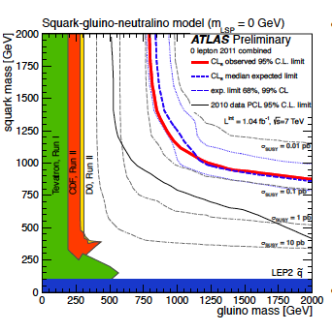
Summary
Results for the threshold-resummed total cross section at NLL+NLO available for all four processes of squark and gluino pair-production, as well as stop-pair production
Significant reduction of the theory error due to scale variation
NNLL+NLO: squark-antisquark production
NLL+NLO results are the most accurate predictions currently available for all channels of squark and gluino production, should be used for determination of mass limits at the LHC
?
CMS search for stopped HSCPs, CMS-EXO-11020

Slide 32
Scale variation ctnd.
[W. Beenakker, S. Brensing, M. Krämer, AK, E. Laenen, L.Motyka and I. Niessen, IJMP A26 (2011) 2637]
Squark-gluino production
Gluino-pair production
Theory error due to scale variation below 10% for NLL+NLO
down by a factor of 2 (squark-gluino) or a factor of 4 (gluino-pair) for masses > 1 TeV

Slide 33
Theoretical Status: Fixed Order
NLO SUSY-QCD corrections → O(α_{s}³ ) [Beenakker, Höpker, Spira, Zerwas'96] [Beenakker, Krämer, Plehn, Spira, Zerwas’97]
EW corrections → O(α_{s}² α) [Hollik, Kollar, Trenkel'07][Hollik, Mirabella'08] [Hollik, Mirabella, Trenkel'08] [Beccaria et al.'08] [Mirabella'09] [Germer, Hollik, Mirabella, Trenkel’10] ] [Germer, Hollik, Mirabella’11]
Corrections to O(α_{s}²) processes
For squark-antisquark and stop-antistop production:approximate NNLO contributions → O(α_{s}⁴ ) [Langenfeld, Moch'09] [Langenfeld’10]
e.g.
…
e.g.

Slide 34
Theoretical Status: Fixed Order
NLO SUSY-QCD corrections → O(α_{s}³ ) [Beenakker, Höpker, Spira, Zerwas'96] [Beenakker, Krämer, Plehn, Spira, Zerwas’97]
EW corrections → O(α_{s}² α) [Hollik, Kollar, Trenkel'07][Hollik, Mirabella'08] [Hollik, Mirabella, Trenkel'08] [Beccaria et al.'08] [Mirabella'09] [Germer, Hollik, Mirabella, Trenkel’10] ] [Germer, Hollik, Mirabella’11]
Corrections to O(α_{s}²) processes
For squark-antisquark and stop-antistop production:approximate NNLO contributions → O(α_{s}⁴ ) [Langenfeld, Moch'09] [Langenfeld’10]
e.g.
…
e.g.
Tree-level EW effects O(α_{s} α) and O(α²)
QCD-EW interference and photon-induced contributions, tree-level EW [Bornhauser et al.'07][Alan, Cankocak, Demir'07] [Hollik, Kollar, Trenkel'07][Hollik, Mirabella'08] [Hollik, Mirabella, Trenkel'08] [Bozzi, Fuks, Klasen'05] [Germer, Hollik, Mirabella, Trenkel’10] [Germer, Hollik, Mirabella’11]
etc.

Slide 35
Theoretical Status: Fixed Order
NLO SUSY-QCD corrections → O(α_{s}³ ) [Beenakker, Höpker, Spira, Zerwas'96] [Beenakker, Krämer, Plehn, Spira, Zerwas’97]
EW corrections → O(α_{s}² α) [Hollik, Kollar, Trenkel'07][Hollik, Mirabella'08] [Hollik, Mirabella, Trenkel'08] [Beccaria et al.'08] [Mirabella'09] [Germer, Hollik, Mirabella, Trenkel’10] ] [Germer, Hollik, Mirabella’11]
Corrections to O(α_{s}²) processes
Typically
order of a few tens of percents
For squark-antisquark and stop-antistop production:approximate NNLO contributions → O(α_{s}⁴ ) [Langenfeld, Moch'09] [Langenfeld’10]
e.g.
…
e.g.
Tree-level EW effects O(α_{s} α) and O(α²)
QCD-EW interference and photon-induced contributions, tree-level EW [Bornhauser et al.'07][Alan, Cankocak, Demir'07] [Hollik, Kollar, Trenkel'07][Hollik, Mirabella'08] [Hollik, Mirabella, Trenkel'08] [Bozzi, Fuks, Klasen'05] [Germer, Hollik, Mirabella, Trenkel’10] [Germer, Hollik, Mirabella’11]
etc.

Slide 36
Theoretical Status: Fixed Order
NLO SUSY-QCD corrections → O(α_{s}³ ) [Beenakker, Höpker, Spira, Zerwas'96] [Beenakker, Krämer, Plehn, Spira, Zerwas’97]
EW corrections → O(α_{s}² α) [Hollik, Kollar, Trenkel'07][Hollik, Mirabella'08] [Hollik, Mirabella, Trenkel'08] [Beccaria et al.'08] [Mirabella'09] [Germer, Hollik, Mirabella, Trenkel’10] ] [Germer, Hollik, Mirabella’11]
Corrections to O(α_{s}²) processes
Typically
order of a few tens of percents
For squark-antisquark and stop-antistop production:approximate NNLO contributions → O(α_{s}⁴ ) [Langenfeld, Moch'09] [Langenfeld’10]
e.g.
…
e.g.
Typically
order of a few percents
(for the total cross section)
Tree-level EW effects O(α_{s} α) and O(α²)
QCD-EW interference and photon-induced contributions, tree-level EW [Bornhauser et al.'07][Alan, Cankocak, Demir'07] [Hollik, Kollar, Trenkel'07][Hollik, Mirabella'08] [Hollik, Mirabella, Trenkel'08] [Bozzi, Fuks, Klasen'05] [Germer, Hollik, Mirabella, Trenkel’10] [Germer, Hollik, Mirabella’11]
etc.

Slide 37
Resummation-improved NLL+NLO total cross section
NLL resummed expression has to be matched with the full NLO result
Inverse Mellin transform evaluated using a contour in the complex N space according to 'Minimal Prescription’ [Catani, Mangano, Nason Trentadue'96]
NLO cross sections evaluated with publicly available code PROSPINO [Beenakker, Hoepker, Krämer, Plehn, Spira, Zerwas] [http://people.web.psi.ch/spira/prospino/] [http://www.thphys.uni-heildelberg.de/plehn/prospino/]

Slide 38
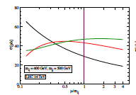
NNLL: Why?
NNLL contributions important for production [Bonciani, Catani, Mangano, Nason’98]
Approximate NNLO cross sections: reduced scale-dependence
Squark-antisquark [Langenfeld and Moch’09]
without
with
LO
NLO
approx. NNLO

Slide 39
Gluino-Pair Production at the LHC
Currently used for determining exclusion limits : NLO SUSY-QCD predictions
LHC @ 7 TeV
For higher masses, theory error due to scale variation will be bigger!
More than 20 % scale variation error

Slide 40
Gluino-Pair Production at the LHC
Currently used for determining exclusion limits : NLO SUSY-QCD predictions
LHC @ 7 TeV

Slide 41
Gluino-Pair Production at the LHC
Currently used for determining exclusion limits : NLO SUSY-QCD predictions
LHC @ 7 TeV
More than 20 % scale variation error

Slide 42
Reminder: Tevatron searches
[CDF, Phys. Rev. Lett. 102, 121801 (2009)]
Essential to know total production cross sections for squarks and gluinos well

