Slide 1
Light Higgs Studies for CLIC CDR
Christian Grefe (CERN/University of Bonn)
Tomáš Laštovička (FZÚ AV ČR, Prague)
Jan Strube (CERN)
3rd Linear Collider Forum, DESY
February 7-9, 2012
Notes:
1

Slide 2
Light Higgs = 120GeV Standard Model Higgs throughout this presentation

Slide 3
Overview
CLIC environment
Light Higgs in the CLIC Conceptual Design Report (CDR) Volume 2
H→bb and H→cc
Largest branching ratios in SM
Jet flavour tagging
H→μ⁺μ⁻
Coupling to 2nd generation fermions, rare decay
Momentum resolution
Plans for CLIC CDR Volume 3
Extension of Higgs studies
Summary

Slide 4
CLIC environment

Slide 5
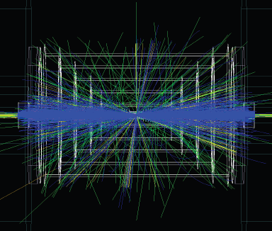
The CLIC accelerator environment
Center of mass energy | 3 TeV
Bunch spacing | 0.5 ns
Bunches per train | 312
Train repetition rate | 50 Hz
γγ → hadrons per BX | 3.2
Challenging
γγ overlay → 19TeV visible energy
Reduced by a factor of 16 in 10ns readout window
Requires to employ “LHC-style” jet reconstruction algorithms (typically FastJet k_{T})

Slide 6
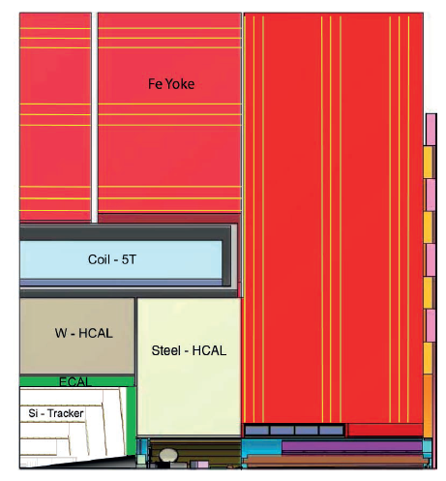
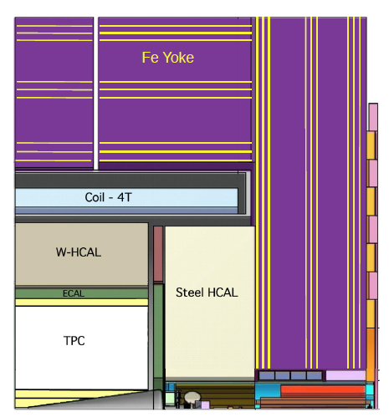
The CLIC detectors
CLIC_SiD and CLIC_ILD
based on SiD and ILD detector concepts for ILC LoIs
CLIC_SiD
Light Higgs analyses
Inner vertex layer @ 27mm (was 14mm for the SiD)
7.5 λ W-HCAL barrel
Tracking down to 10°
5T magnetic field
CLIC_SiD
CLIC_ILD

Slide 7
The CLIC CDR studies
Event generation, both signal and background: Whizard 1.95
Hadronisation: Pythia 6.4
Simulation: Geant4 – via SLIC (CLIC_SiD) and Mokka (CLIC_ILD)
60BX γγ→hadrons overlaid in each event
Full event reconstruction
PFA with PandoraPFA
10ns readout window,
except HCAL: 100ns
Reference luminosity: 2ab⁻¹
CLIC @ 3 TeV = Light Higgs-factory (σ_{hhνν} = 420fb, WW fusion)

Slide 8
Higgs decays to quarks
CLIC CDR Vol. 2

Slide 9
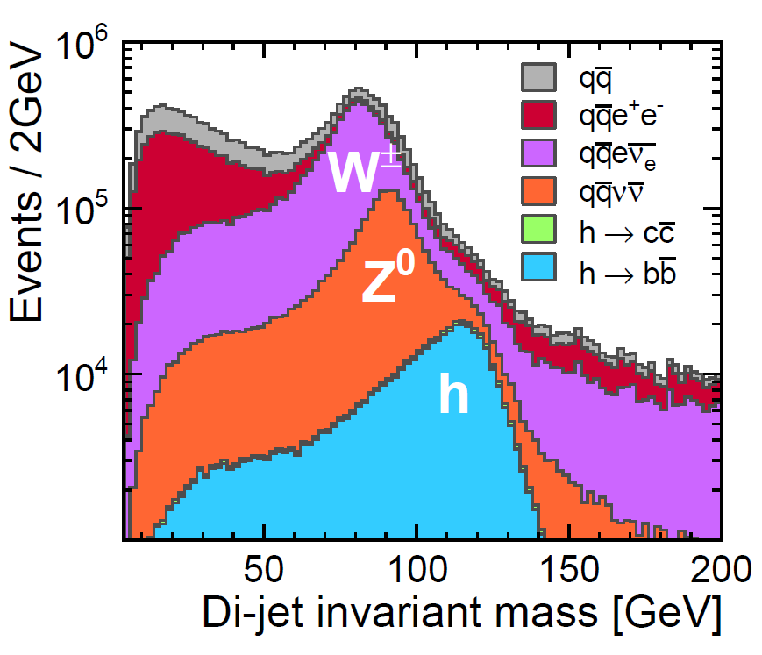
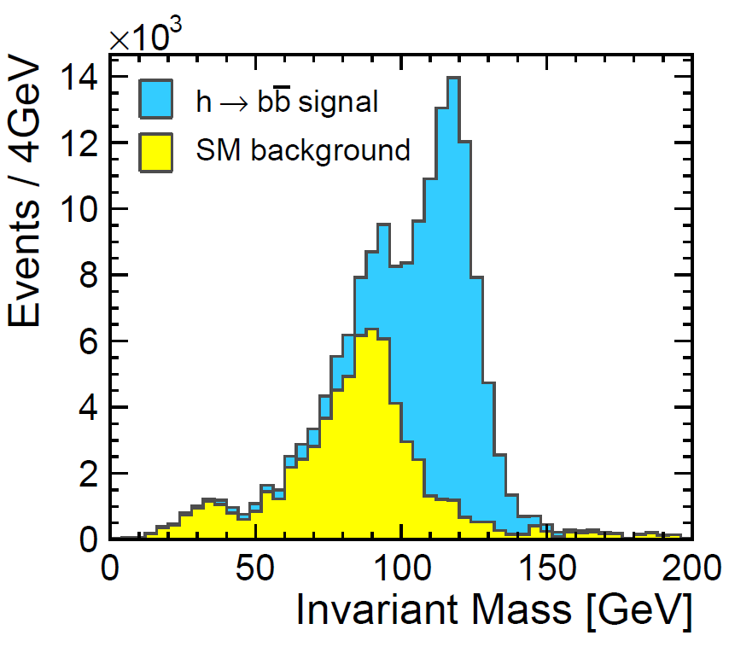
Event selection
Pre-selection
PFO timing cuts
FastJet k_{T} algorithm R = 0.7
2 jets required in exclusive mode
Durham k_{T} algorithm does not work due to γγ overlay
Top plot – inclusive
Bottom plot
invariant mass not used in the neural net event selection
working point with the highest signal significance chosen for an illustration
mass resolution does not allow “Exp() + Gauss()”- style fits.

Slide 10
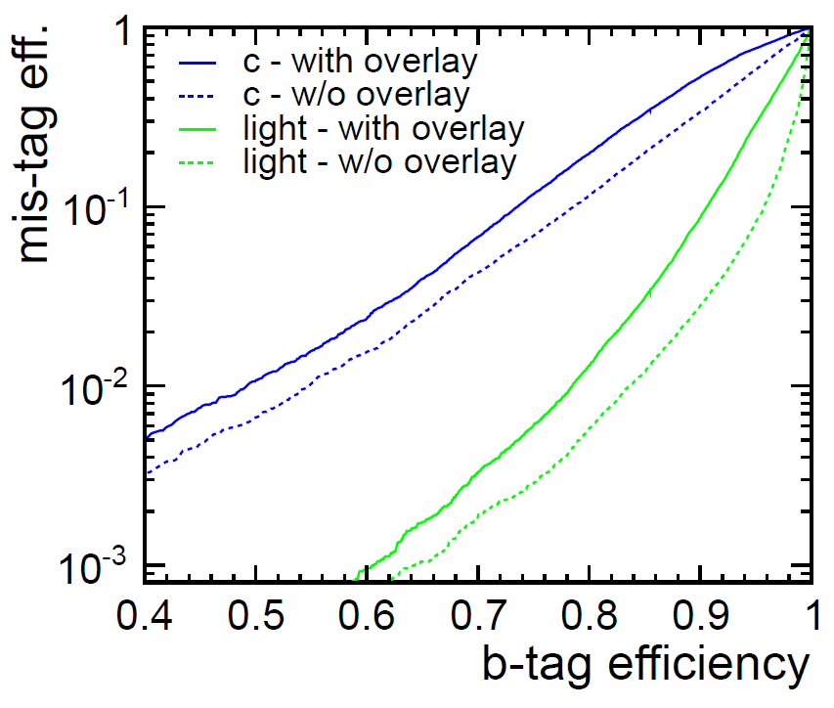
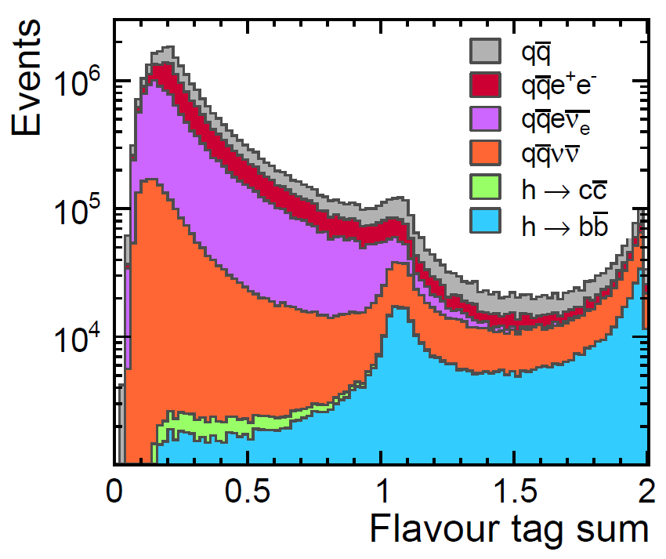
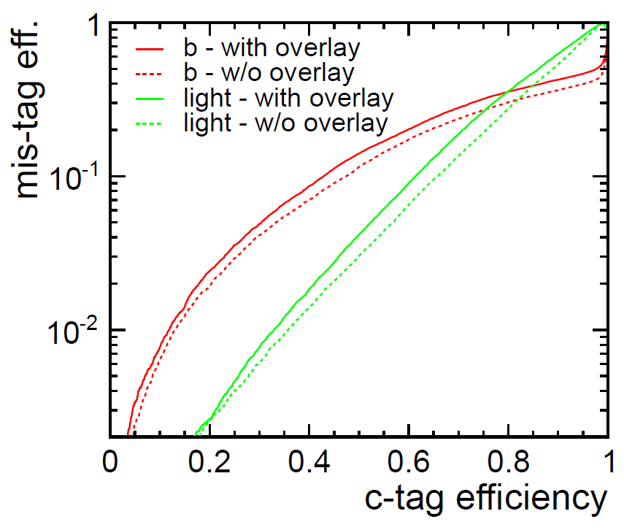
Jet flavour tagging at 3TeV with γγ overlay
LCFI package
FANN neural net package used throughout the Higgs analysis both for the flavour tag and the event selection
Presence of γγ overlay (60BX considered) degrades both the jet-finding and the jet flavour tag quality

Slide 11
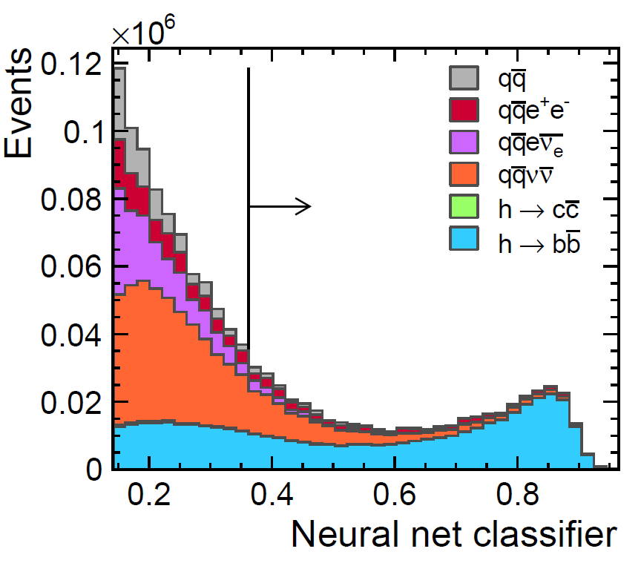
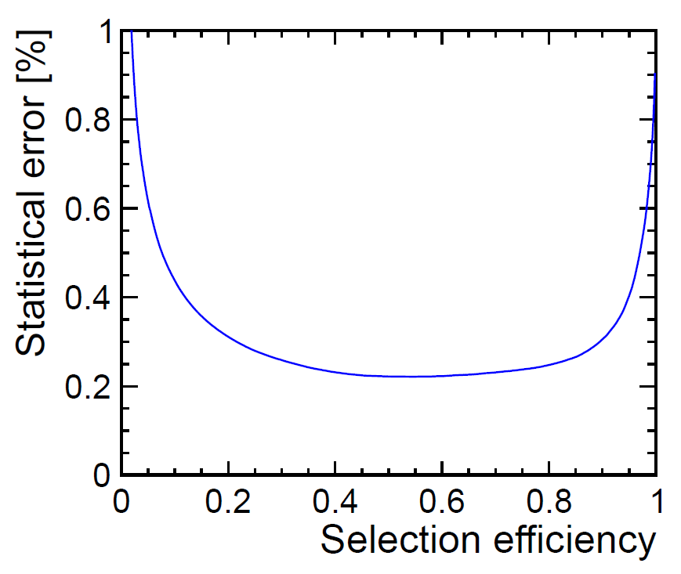
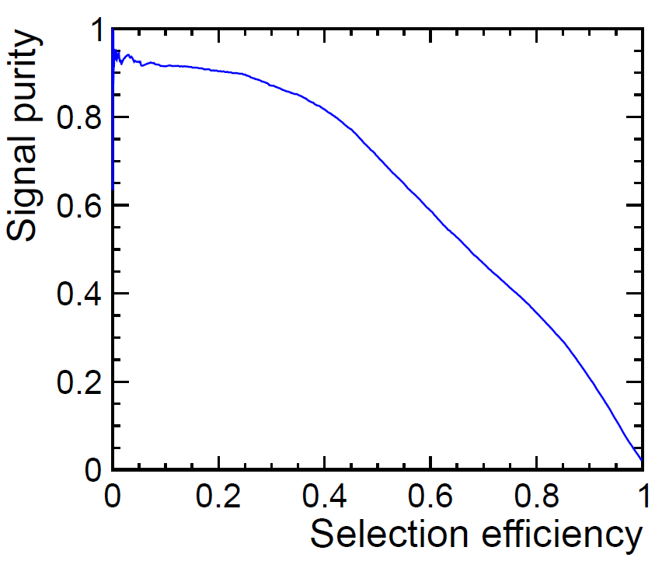
Event selection with neural net (h→bb)
Neural net inputs used to classify events
di-jet invariant mass
ΔR(jets)
ΣE_{jets}
Total number of leptons and photons in jets
Jet acoplanarity
Sum of jet flavour tags for b-, c-, c(b)- and b(l)- tag
Maximum absolute pseudorapidity of jets
Choose optimal NN output cut
Cut-and-count method

Slide 12
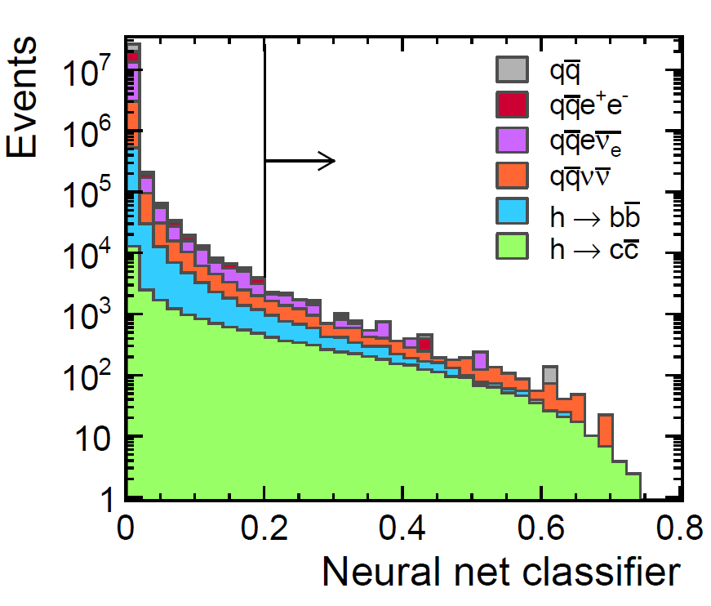
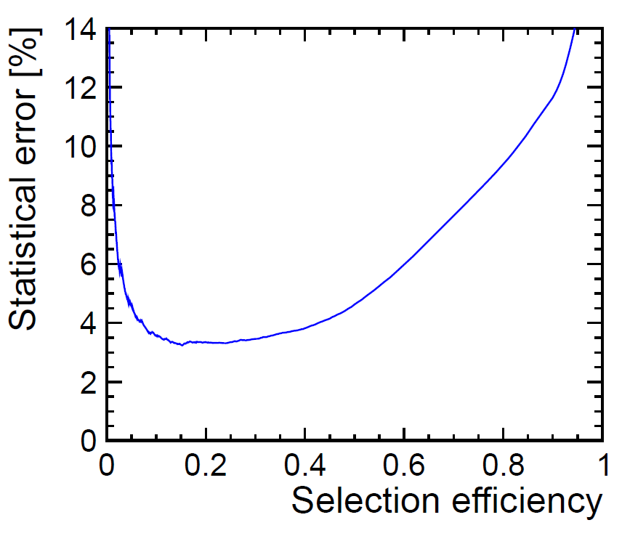
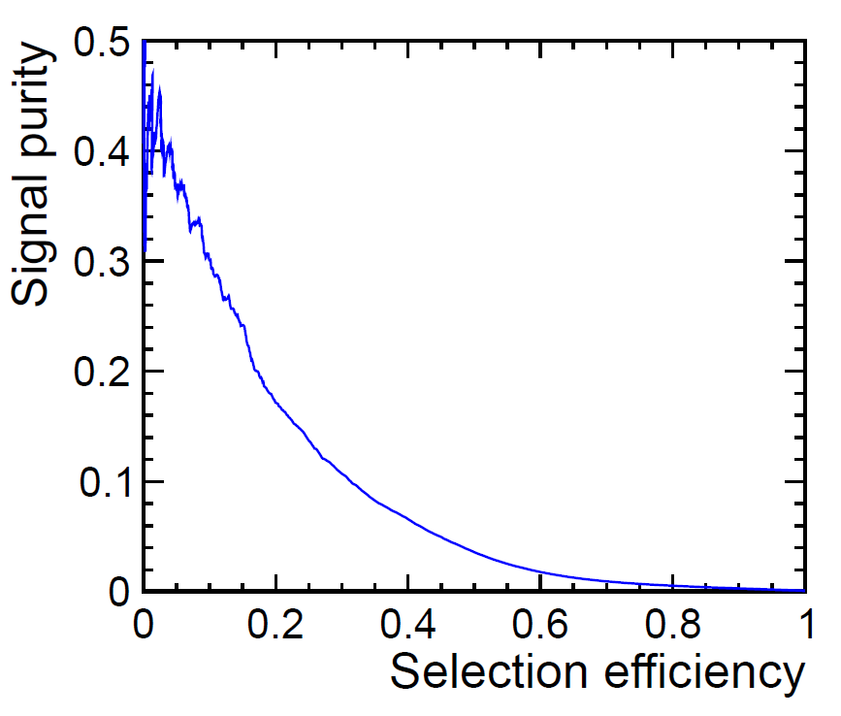
Event selection with neural net (h→cc)
Flag h→cc as a signal instead of h→ bb in neural net training, otherwise the same as h→ bb
More difficult due to
Smaller cross-section
Worse jet flavour tagging performance for c-jets

Slide 13
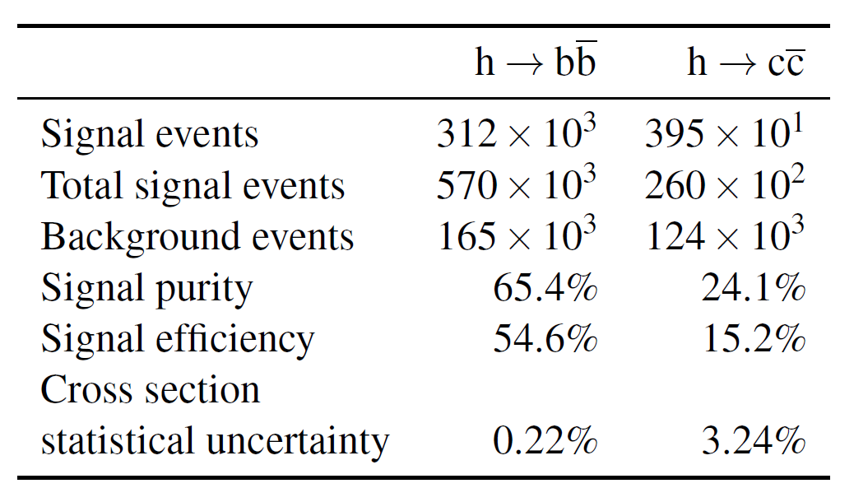
Results
Assuming 2000fb⁻¹, corresponding to 4-year running at nominal machine param.
We assume that with sufficient experience at the running machine, the systematic variations are well enough understood so that the systematic uncertainties are comparable to the statistical uncertainties quoted.
Theoretical uncertainties will be crucial for the bb channel, we conclude in the CDR that the coupling could be determined to 2–4% (bb) and 3–6% (cc) precision.
based on Eur. J. Phys., C71 (2011) 1753

Slide 14
Higgs decays to muons
CLIC CDR Vol. 2

Slide 15
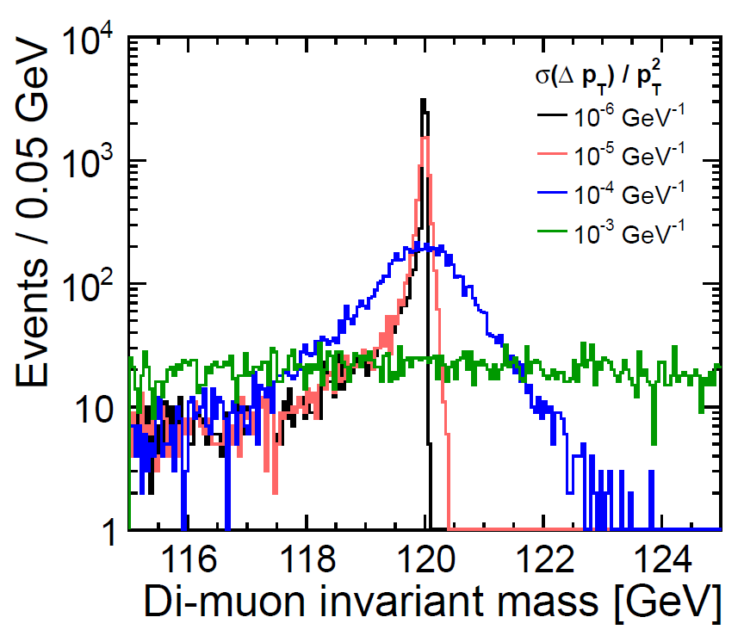
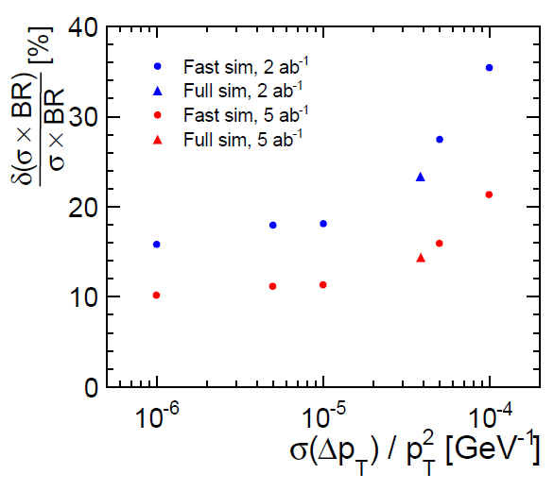
Higgs decay to muons
Rare decay with branching ratio on the level of 10⁻⁴
Very challenging
Tests excellent momentum resolution
Clean channel, only 2 muons required
Little sensitivity to γγ background

Slide 16
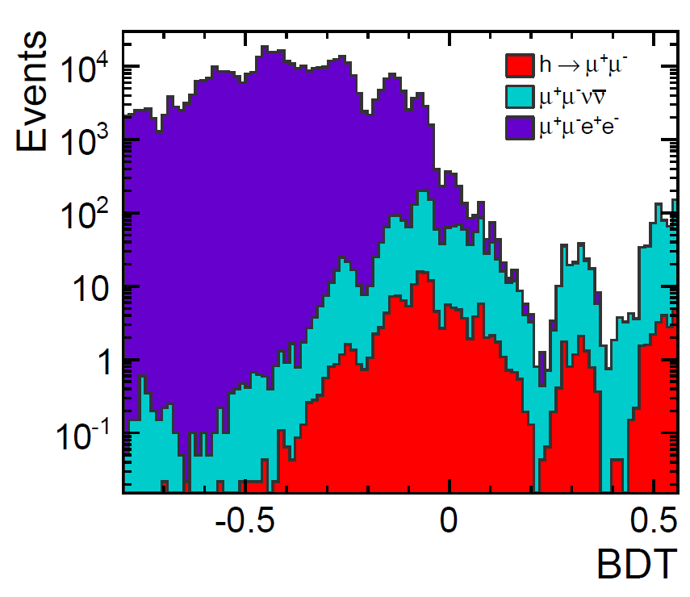
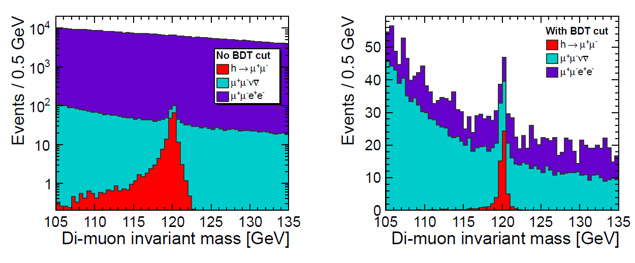
Event selection
Two reconstructed and identified muons
Boosted Decision Tree (BDT) classifier
E_{vis}, p_{T}^{sum}, cos(μ₁,μμ), p_{T}(μμ), β(μμ), θ(μμ)
Likelihood fit to the di-muon invariant mass

Slide 17
Results
Average of three likelihood fits
No timing cuts against γγ
Boosted decision trees help to increase the signal efficiency
Forward electron tagging is very important
Br(h → bb)/Br(h→μ⁺μ⁻)
some uncertainties cancel
result dominated by stat. uncertainty of h→μ⁺μ⁻ channel
 | No forward electron tagging | 95% forward ET in LumiCal
Signal efficiency | 21.7% | 50%
Stat. uncertainty on σ x BR | 26.3% | 15.7%

Slide 18
Extension of Higgs studies
CLIC CDR Vol. 3

Slide 19
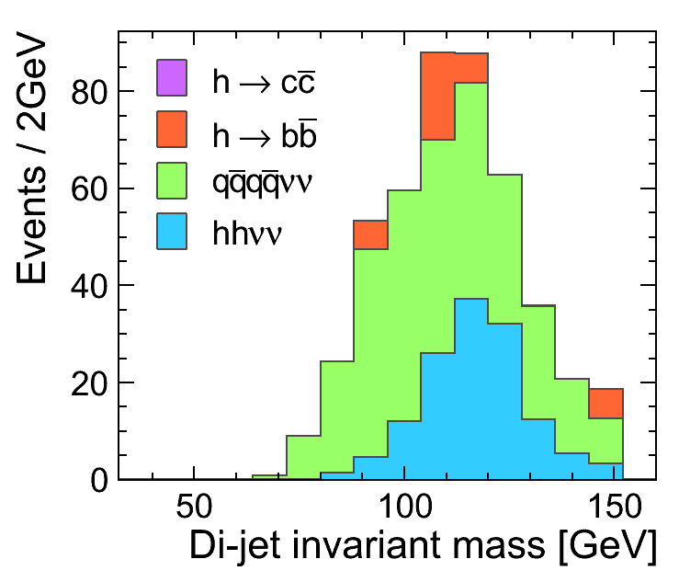
Higgs in CLIC CDR Vol. 3
Volume 3 due in Summer 2012
It will extend studies to lower energies, presumably √s = 1.4TeV and 340GeV
Higgs branching ratios at lower √s
Higgs self-coupling
analysis @ 3TeV well progressed
Higgs coupling to vector bosons
not explored yet
8

Slide 20
Summary
Excellent measurement of light SM Higgs decays possible at 3TeV CLIC
Utilisation of the whole detector improves its ability to measure rare decays
Further studies in progress for CDR Vol. 3
Higgs self-coupling (and eventually Higgs to vector boson coupling)
Lower beam energies
 | h→bb | h→cc | h→μμ
Stat. uncertainty σxBR | 0.22% | 3.24% | 15.7%
SM coupling | 2-4% | 3-6% | 16%

